Slide 1
Welcome!
The webinar will begin shortly

Slide 2
Making Effective Decisions in the Face of Uncertainty: Part 2
(or, “It doesn’t snow around here like it used to!”)
February 24, 2021
Terry Callanan

Slide 3
Presented by
Terry Callanan, PhD, CCXP
GRQC Board
Owner, WalkOn Consulting LLC
Former C-Suite Executive, Quality and Culture, Carestream Health
20 + years Lean Six Sigma Black Belt
WalkOnConsulting@gmail.com
(585) 500-7236

Slide 4
How to Engage
Unmute/Mute: To keep a free flowing interaction, please unmute your line (unless a lot of background noise).
Raise Hand: Answer question, participate in conversation, ask a question of presenter
Chat: Technical difficulties, communicate with each other, general requests
4
Notes:
4

Slide 5
Agenda: Part 2
Practical applications of…
  Statistical Thinking (Part 1)
    Review and reinforcement
  Control Charts (NEW)
    Purpose
    Construction and Interpretation
    Practice (with template)

Slide 6
Recall from Part 1
What Is Statistical Thinking?
An habitual way of looking at work that:
Recognizes all activities are ________.
Recognizes that processes have inherent _________.
Uses _______ to understand variation and drive __________ ________ to improve these processes.
6
Notes:
6

Slide 7
Recall from Part 1
What Is Statistical Thinking?
An habitual way of looking at work that:
Recognizes all activities are _processes_.
Recognizes that processes have inherent _________.
Uses _______ to understand variation and drive __________ ________ to improve these processes.
7
Notes:
7

Slide 8
Recall from Part 1
What Is Statistical Thinking?
An habitual way of looking at work that:
Recognizes all activities are _processes_.
Recognizes that processes have inherent _variation_.
Uses _______ to understand variation and drive __________ ________ to improve these processes.
8
Notes:
8

Slide 9
Recall from Part 1
What Is Statistical Thinking?
An habitual way of looking at work that:
Recognizes all activities are _processes_.
Recognizes that processes have inherent _variation_.
Uses _data__ to understand variation and drive __________ ________ to improve these processes.
9
Notes:
9

Slide 10
Recall from Part 1
What Is Statistical Thinking?
An habitual way of looking at work that:
Recognizes all activities are _processes_.
Recognizes that processes have inherent _variation_.
Uses _data_ to understand variation and drive _appropriate actions__ to improve these processes.
10
Notes:
10

Slide 11
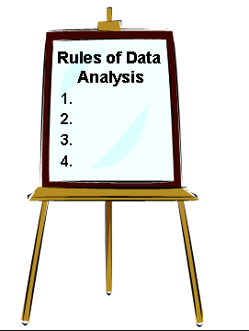
Recall from Part 1
The 4 Rules of Data Analysis
Rule 1: Ask to see the _____!
Rule 2: ____ the data
Rule 3: Plot the data in ______
Rule 4: Recognize that there are _____ types of variation – common cause and special cause

Slide 12
Recall from Part 1
The 4 Rules of Data Analysis
Rule 1: Ask to see the data_!
Rule 2: ____the data
Rule 3: Plot the data in ______
Rule 4: Recognize that there are _____ types of variation – common cause and special cause

Slide 13
Recall from Part 1
The 4 Rules of Data Analysis
Rule 1: Ask to see the data_!
Rule 2: Plot the data
Rule 3: Plot the data in ______
Rule 4: Recognize that there are _____ types of variation – common cause and special cause

Slide 14
Recall from Part 1
The 4 Rules of Data Analysis
Rule 1: Ask to see the data_!
Rule 2: Plot the data
Rule 3: Plot the data in context
Rule 4: Recognize that there are _____ types of variation – common cause and special cause

Slide 15
Recall from Part 1
The 4 Rules of Data Analysis
Rule 1: Ask to see the data_!
Rule 2: Plot the data
Rule 3: Plot the data in context
Rule 4: Recognize that there are _two_ types of variation – common cause and special cause

Slide 16

What Should We Do?
Our quality has declined 10% year over year, or…
Our patient satisfaction is down 12% this month versus last, or…
Decision Time:
How should we react?
Notes:
16

Slide 17
What Should We Do?
Our quality has declined 10% year over year, or…
Our patient satisfaction is down 12% this month versus last, or…
Decision Time:
How should we react?
Plot the data, in context.
Assess type of variation.
React accordingly.
Notes:
17

Slide 18
Example 1: Case 1
“We lost 5 points of share last quarter.”
Plot the data, in context.
Assess type of variation.
React accordingly.

Slide 19
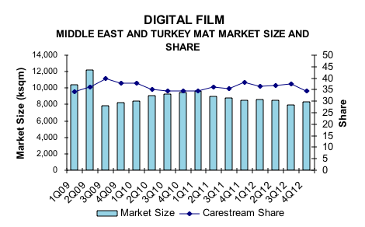
5 point drop
Market Size and Share Data

Slide 20
5 point drop
Market Size and Share Data
Looks like common cause variation
Maintain course, or change the underlying process
- Do not try to explain, or react to, just this last data point

Slide 21
Example 1: Case 2
“We lost 5 points of share last quarter.”
Looks like same problem, but it isn’t….
Plot the data, in context.
Assess type of variation.
React accordingly.

Slide 22
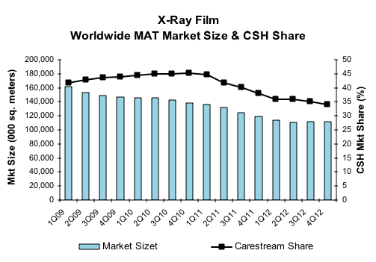
5 point drop
Market Size and Share Data
Market Size and Share Data

Slide 23
5 point drop
Market Size and Share Data
Market Size and Share Data
Looks like special cause variation
Explain this last data point
Take actions to return to prior state

Slide 24

Example 2: M.P.G. Data
The last time you filled up your car you noted that you had gotten 28 mpg on that tank of gas
You had been getting 34 mpg over the past year
Is it time to get a tune-up?
Is it time to get a new car?
Is it time to "do nothing?”
Notes:
24

Slide 25
M.P.G. Data - Case 1
What should you do?
MPG Run Chart
40
Case 1
M
P
35
G
34
30
28
25
0
4
8
12
16
20
Tank #
Notes:
25

Slide 26
M.P.G. Data - Case 2
What should you do?
MPG Run Chart
40
Case 2
M
P
35
G
34
30
28
25
0
4
8
12
16
20
Tank #
Notes:
26

Slide 27
M.P.G. Data - Case 3
What should you do?
MPG Run Chart
40
Case 3
M
P
35
G
34
30
28
25
0
4
8
12
16
20
Tank #
Notes:
27

Slide 28
M.P.G. Data - Case 4
What should you do?
MPG Run Chart
40
Case 4
35
34
30
28
25
0
4
8
12
16
20
Tank #
Notes:
28

Slide 29
What Should We Do?
All 4 cases had the same last data point (28 mpg) and same average over the last year (34 mpg) --- BUT, they do not suggest the same actions!
Possible Actions
Case 1
Case 2
Special cause point
Investigate “why?”
Act
Common cause
Leave alone
Case 3
Case 4
Special cause trend
Investigate “why?”
Act
Monitor
29
Notes:
29

Slide 30
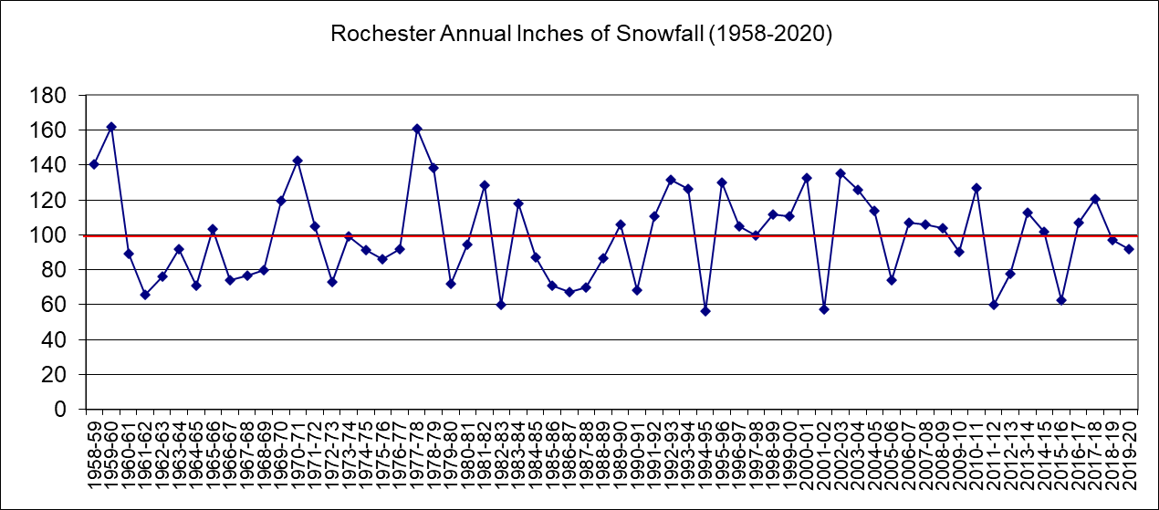
Example 3: Recall Snowfall Data
Where would you draw lines indicating “typical performance” for snowfall in Rochester?
Notes:
30
M = 27.9
20
35.8

Slide 31
Where to Draw the Lines?
A Control Chart is a tool for decision making that
  draws the lines using statistically-derived limits based on data from the process, in order to
  distinguish between common and special cause variation
So that:
We recognize when the process has not changed
  only common cause variation present
We recognize when the process has changed
  - special cause variation present
31
Notes:
31

Slide 32
Elements of a Control Chart
Upper
Control Limit
30
Performance
Data plotted in time order
and connected
20
Center Line
(Average)
10
Lower
Control Limit
0
2
4
6
8
10
12
14
16
18
20
Sample
Data Information
Quality
Characteristic
Time Sequence of Samples
Process X from 10/1-10/10
Notes:
32

Slide 33
State of Statistical Control
Total Pins
Bill's Weekly Total - Bowling .
600
Upper control limit
550
500
450
Lower control limit
400
0
10
20
30
40
50
60
70
80
90
100
Week
A control chart helps us decide whether the process has changed
Notes:
33

Slide 34
State of Statistical Control
Total Pins
Bill's Weekly Total - Bowling .
600
Upper control limit
550
500
450
Lower control limit
400
0
10
20
30
40
50
60
70
80
90
100
Week
“In Control”
Stable
Operating at fixed level
Random, constant spread
Predictable
Only common cause variation present
34
Notes:
34

Slide 35
State of Statistical Control
Total Pins
Bill's Weekly Total - Bowling .
600
Upper control limit
550
500
450
Lower control limit
400
0
10
20
30
40
50
60
70
80
90
100
Week
“In Control”
Stable
Operating at fixed level
Random, constant spread
Predictable
Only common cause variation present
“Out of Control”
Unstable
Level shifts, trends
Changes in spread
Unpredictable
Special cause variation present
35
Notes:
35

Slide 36
How to Respond?
Type of Action
Special Cause
Ask “why?”
Look for differences between individual points
Take action based on differences
Common Cause
Study all the data
Seek to understand the system of common causes
Make changes to the process
Don’t react to single data points
Common Cause
Type of Variation
Special Cause
Notes:
36

Slide 37
How to Respond?
Type of Action
Special Cause
Ask “why?”
Look for differences between individual points
Take action based on differences
Common Cause
Study all the data
Seek to understand the system of common causes
Make changes to the process
Don’t react to single data points
Gain useful information, reduce variation
Common Cause
Type of Variation
Special Cause
Notes:
37

Slide 38
How to Respond?
Type of Action
Special Cause
Ask “why?”
Look for differences between individual points
Take action based on differences
Common Cause
Study all the data
Seek to understand the system of common causes
Make changes to the process
Don’t react to single data points
 | Gain a better understanding of the system, reduce variation
Gain useful information, reduce variation
Common Cause
Type of Variation
Special Cause
Notes:
38

Slide 39
How to Respond?
Type of Action
Special Cause
Ask “why?”
Look for differences between individual points
Take action based on differences
Common Cause
Study all the data
Seek to understand the system of common causes
Make changes to the process
Don’t react to single data points
Waste time, increase variation (remember Deming funnel!) | Gain a better understanding of the system, reduce variation
Gain useful information, reduce variation
Common Cause
Type of Variation
Special Cause
Notes:
39

Slide 40
How to Respond?
Type of Action
Special Cause
Ask “why?”
Look for differences between individual points
Take action based on differences
Common Cause
Study all the data
Seek to understand the system of common causes
Make changes to the process
Don’t react to single data points
Waste time, increase variation (remember Deming funnel!) | Gain a better understanding of the system, reduce variation
Gain useful information, reduce variation | Lose time in responding to the problem, increase variation
Common Cause
Type of Variation
Special Cause
Notes:
40

Slide 41
How to Respond?
Type of Action
Special Cause
Ask “why?”
Look for differences between individual points
Take action based on differences
Common Cause
Study all the data
Seek to understand the system of common causes
Make changes to the process
Don’t react to single data points
Waste time, increase variation (remember Deming funnel!) | Gain a better understanding of the system, reduce variation
Gain useful information, reduce variation | Lose time in responding to the problem, increase variation
Common Cause
Type of Variation
REACTING WHEN YOU SHOULDN’T
Special Cause
NOT REACTING WHEN YOU SHOULD
Notes:
41

Slide 42
How to Respond?
We could minimize the chance of “REACTING WHEN YOU SHOULDN’T” by making the limits as wide as possible (never react)
We could minimize the chance of “NOT REACTING WHEN YOU SHOULD” by making the limits as narrow as possible (always react)
How to balance the two objectives?
Notes:
42

Slide 43
Control Chart Limits
Provide balance of risks in making one of two errors
  Reacting when you shouldn’t
  Not reacting when you should
Known as “3 Sigma” limits
Notes:
43

Slide 44
Control Chart Limits
+/- 3σ (3 “Sigma”) limits around the center line
Upper
Control
Limit
Center Line
Average
Lower
Control
Limit
An “in control” process will exceed
3σ limits only about 3 times in 1000.
44
Notes:
44

Slide 45
Control Chart Limits
Represent common cause variability
  this is the best my process can do right now
  this is where my process has been operating
  this is where it will continue to operate unless changed
KEY FACT
Control limits are NOT influenced by goals, targets, customer requirements or performance specs. In fact, you can be:
        In control, but out of spec
        Out of control, but in spec
Notes:
45

Slide 46
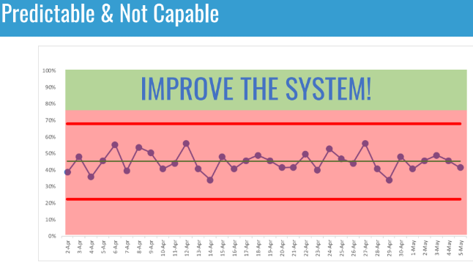

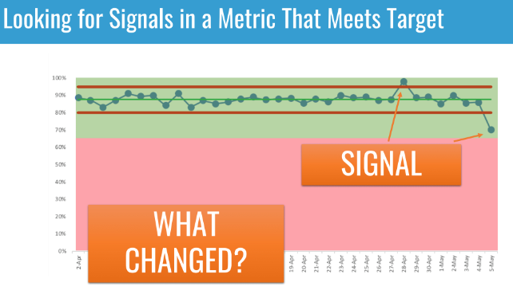

Illustrations
(charts from www.MarkGraban.com)
Shift level of performance, and reduce variation
Unpredictable how long you’ll stay green!
Notes:
46

Slide 47
Estimating Common Cause
Variability
For individual data collected over time:
Calculate “moving ranges” between successive data points
Calculate Average moving range
Use Average moving range in calculation of Upper and Lower Control Chart Limits
For example:
P
o
i
n
t
V
a
l
u
e
Moving Range
1
10
2
12
1
2
-
1
0
=
2
3
8
1
2
-
8
=
4
Average moving range = 3.2
4
13
1
3
-
8
=
5
5
15
1
5
-
1
3
=
2
6
14
1
5
-
1
4
=
1
7
9
1
4
-
9
=
5
Notes:
47

Slide 48
The Moving Range (MR) Chart
Average MR = 3.2
Use MR Chart as first check for special cause variation
If special cause suggested, investigate;
If none, proceed with building Control Chart for your data
48
Notes:
48

Slide 49
Let’s Try It
Create Control Chart for snowfall data
I do
You do

Slide 50
You Do
Create Control Chart for snowfall data
Download template from GRQC website www.grqc.org
Steps (close Excel application first, if you have it open)
  Click Resources in header bar
  Select Tools and Templates
  Search by keyword “control”
  Click on Control Chart to download template to your computer
  Open up Control Chart file …. Click on “Enable Editing”
  Copy/paste snowfall data into template

Slide 51
Snowfall Data
Where would you draw lines indicating “typical performance” for snowfall in Rochester?
173.9
24.6
Notes:
51
M = 27.9
20
35.8

Slide 52
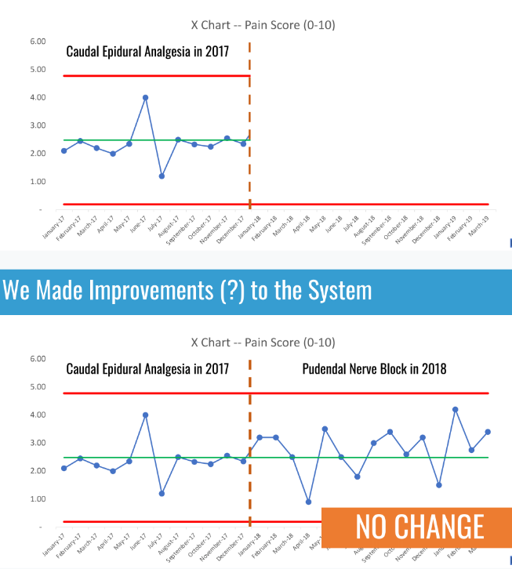
Other Examples
(from www.MarkGraban.com)
Notes:
52
M = 27.9
20
35.8

Slide 53
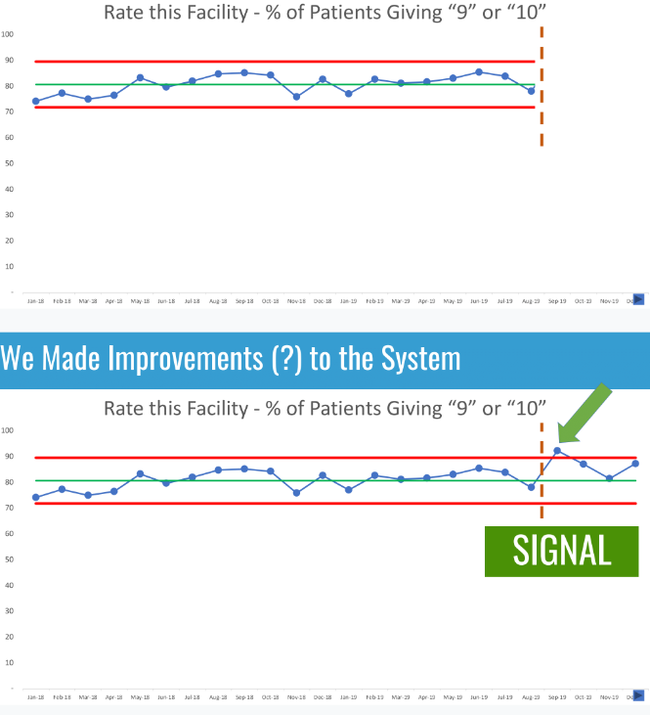
Other Examples
(from www.MarkGraban.com)
Notes:
53
M = 27.9
20
35.8

Slide 54
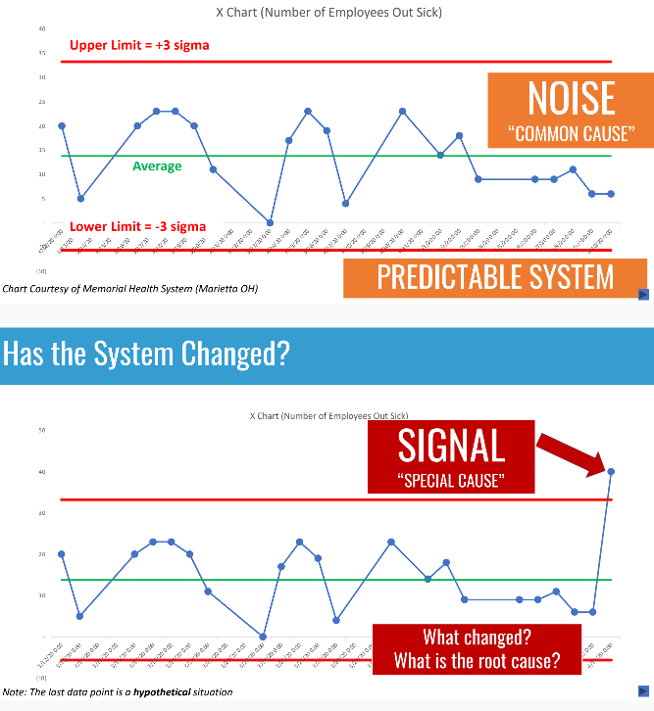
Other Examples
(from www.MarkGraban.com)
Notes:
54
M = 27.9
20
35.8

Slide 55
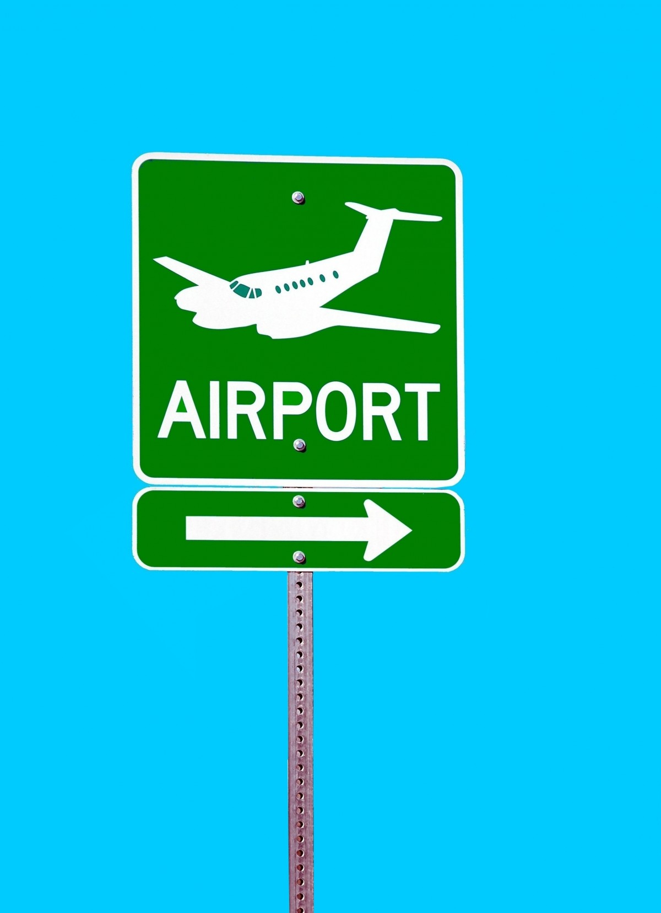
What We’ve Covered > 80%
1. Out of Control Signals
  Exceeding 3σ limits is one indication of the presence of special causes
  There are actually 8 established “Rules” for detecting special (Western Electric Rules)
2. Type of Data
  Variable
  Attribute
See Appendix

Slide 56

Now, You Try It
Create control chart for your process
  Copy/paste your data into Control Chart template
How did it go? What do you see?
  An “in control” process … only common cause variation?
  An “out of control” process … evidence of special cause variation?
  Something else
Raise hand to share or ask questions

Slide 57
Where to Learn More
Monroe Community College (MCC)
www.workforceforward.com
Jim Gertner, MCC Director, Workforce Projects and Operations
Mobile: (585) 953-2670 jgertner1@monroecc.edu
Rochester Institute of Technology (RIT)
www.rit.edu/kgcoe/cqas
Margi Ochs, Instructor, Saunders College of Business, Master Black Belt
Mobile: (585) 261-8046 mmobbu@rit.edu

Slide 58
Where to Learn More
“Understanding Variation – The Key to Managing Chaos,” Wheeler
“Understanding Statistical Process Control,” Wheeler and Chambers

Slide 59
Summary
Statistical Thinking (Part 1)
Control Charts (NEW)
This presentation is posted on GRQC website www.grqc.og under Resources >> Event Presentations

Slide 60

Questions and Thoughts
Before we finish with a quick evaluation…
What questions or thoughts do you have?
Please raise hand and unmute yourself…interaction is great for learning!

Slide 61

Quick Evaluation
Please click the link sent through Chat
Please take about 3 minutes to provide your thoughts about today’s session and future topics of interest….it will help us plan events most useful to you.
Thank you!!
This Photo by Unknown Author is licensed under CC BY-SA

Slide 62
APPENDIX

Slide 63
Western Electric Rules
Divide Control Chart into “Zones:” A, B and C
Upper Control Limit
A
B
C
Average
C
B
A
Lower Control Limit
63

Slide 64
Western Electric Rules
Guidelines to test for Special Causes
One or more points beyond the upper or lower control limit.
Nine consecutive points on one side of the average.
Six consecutive points increasing or decreasing.
Fourteen consecutive points alternating up and down.
Two out of three consecutive points on the same side of the average in Zone A or beyond.
Four out of five consecutive points on the same side of the average in Zone B or beyond.
Fifteen points in a row in Zone C, above and below the average.
Eight points in a row on both sides of the average with none in Zone C.

Slide 65
Types of Variable Control Charts
Type of Chart
Center or Mean
Spread or Variability
Single Data Points
Moving Range (MR)
Plot differences between points
X
Plot single data values
Type of Data
Multiple Points (Subgroups)
X-Bar
Plot average of data values
Range (R)
Plot range of data points
X-MR (or X-BarR) charts should always be used in pairs.
One for the mean, one for the spread.
65

Slide 66
Types of Attribute Control Charts
Sample Size | Nonconforming Units - Defectives | Nonconformities - Defects
Constant | np (Total defective) | c (Total defects)
Varies | p (Proportion defective) | u (Defects/unit = dpu)
Note: The above charts will have wide limits for small sample sizes
66

Slide 67
Thank You!

