Slide 1

GRQC Performance Excellence Forum
Process Mapping

Slide 2



Speakers
Lucas Dodge
Jason Becker
Process Engineer @ ESL
Six Sigma Green Belt
PMP
Cont. Improvement @ L3Harris
Six Sigma Black Belt
PMP
Notes:
Amber to announce speakers…
Get ready for a tag-team extravaganza at the GRQC event on February 12, where Jason Becker and Lucas Dodge will map out the secrets to operational success – and they promise not to use a GPS!
Jason Becker, our in-house Lean and Six Sigma caped crusader from L3Harris Technologies, has been battling process inefficiencies for a decade with his trusty sidekick, Process Mapping. He's known for turning convoluted workflows into streamlined highways of productivity.
Adding to the mix is the equally talented Lucas Dodge from ESL, who'll co-pilot this journey with Jason. Together, they're like the Batman and Robin of the continuous improvement world, ready to guide you through the twists and turns of process optimization.
These two process maestros will show you how to dodge the common pitfalls and leap over business hurdles in a single bound, all while keeping a smile on your face. Expect a session packed with insights, anecdotes, and maybe even a few process-related puns that are sure to 'flow-chart' your day.
So, chart a course for February 12 and join this dynamic duo as they unfold the map to efficiency and beyond. It's an opportunity to learn from the best, laugh a little, and leave with the superpowers you need to conquer the world of operational excellence. Don't miss out!

Slide 3
Agenda
A few questions
History
Pizza
Why make a process map
Where to start
Examples
What’s next

Slide 4
History
The first structured method for documenting process flow, the flow process chart, was introduced by Frank Gilbreth to members of ASME in 1921 as the presentation “Process Charts—First Steps in Finding the One Best Way”.
Gilbreth's tools were quickly integrated into industrial engineering curricula. In the early 1930s industrial engineer Allan H. Mogensen began training business people by using these tools of industrial engineering at his Work Simplification Conferences in Lake Placid, New York.
Business process mapping, also known as process charting, has become much more prevalent and understood in the business world in recent years. Process maps can be used in every section of life or business.
Wikipedia

Slide 5




Pizza
Notes:
Do you know how is it made? Does every pizza shop make it the same way?
Perhaps a process map would help to explain the various steps involved in carrying out a pizza delivery — from when a customer places their order to when they've received their pizza.
Here's a simple example of what a process map for making pizza might look like:
Preparation Stage
Gather ingredients (dough, sauce, cheese, toppings)
Preheat oven
Dough Preparation
Mix ingredients for dough
Knead dough
Let dough rise
Assembling Pizza
Roll out dough
Spread sauce
Add cheese
Add toppings
Cooking
Place pizza in oven
Bake for specified time
Finishing
Remove pizza from oven
Slice pizza
Serve

Slide 6

Why make a process map?
Standardization
Efficiency
Training
Quality Control
Problem-Solving
Resource Management
Communication
Notes:
Standardization: A process map helps standardize the steps involved in making pizza, ensuring consistency in quality and taste.
Efficiency: It helps identify and eliminate any unnecessary steps, making the process more efficient and reducing preparation time.
Training: New employees can be trained more effectively using a clear visual representation of the process.
Quality Control: It allows for better monitoring and control of each step, ensuring that each pizza meets the desired standards.
Problem-Solving: If issues arise, a process map can help pinpoint where the problem occurred, making it easier to implement corrective actions.
Resource Management: Helps in managing resources better by identifying what ingredients and equipment are needed at each step.
Communication: Facilitates better communication among team members by providing a clear understanding of the workflow.

Slide 7
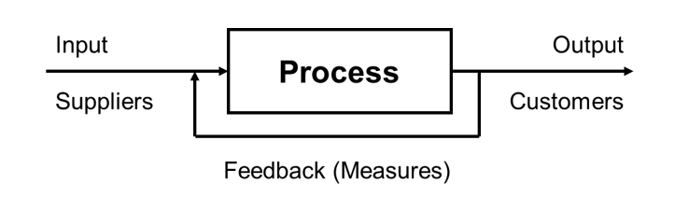
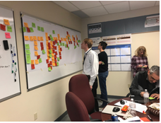
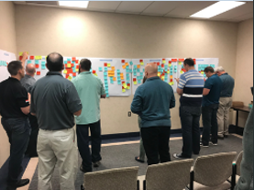
Where to Start?
Notes:
Processes can be mapped to show how inputs become outputs
The mapping helps to effectively communicate the flow and steps of a process
There are different types of process maps
Is easy to use, flexible tool
Provides easy-to-interpret representation of a process
Can be utilized to support training, improvements and compliance
Time Management – what to do with larger groups

Slide 8
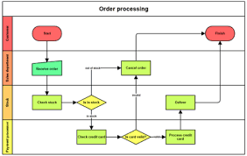
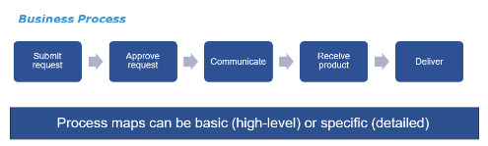
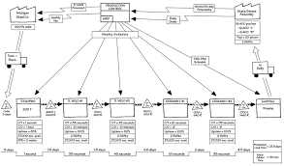
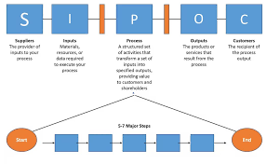
Examples
Start
Process Step
Yes
Process Step
Decision
No
Process Step
End
Notes:
A visual display of the interaction and sequence of all process steps and decisions
High Level Process Map
Basic flow chart
Swimlane
Value stream map
Cross-functional map
Detailed process map
SIPOC

Slide 9
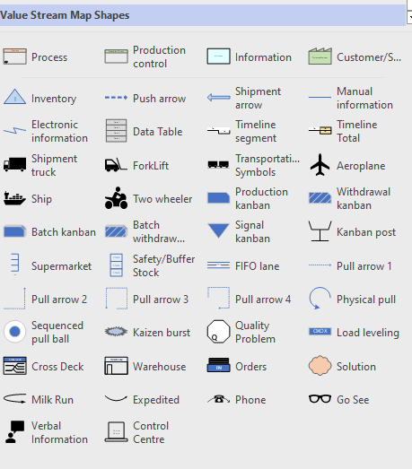
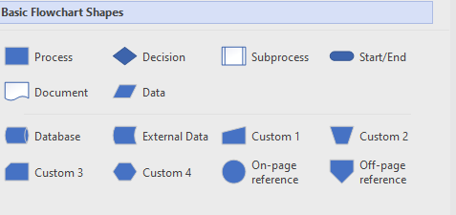
Shapes

Slide 10
Pizza Example
Preparation
Dough
Assembly
Baking
Finishing
Notes:
Finishing
Baking
Assembly
Dough
Preparation
Start at the end that is closest to the customer

Slide 11

What Could Go Wrong?
Notes:
Lack of Clear Objectives:
Not having a clear understanding of why the process map is being created can lead to a map that is unfocused and unhelpful.
Inadequate Stakeholder Involvement:
Failing to involve all relevant stakeholders can result in missing important steps or perspectives, leading to an incomplete or inaccurate map.
Overcomplicating the Map:
Including too much detail can make the process map difficult to read and understand. It's important to strike a balance between detail and clarity.
Ignoring Variations in the Process:
Not accounting for variations or exceptions in the process can lead to a map that doesn't accurately reflect real-world operations.
Lack of Standardization:
Using inconsistent symbols, terminology, or formats can cause confusion and make the map less useful.
Not Updating the Map:
Processes change over time, and failing to update the map accordingly can make it obsolete and unhelpful.
Focusing Only on the Current State:
While it's important to understand the current process, it's also crucial to map out the desired future state to identify areas for improvement.
Ignoring Feedback Loops:
Not including feedback loops can result in a linear map that doesn't accurately represent the iterative nature of many processes.
Lack of Clarity in Roles and Responsibilities:
Not clearly defining who is responsible for each step can lead to confusion and inefficiencies.
Poor Communication:
Not effectively communicating the process map to all relevant parties can result in misunderstandings and lack of buy-in.
Tool Misuse:
Using inappropriate or overly complex tools for creating the process map can lead to technical difficulties and frustration.
Not Validating the Map:
Failing to validate the process map with those who perform the process can result in inaccuracies and missed opportunities for improvement.
To avoid these common problems, it's essential to plan carefully, involve the right people, use standard symbols and terminology, and regularly review and update the process map.

Slide 12

Questions

Slide 13




What’s Next?
April 24 or 29, volunteer for a half to full day
Support the organization
To address their process problem with a small team

Slide 14

Need more information
Meet us for lunch…

Slide 15

Thank you
Lucas and Jason

