Slide 1
Welcome!
The webinar will begin shortly

Slide 2
Making Effective Decisions in the Face of Uncertainty: Part 1
(or, “It doesn’t snow around here like it used to!”)
January 27, 2021
Terry Callanan

Slide 3
How to Engage
Unmute/Mute: To keep a free flowing interaction, I will unmute everyone’s line. If background noise, please mute yourself
Raise Hand: Answer question, participate in conversation, ask a question of presenter
Chat: Technical difficulties, communicate with each other, general requests
Polls: Reply to polls and see results on your Zoom screen
3
Notes:
3
ASK people to help you fill in the blanks
• ...... processes
• ...... variability
• ...... data ..... decisions

Slide 4
Presented by
Terry Callanan, PhD, CCXP
GRQC Board
Owner, WalkOn Consulting LLC
Former C-Suite Executive, Quality and Culture, Carestream Health
20 + years Lean Six Sigma Black Belt
WalkOnConsulting@gmail.com
(585) 500-7236

Slide 5
Agenda: Part 1
Principles and practical implications of…
  Statistical Thinking
  Rules of Data Analysis
  Types of Variation
  Deming Funnel Experiment
Plus,
Preparation for Part 2 (Feb 24)

Slide 6
As We Go...
What Is Statistical Thinking?
An habitual way of looking at work that:
Recognizes all activities are __________.
Recognizes that processes have inherent _________.
Uses ______ to understand variation and drive ________________ to improve these processes.
6
Notes:
6
ASK people to help you fill in the blanks
• ...... processes
• ...... variability
• ...... data ..... decisions

Slide 7
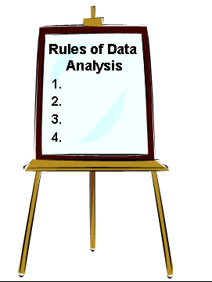
As We Go...
The 4 Rules of Data Analysis
Rule 1:
Rule 2:
Rule 3:
Rule 4:

Slide 8

Quick Poll
“It Doesn't Snow Around Here Like It Used To.”
What do you think?
  Agree
  Disagree
8
Notes:
8
These are suggested measures for a project.
It is highly encouraged to involved your Finance people early in the definition of a project to make sure that good financial practices are in place to value a project.

Slide 9
Let’s Look at Some Data
Year
Inches of
Year
Inches of
Year
Inches of
Year
Inches of
snowfall
snowfall
snowfall
snowfall
1958-59
140.6
1976-77
92.1
1994-95
56.2
2012-13
78.0
1959-60
161.7
1977-78
160.9
1995-96
130.3
2013-14
112.7
101.9
1960-61
89.4
1978-79
138.5
1996-97
104.7
2014-15
2015-16 62.8
2016-17 107.1
2017-18 120.5
2018-19 97.1
2019-20 91.8
1961-62
65.6
1979-80
72.2
1997-98
99.7
1962-63
76.4
1980-81
94.4
1998-99
111.6
1963-64
92
1981-82
128.4
1999-00
110.7
1964-65
71.1
1982-83
59.9
2000-01
132.5
1965-66
103.2
1983-84
118
2001-02
57.5
1966-67
74
1984-85
87.1
2002-03
135.2
1967-68
76.7
1985-86
70.7
2003-04
125.6
1968-69
79.8
1986-87
67.1
2004-05
113.6
1969-70
119.6
1987-88
69.8
2005-06
73.9
1970-71
142.7
1988-89
86.6
2006-07
107.2
1971-72
105.1
1989-90
105.8
2007-08
106
1972-73
73
1990-91
68.3
2008-09
103.7
1973-74
99.1
1991-92
110.6
2009-10
90.2
1974-75
91.2
1992-93
131.5
2010-11
127
1975-76
86.2
1993-94
126.2
2011-12
59.9
Notes:
9
What do you see? Variation.
What do you think? Is there a trend downward over time that would suggest that it doesn't’t snow around here like it used to? Hard to tell.
What would be a better way of looking at these data? PLOT the data!!

Slide 10
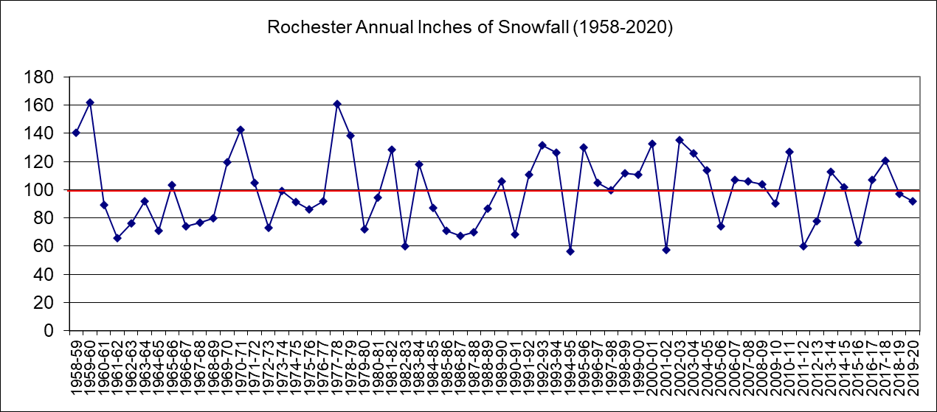
Plot The Data!
10
Notes:
10
What do you see now? Variation, no trends, random behavior.
How do recent snowfalls compare to the past? Nothing unusual – seems to just be part of normal variation.
If you had to predict what next years snowfall would be what would you say? Likely to be 100”, but could fall within 20-180” and be normal behavior. Don’t let perception (“it doesn't’t snow around here like it used to”) guide you – look at the data for trends and patterns before you react.
Someone says our results are down from last year, or our error rate has increased this quarter, or our client base has dropped YTD….what should you do?
We have our first two Data Learnings from this simple example (have the volunteer write these on the easel):
Ask to see the data
Plot the data

Slide 11
As We Go...
The 4 Rules of Data Analysis
Rule 1: Ask to see the data!
Rule 2: Plot the data
Rule 3:
Rule 4:

Slide 12

Another Example
Your friend comes back from vacation and says, “I gained five pounds last week.”
The same friend comes back a few days later and says, “I'm on a new diet and lost 5 pounds already.”
12
Notes:
12
Poll the students in a FUN survey: ASK people to vote by raising their hands.
Ans: Ask to see the data (if you dare)

Slide 13
Voice Poll
What is your best response to your friend’s comments?
  Keep your mouth shut
  Sympathize and then rejoice
  Ask to see the data!
13
Notes:
13
These are suggested measures for a project.
It is highly encouraged to involved your Finance people early in the definition of a project to make sure that good financial practices are in place to value a project.

Slide 14
There is a Process
A “Model” Of The Process
Water
Vapor
Food
Energy
Health
Air
Process
Water
Measurement
14
Notes:
14
LECTURE
Your weight is the result of a process:
• Inputs vary from day-to-day
• The process (your metabolism) varies from day to day
• Output varies from day to day
• There is measurement variability
As a result of this inherent variability in the process, your weight will have inherent variability from day to day.

Slide 15
As We Go…
What Is Statistical Thinking?
An habitual way of looking at work that:
Recognizes all activities are _processes_.
Recognizes that processes have inherent _________.
Uses _____ to understand variation and drive ____________ to improve these processes.
15
Notes:
15
ASK people to help you fill in the blanks
• ...... processes
• ...... variability
• ...... data ..... decisions

Slide 16
Plot of the Data
RS DAILY WEIGHTS
228
After
P
O
U
N
D
S
224
Vacation
220
Before
After
216
Vacation
Diet
212
16
Notes:
16
LECTURE / DISCUSS
These are the three data points. The weight really was different before the vacation, after the vacation and after the diets. The real question is “Did the process / system change?” What’s missing to answer the question?
Ans: The three points in context of additional data.

Slide 17
Let’s Look at More Data
RS DAILY WEIGHTS
228
P
O
U
N
D
S
224
220
216
212
Jan
Jul
Jan
Jul
17
Notes:
17
ASK
• Here are the three point in the context of the process. What do you see?
Ans: At that time they represent just random variability in the process.
LECTURE
There are really changes, trends and cycles. But there is also random noise. The three points appear at a time when the basic process is not changing.
The data based decision is at that point: It’s just random variability. Don’t worry about the initial “gain,” don’t celebrate the later “loss.”

Slide 18
As We Go...
The 4 Rules of Data Analysis
Rule 1: Ask to see the data!
Rule 2: Plot the data
Rule 3: Plot the data in context
Rule 4:

Slide 19

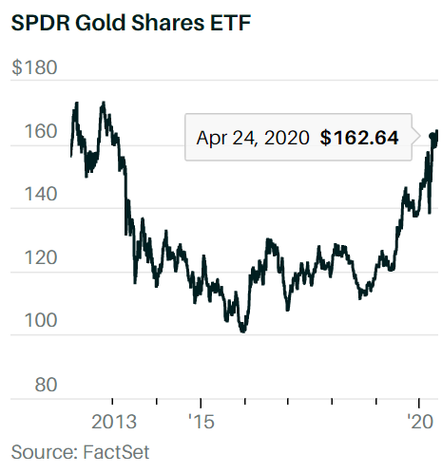
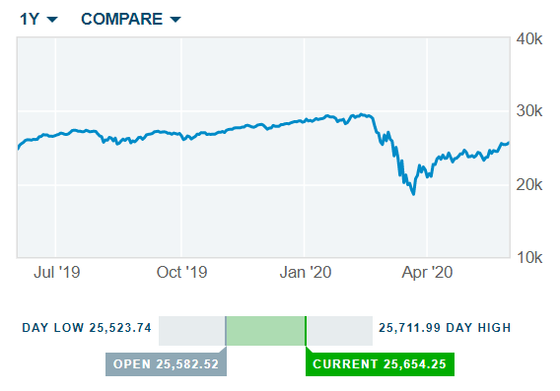
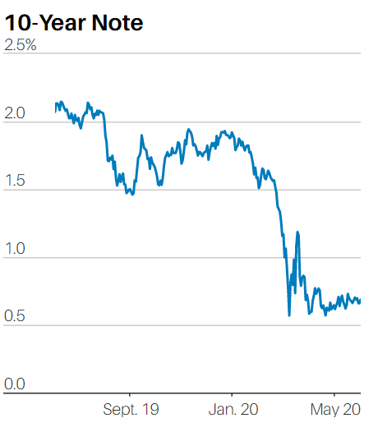
Viewing Data in Context
HEADLINE EXCERPTS FROM WSJ
Stocks, Bonds Plunge as....
Bonds Tumble Following Comments
Dollar Plummets, Then Soars
Money Fund Assets Soared in Latest Week
Sallie Mae’s Earnings Rise 15% in Quarter
CHARTS FROM BARRONS
19
Notes:
19
Key point: Use slide as an example of this barrage.

Slide 20
As We Go…
What Is Statistical Thinking?
An habitual way of looking at work that:
Recognizes all activities are _processes_.
Recognizes that processes have inherent _variation_.
Uses ______ to understand variation and drive ________________ to improve these processes.
20
Notes:
20
ASK people to help you fill in the blanks
• ...... processes
• ...... variability
• ...... data ..... decisions

Slide 21
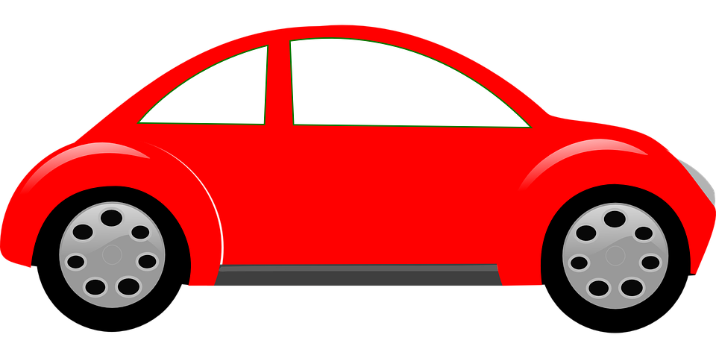
Drive Time to Work
(when we were driving to work)

Slide 22
_____’s Drive Time to Work
Time (min)
SPECIAL CAUSE
COMMON CAUSE
xx
1 2 3 4 5 6 7 8 9 10 11 12 13 14 15 16 17
Trip #

Slide 23
Sources Of Variation
Process: Drive Time to Work
Normal in the process
Notes:
23
EXERCISE: Do this as a class. Capture the ideas on a flip chart or the overhead.
CAUTION: There are no right or wrong answers here. As before, some causes may be viewed as ”Common cause” or “Special cause” depending on the point of view.
If this arises have the student explain why it is viewed as common or special in this instance.
For non U.S. delivery, change example from NASCAR to Formula 1 race times.
COMMON CAUSE:
normal traffic
differing times in leaving the house
normal weather variations
“hitting” or not “hitting” the lights
NOTE
It may help to use the overhead for the flowchart and/or C&E Diagram for this problem.
Then:
List each of the causes
Have each student take one cause and categorize it as to common or special.
Students have a tendency to see everything as “special” causes. If this is happening probe the students to
see if it truly is a special cause, or if it is part of Joe’s system, and therefore a common cause.

Slide 24
Sources Of Variation
Process: Drive Time to Work
Normal in the process | Not typical in the process
Notes:
24
EXERCISE: Do this as a class. Capture the ideas on a flip chart or the overhead.
CAUTION: There are no right or wrong answers here. As before, some causes may be viewed as ”Common cause” or “Special cause” depending on the point of view.
If this arises have the student explain why it is viewed as common or special in this instance.
For non U.S. delivery, change example from NASCAR to Formula 1 race times.
COMMON CAUSE:
normal traffic
differing times in leaving the house
normal weather variations
“hitting” or not “hitting” the lights
NOTE
It may help to use the overhead for the flowchart and/or C&E Diagram for this problem.
Then:
List each of the causes
Have each student take one cause and categorize it as to common or special.
Students have a tendency to see everything as “special” causes. If this is happening probe the students to
see if it truly is a special cause, or if it is part of Joe’s system, and therefore a common cause.

Slide 25
Types of Variation

Slide 26
As We Go...
The 4 Rules of Data Analysis
Rule 1: Ask to see the data!
Rule 2: Plot the data
Rule 3: Plot the data in context
Rule 4: Recognize that there are two types of variation – common cause and special cause

Slide 27
Characteristics of Variation
Process operating as usual | Process has "changed"
Part of the system | Unusual
Many, trivial | Few in number, important
Hard to detect and identify | Easy to detect and identify
Predictable over the long run | Unpredictable
Inherent to process | Specific Event
Remain present until system has changed | Signals a change
Which column describes Special Cause variation? Common Cause?
27
Notes:
27

Slide 28
Characteristics of Variation
Common Cause | Special Cause
Process operating as usual | Process has "changed"
Part of the system | Unusual
Many, trivial | Few in number, important
Hard to detect and identify | Easy to detect and identify
Predictable over the long run | Unpredictable
Inherent to process | Specific Event
Remain present until system has changed | Signals a change
28
Notes:
28

Slide 29
How to React to Variation?
COST
50
UNUSUAL EVENTS - FIND OUT WHAT CAUSED THESE AND
IMPLEMENT A PERMANENT FIX
40
RESULTS HERE ARE NORMAL FOR
30
THE SYSTEM AS IT IS
BREAKTHROUGH DUE TO
20
CHANGE IN THE SYSTEM
BETTER RESULTS WITH LESS
VARIATION FROM THE
10
CHANGED SYSTEM
0
TIME
29
Notes:
29
This is a central idea to Statistical Thinking.
Do we react to movements within the natural variability? What do we do if it exceeds the natural variability?
Only react to real signals. Otherwise leave it alone, or better yet improve it - decrease variability and move it to a more appropriate level.
Reinforce that less variability means more predictability and easier management.

Slide 30
Deming Funnel Experiment
Process: Drop a marble through funnel; mark spot where it rests; repeat
Aim: Have marble come to rest on target
Measure of success: Spread of spots around target
30
Notes:
30
Instructor Note: You need a CARPETED FLOOR for this exercise !!! Before dropping,
try to find a relatively flat spot on the floor in the room. Usually best if you do this prior to the
start of class or the module during a break. Leave a sticky dot on the floor as the target so you
can start at the desired location.
Historical note: While the experiment is known generically as the “Deming” funnel Dr.
Deming actually credits Dr. Lloyd S. Nelson for the experiment. A complete discussion of
the experiment is contained in Deming’s “Out of the Crisis”.
LECTURE: We will now demonstrate what happens if you react improperly to common
cause variability.
EXPLAIN: The funnel process as relating to a manufacturing process. In this case, we
will be dropping a marble through the funnel trying to hit a target (a dot
marker) on the floor.
Ask for a volunteer to be the marble dropper. Ask another student to be the marker.
Sometimes the dropper needs some instructions in how to move in rules 2 - 4.

Slide 31

Experiment: Rule 1
Rule 1: No adjustment
Watch Video
Watch Video
Notes:
31
Explain rule #1: Do nothing
ASK the above questions
Ans: A circle around the aim
Ans: Random, common cause variability

Slide 32
Quick Poll
What kind of variation is demonstrated by the spread of dots on the floor following Rule 1?
  Common cause
  Special cause
  Both
32
Notes:
32
These are suggested measures for a project.
It is highly encouraged to involved your Finance people early in the definition of a project to make sure that good financial practices are in place to value a project.

Slide 33

Sources of Variation
What are some sources of common cause variation in the funnel drops?

Slide 34
Experiment: Rule 2
Rule 2: Adjust based on last drop behavior
8
8
9
9
8
8
Watch Video
Notes:
34
EXPLAIN Rule #2: Adjust with memory
If the marble lands NE of the target, move the funnel aim-point to the SW by the distance you missed the target.
INSTRUCTOR NOTE:
It’s easier to explain this rule on the floor when you are actually working the funnel with the rule.
ASK: As the “dropper” is dropping the marble, add some “patter” to the exercise and ask
the question “What variability should we expect to see? Shouldn't’t it get better (less
that is!) ?
Ans: A circle around the aim
Ans: Bigger variability.
• Why? Ans: You are “adjusting the process” based on random variability (This may
not be obvious; but the funnel results will eventually show it)

Slide 35
Sources of Variation
What are some sources of common cause variation in Rule 2?
Answer: The same as in Rule 1! (plus moving the funnel around)

Slide 36
Experiment: Rule 3
Rule 3: Adjust based only on the last result (skip)
8
9
8
8
9
36
Notes:
36
INSTRUCTOR NOTE: We won’t use this rule here, because we don’t see it much at Kodak.
It’s in the notes here for sake of completeness.

Slide 37
Experiment: Rule 4
Rule 4: Adjust – Make it same as last one
8
8
9
9
8
8
Watch Video
Watch Video
Notes:
37
EXPLAIN: Rule #4. This rules tries to make each product “just like the last one we
made”. If we can’t hit the target, make it like the last unit so the customer
won’t see the variability
ASK: the above questions on the slide. what should we expect to see?
Ans: A line out the door.
AFTER RUNNING the funnel experiment, group the class around the dots marking the
floor and highlight the spread in the various colored patterns.
Demonstrate and discuss points as they happen.

Slide 38
What Should we Do Instead?
What could we do to reduce the system of common cause variation in the funnel drops?

Slide 39
Change the System
Watch Video
39
Notes:
39
EXPLAIN: Rule #4. This rules tries to make each product “just like the last one we
made”. If we can’t hit the target, make it like the last unit so the customer
won’t see the variability
ASK: the above questions on the slide. what should we expect to see?
Ans: A line out the door.
AFTER RUNNING the funnel experiment, group the class around the dots marking the
floor and highlight the spread in the various colored patterns.
Demonstrate and discuss points as they happen.

Slide 40
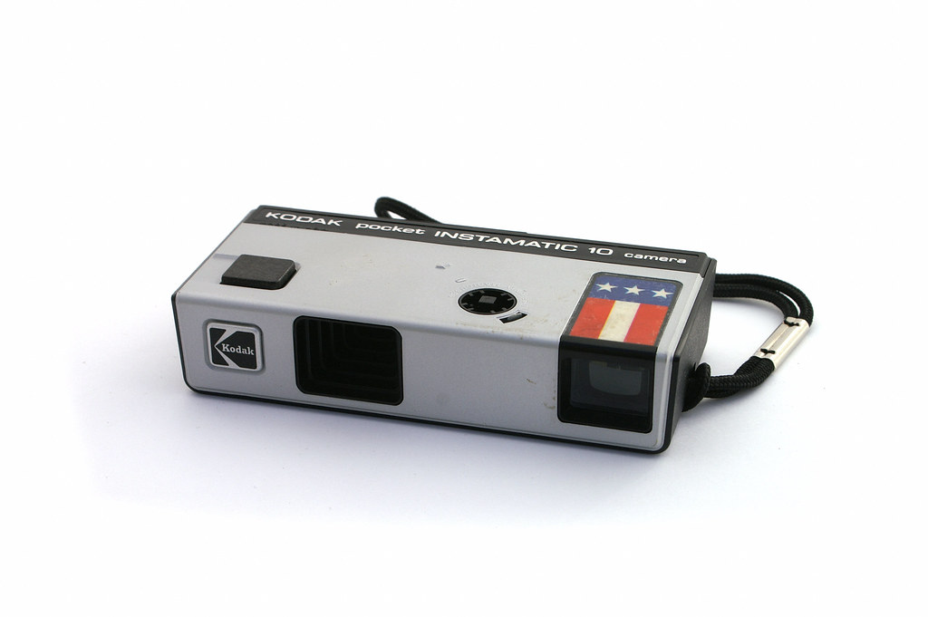
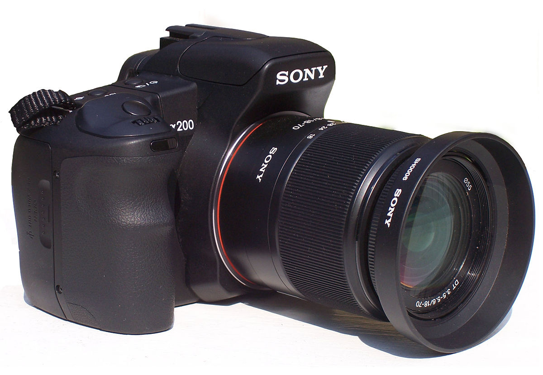
Example: Film Manufacturing
Film Codes A & B are essentially identical in terms of formulation
Film code A: Consumer product
  Specifications +/-10 units
  Little to no adjustment of process performed
Film code B: Professional product
  Specifications +/-5 units
  Adjustment of process is routine
40
Notes:
40
EXPLAIN:
This is a real story from Kodak Park manufacturing. We have the data.

Slide 41
Which Is A and Which Is B?
41
Notes:
41
EXPLAIN: These are a year’s worth of real data.
ASK: Which is the professional film ? Which the consumer ( or amateur) ?
Ans: The film with the larger variability is the professional.
ASK: How can this be ?
DISCUSS / LECTURE:
• The product engineer for the amateur product has wider specs which the process can meet. Thus he/she leaves the process alone. Note the nice bell shaped curve.
• The product engineer for the professional product has specs that the process cannot meet, thus he/she tries to compensate by making adjustments. Notice the irregular shape of the data - it is typical of a process that is being over-adjusted.
ASK:
• What’s the moral? Ans: Don’t tamper with common cause variability
• What must the professional group do? Ans: Improve the process, meanwhile, inspect and sort.

Slide 42
Which Is A and Which Is B?
B
A
42
Notes:
42
EXPLAIN: These are a year’s worth of real data.
ASK: Which is the professional film ? Which the consumer ( or amateur) ?
Ans: The film with the larger variability is the professional.
ASK: How can this be ?
DISCUSS / LECTURE:
• The product engineer for the amateur product has wider specs which the process can meet. Thus he/she leaves the process alone. Note the nice bell shaped curve.
• The product engineer for the professional product has specs that the process cannot meet, thus he/she tries to compensate by making adjustments. Notice the irregular shape of the data - it is typical of a process that is being over-adjusted.
ASK:
• What’s the moral? Ans: Don’t tamper with common cause variability
• What must the professional group do? Ans: Improve the process, meanwhile, inspect and sort.

Slide 43
Deming Funnel Experiment
Rule 1: σ²=1
Rule 2: σ²=2
0
0
0
0
0
0
0
0
0
0
0
0
0
0
0
0
0
0
0
X
0
X
0
0
0
0
0
0
0
0
0
0
0
0
0
Rule 3: σ² = ∞
0
Rule 4:σ² = ∞
0
0
0
0
0
0
X
0
0
0
0
0
0
X
0
0
0
0
0
0
0
0
0
0
0
0
43
Notes:
43
DISCUSS and ASK for each rule
Rule 1:
• What pattern of variability? Ans: Random
• What kind of variability? Ans: Common Cause
Rule 2:
• What amount of variability: Ans: Double that of before
• Why ? Our adjustments added to the variability
• Do you have any examples? Ans: Golfer adjusting after each stroke, etc.
Rule 4:
• What happened? Ans: We moved further and further from the target
• Why? We kept on adjusting to the last point
• Are there some examples ? Ans: Worker training worker; cutting length of wood to the last one cut.
ASK:
• What the moral ? Ans: Don’t react to common cause variability or the last data point. It will increase the variability.
• What if the variability is too large? Ans: Change, re-engineer the system
• How for the funnel ? Ans: Lower it, put Velcro on the ball marble, etc.
• How do you improve Kodak processes? Ans: Better raw materials, better machinery and instrumentation, training, etc.

Slide 44
Key Learning Points
Distinguish between Special Cause and Common Cause Variation
Reacting to Common Cause Variation as if it Were Special Cause Will Increase the Variability of Your Processes
44
Notes:
44

Slide 45
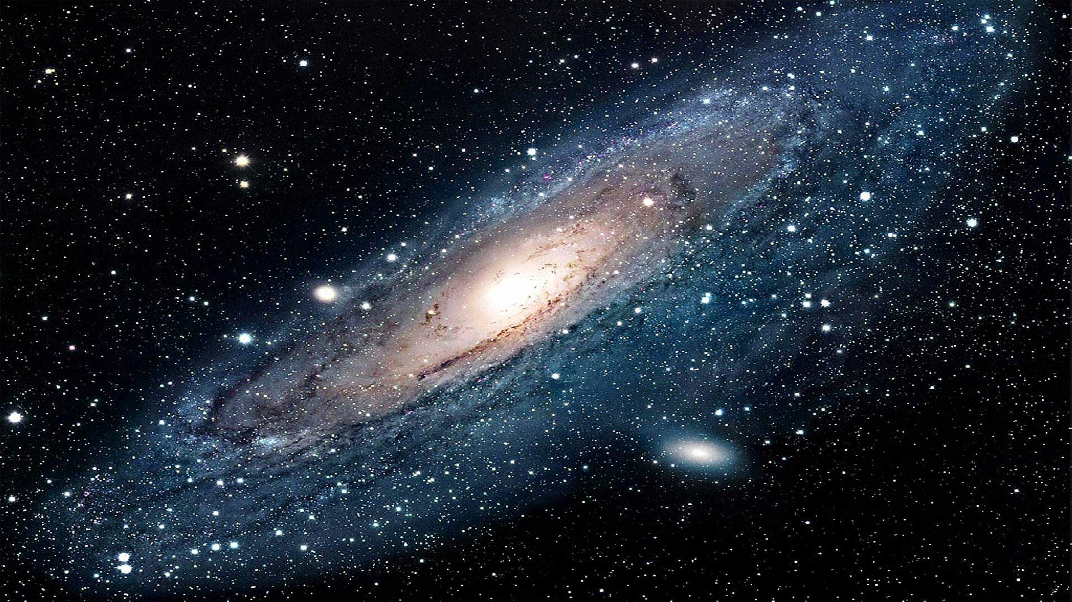
Avoid the Milky Way
“Tamper, tamper is the game,
Try to make it all the same,
Squeak and tweak it every day,
Off we go to the Milky Way” - Deming
45
Source: techexplorist.com
Notes:
45

Slide 46
As We Go…
What Is Statistical Thinking?
An habitual way of looking at work that:
Recognizes all activities are _processes_.
Recognizes that processes have inherent _variation_.
Uses _data_ to understand variation and drive _appropriate actions_ to improve these processes.
46
Notes:
46
ASK people to help you fill in the blanks
• ...... processes
• ...... variability
• ...... data ..... decisions

Slide 47
Statistical Thinking
What it can do for your team:
  Separate fact from fiction
  Discourage tinkering
  Stimulate thinking
  Focus attention properly
  Improve constancy of purpose
  Contribute to improvement
47
Notes:
47
Just read slide. This is a KEY SUMMARY slide !!

Slide 48
Part 1 Summary
What are the 3 principles of Statistical Thinking?
It is an habitual way of looking at work that:
Recognizes all activities are __________.
Recognizes that processes have inherent __________.
Uses _____ to understand variation and drive ________ to improve these processes.

Slide 49
Part 1 Summary
Customer complaints are up this month. How should you respond?
Costs are up 250% this quarter….does this represent common or special cause variation (or can’t you tell)?
Reducing common cause variation will require changing what?

Slide 50
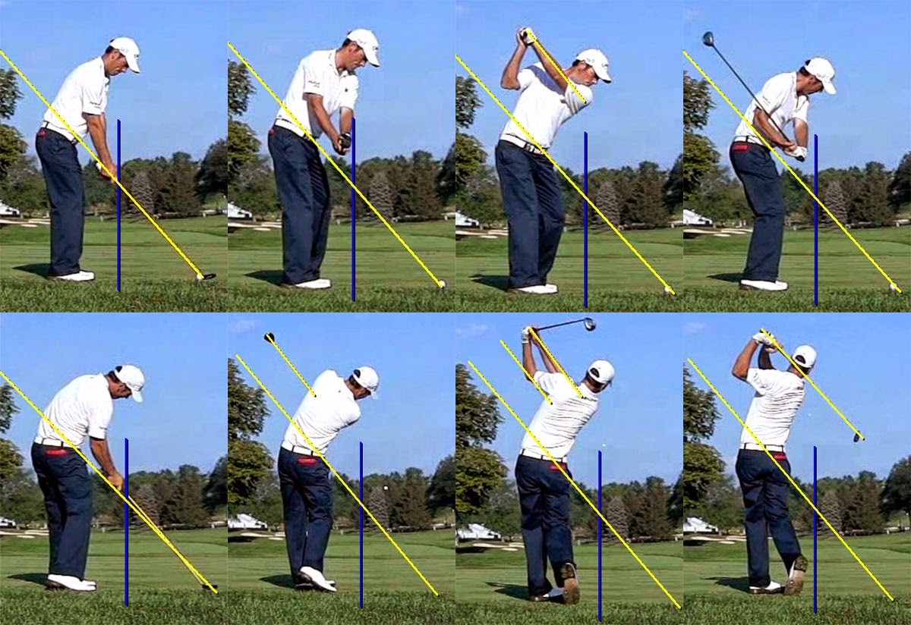
Part 1 Summary
Is it a good use of resources to investigate what happened in a special cause event?
What will happen to your (golf) performance if you make swing adjustments after every (shot)?
This Photo by Unknown Author is licensed under CC BY-SA-NC

Slide 51
End of Part 1
Statistical Thinking
Rules of Data Analysis
Types of Variation
Deming Funnel Experiment

Slide 52
Questions and Thoughts
What questions or thoughts do you have?
Please raise hand and unmute yourself…interaction is great for learning!

Slide 53
Introducing Part 2 (Feb 24)
Where would you draw lines indicating “typical performance” for snowfall in Rochester?
Notes:
53
EXERCISE: Have each student estimate where they think the limits belong and draw
them on their chart in their notebooks. Get a few students to holler out
their limits. Compare these to the “right” answers of 20 and 35.8.
(Draw limits at the values on the overhead - see chart below.)
ASK: Why did they put the limits where they did ? Ans.: To try to capture all the data.
This is a good lead in to why we use 3 sigma limits – so that we rarely exceed the limits when we are in control !
DE-BRIEF:
• The values the class arrived at were probably close to the calculated values.
• To minimize confusion we have a standard approach - everybody will know
exactly what the limits are based on.
M = 27.9
20
35.8

Slide 54
Introducing Part 2 (Feb 24)
Where would you draw lines indicating “typical performance” for snowfall in Rochester?
173.9
24.6
Notes:
54
EXERCISE: Have each student estimate where they think the limits belong and draw
them on their chart in their notebooks. Get a few students to holler out
their limits. Compare these to the “right” answers of 20 and 35.8.
(Draw limits at the values on the overhead - see chart below.)
ASK: Why did they put the limits where they did ? Ans.: To try to capture all the data.
This is a good lead in to why we use 3 sigma limits – so that we rarely exceed the limits when we are in control !
DE-BRIEF:
• The values the class arrived at were probably close to the calculated values.
• To minimize confusion we have a standard approach - everybody will know
exactly what the limits are based on.
M = 27.9
20
35.8

Slide 55
Preparation for Part 2 (Feb 24)
We’ll provide a template (and practice using it) to draw lines on a run/trend chart in order to distinguish common cause from special cause variation.
Preparation
Gather between 4 and 100 performance measurements from a process that you touch (personal or work, historical or current)
Enter into an Excel file using 2-column format, for example:
Time | Data |  | Time | Data
Jan | 21.3 |  | 1 | 130
Feb | 15.2 |  | 2 | 210
Mar | -20.1 |  | 3 | 551
Apr | 26.3 |  | 4 | 226

Slide 56
Before Quick Evaluation
Any final questions or thoughts?
Please raise hand and unmute yourself…interaction is great for learning!

Slide 57
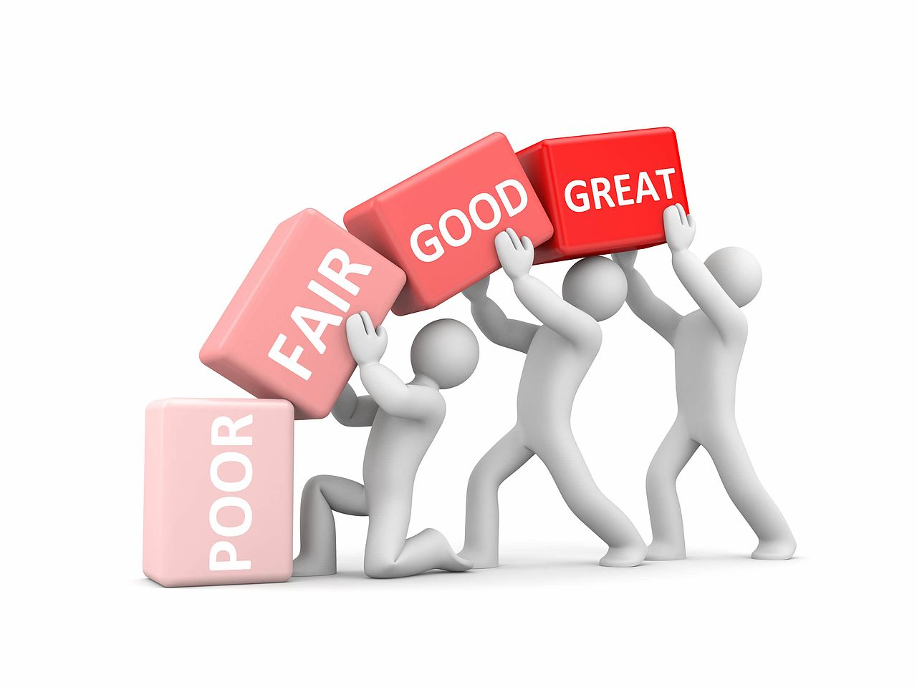
Quick Evaluation
Please click the link sent through Chat
Please take about 3 minutes to provide your thoughts about today’s session and future topics of interest….it will help us plan events most useful to you.
Thank you!!
This Photo by Unknown Author is licensed under CC BY-SA

Slide 58
Thank You!

Slide 59
Flyer
Title: Making Effective Decisions in the Face of Uncertainty (or, “It just doesn’t snow around here like it used to!”): Part 1
Abstract: We make decisions all the time. Some as casual as deciding whether to agree or disagree that it doesn’t snow in Rochester like it used to! Others of more significance. We strive to make decisions and draw conclusions that will benefit our customers and employees. But, in the absence of what is called “statistical thinking,” we can end up making decisions that hurt rather than help. Whether you are a senior leader, mid-manager or individual contributor, this webinar is for you. Come learn how to make smart decisions that will reward you with improved performance!

