Slide 1
MANAGING STRESS AND MAINTAINING WELL-BEING IN DISRUPTIVE TIMES
GRQC Performance Excellence Forum, March 26, 2025.
Presenters
  Jessica C. Shand MD MHS GCTS
    Jessica_Shand@urmc.rochester.edu
  David Pierce, MD, FACEP, MHCM, MBA
    David.Pierce@rochesterregional.org
Dr. Shand and Dr. Pierce invite you to contact them to continue the discussion

Slide 2

Wellbeing by Design
Greater Rochester Quality Council
Jessica C. Shand MD MHS GCTS
Associate Professor of Pediatrics, Health Humanities, and Bioethics
Associate Chief Wellbeing Officer
University of Rochester School of Medicine
Adjunct Professor, Colgate Rochester Crozer Divinity School

Slide 3
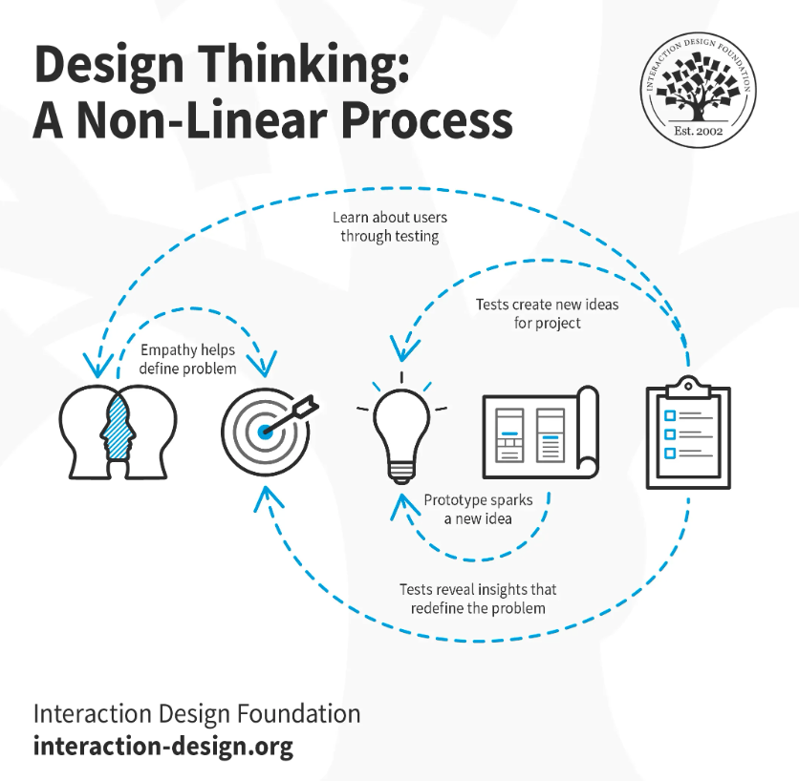
Design Thinking:
An Approach to Complex Problem Solving
Engineers are doing it,
Why not healthcare?
Cultivating empathy is
an embodied skill

Slide 4
My Story: A long, strange trip in medicine
Chapter 1: You can’t do that.
Chapter 2: But I can, though
Chapter 3: The pursuit of all knowledge
Chapter 4: Hozho: is there only 1 truth?
Chapter 5: On science, children, cancer, & grief.
Chapter 6: The pediatrician goes to seminary.
Chapter 7: Lessons learned from endurance.
Chapter 8: Leading fearlessly.
Chapter 9: Still writing, stay tuned

Slide 5
Some of these may work for you
Know your story, tell your story, keep writing your story.
See and honor other people’s stories.
Carry your “words to live by” (and don’t be afraid to change them!)
Commit to what fills you.
Create a quarterly “absolute yes and absolute no” list.
Be amazed when different parts of your story come together (grab a tissue, I have a story for that).

Slide 6
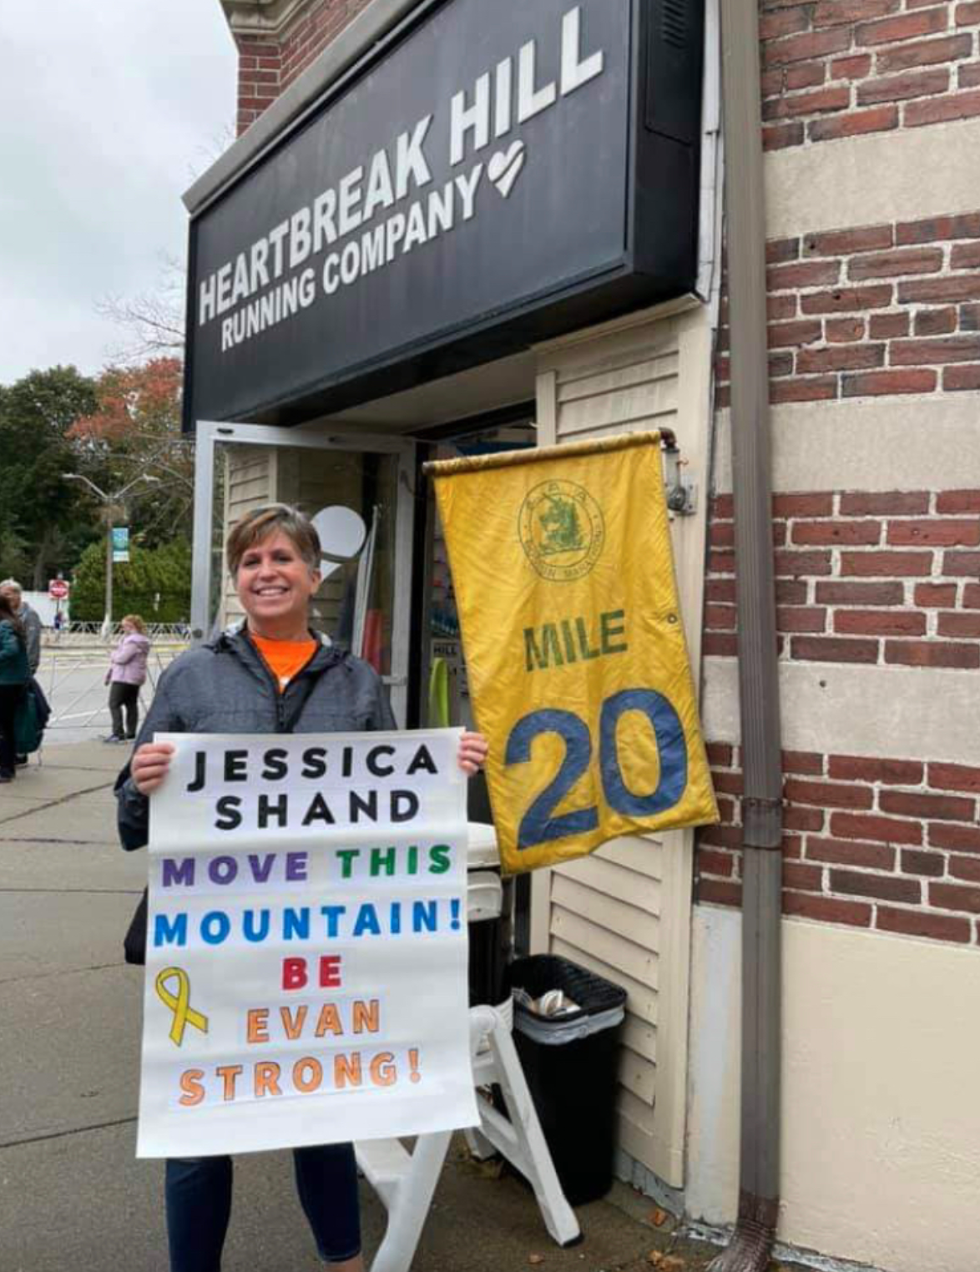

Slide 7
Healthcare Institutional Approaches
1. IMPROVE OUR RELATIONSHIP WITH DATA: EMR functionality optimization, improving user education and usability. ​
2. EMPHASIZE TEAM SUPPPORT: Expand access to critical incident debriefs.​
3. ASK WHAT WE CAN TAKE AWAY- THEN TAKE IT AWAY: Reduce administrative and regulatory burdens that are "non-value add" (American Medical Association’s "Getting Rid of Stupid Stuff”)
4. COMMUNICATE THE WHY: Re-imagine institutional communication about wellbeing efforts and progress. Reduce publication bias!
5. VALUE INDIVIDUAL COPING SKILLS: improve access to individual wellbeing tools including mindful practice, time management, boundary-setting, lifestyle management, conflict resolution, etc.
THE RIGHT DISRUPTION IS GOOD

Slide 8
Thriving (Not Just Surviving)
David Pierce, MD, FACEP, MHCM, MBA
Chief Medical Officer
Emergency Medicine Physician
Rochester Regional Health
Rochester General Hospital

Slide 9
Do I Have My Dream Job?

Slide 10
Dream Job
Promises Wellbeing Mission

Slide 11
Depersonalization | Moral Injury | Depression | Frustration | Blame
I can’t get my work done…
Why is the patient even here?
The patients are _____ and _____...
There are too many___ and not enough___
I’m not making a difference…
I don’t feel connected to my _______
I know what my patient needs but…
I’m missing time with my family!
________ doesn’t care about me
I’m mentally exhausted...

Slide 12
Rate 10 Areas of My Life
4
4
3
3
3
2
2
2
1
1
-6 Habits of Growth by Brendon Burchard-
Mental Health
Physical Health
Family
Learning
Growth
Mission
Spiritual
Friends
Finances
Adventure
-
25/100

Slide 13
My Path Back…
Professional and Personal
AIDET
Sleep

Slide 14
Dream Job
Promises Wellbeing Mission

