Slide 1

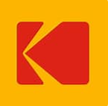
Eileen Brooks, PHR ebrooks@stjohnsliving.org
585.292.5214
St. John’s Health Care Corporation, Talent Acquisition Specialist & Compensation Partner, Nursing – 6 years
Eastman Kodak Company, Recruitment Leader, Research & Development – 10+ years

Slide 2

Recruiting - It’s a New World
Demand > supply
Captivate candidate attention
Perfect candidate no longer exists
Talent pool smaller
Negotiation
Innovative interviewing experiences

Slide 3

Onboarding & Retention
Welcome, welcome, welcome
Develop internal talent
Employee referral program
Flexible work arrangements
Compensation changes
Employee value partnership

Slide 4
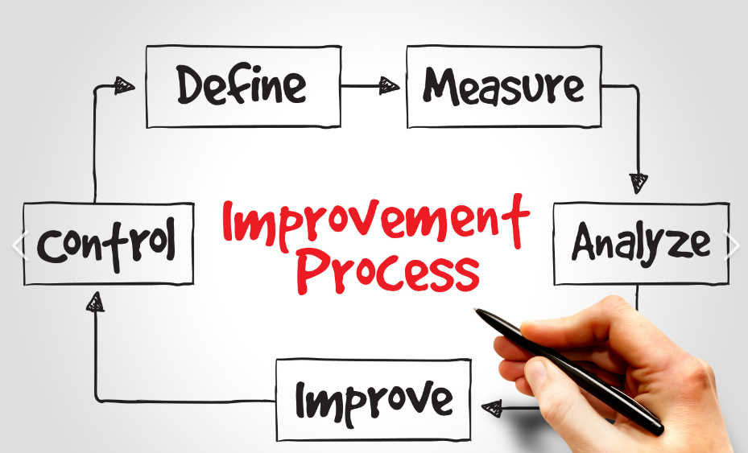
Process Improvement
Eliminate redundancies – no value
Establish analytics
Committee participation
Communication

Slide 5


Coordinated Care Services, Inc.
Greater Rochester Quality Council
Recruiting, Onboarding & Retention, Oh My!
Shaunta Collier-Rankin
CCSI
Director, Human Resources
Presented: June 22, 2022
Notes:
I’m just going to run through this really quickly because I know a lot of you are familiar with the CCSI Overview PPT that we’ve used in the past and a lot of this content is similar to that, but we have made some important updates.

Slide 6

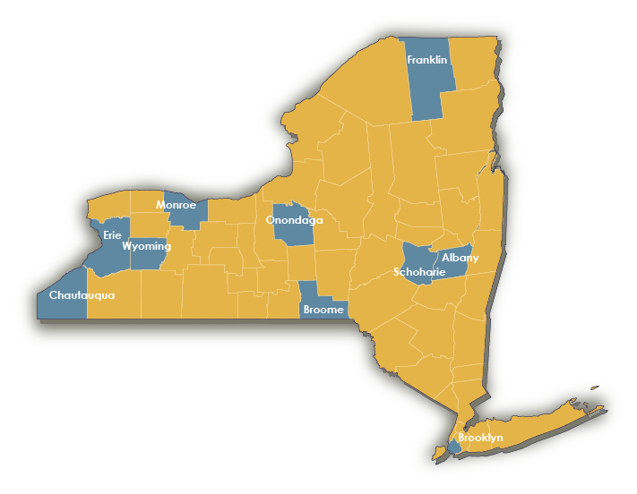

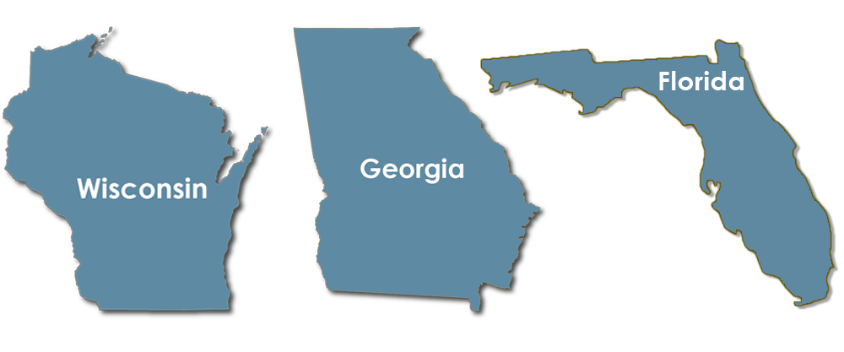
Quick Facts
- indicates a NYS county where CCSI
staff are located
Not-for-Profit Management Services Organization
Founded in 1992 to support the Monroe County Office of Mental Health
Today - staff of >400 talented people working to support customers across Upstate NY – and beyond

Slide 7








Our mission
Our Vision
  CCSI is a nonprofit organization dedicated to inspiring innovation in practice by providing essential business services in partnership with organizations that improve lives and strengthen communities.
To be an exceptional place for individuals to grow and build a career, while expanding our capacity to invest in communities.
Our Operating Principles
Integrity
Honoring People & Their Work
Individualized Work-Life Integration
Diversity & Inclusion
Innovation
Collaboration
Community Connectedness
Excellence in Customer Service
Simply put, we help organizations that help others.

Slide 8
About
CCSI Services
Program Management
Based on customer locations, guided by the customer’s priorities and vision, and managed in partnership with CCSI, we provide the talent and infrastructure needed to plan, implement, and operate programs successfully.
Consulting Services
We provide the expertise and support organizations need to understand, implement, and sustain practices aimed at improving the way health and social care is provided. Our Consulting Division is made up of six, key Areas of Practice.

Slide 9
Today’s Focus
Recruiting
Onboarding
Retention
Three Critical Keys
Conversations/Relationship Building
Building Circles of Trust/Modeling Integrity
Developing Accountable Partnerships

Slide 10
Contact Information
Shaunta Collier-Rankin
CCSI
Director, Human Resources
scollier-rankin@ccsi.org
(585) 329-8362

Slide 11

Recruiting 2022
Dorothy Johnson, MKS Instruments
Yes, It is harder than it seems

Slide 12
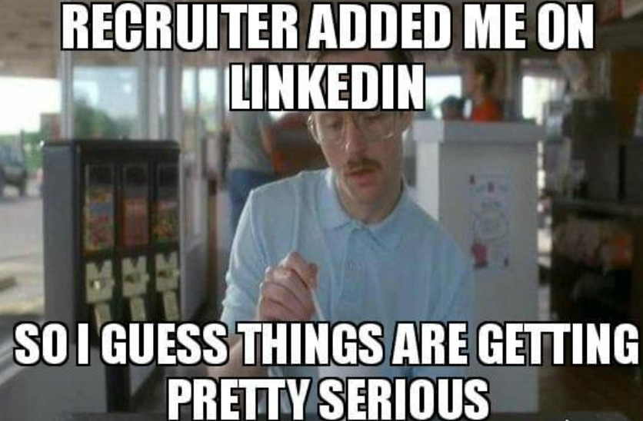
Corporate Recruiting
About Me: Dorothy Johnson
15+ years in recruiting. Companies like: Xerox, Carestream Health, Rochester Regional Health, Ultra Electronics and now MKS Instruments.
Recruiting philosophy:
  People matter!
  Candidate experience counts.
  There are no magic bullets.
  When we hire correctly, we increase employee retention and employee satisfaction.

Slide 13
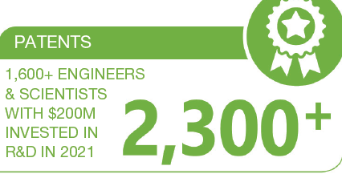
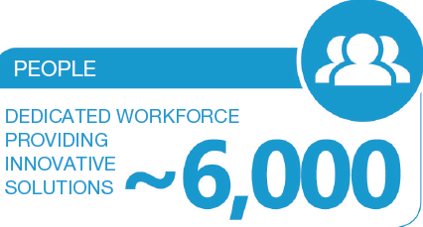
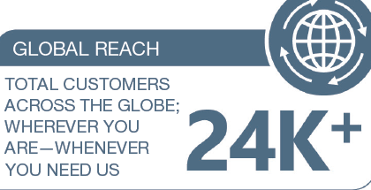
MKS Instruments
MKS Instruments, Inc (NYSE: MKSI) has been pushing the boundaries of possibilities for over 60 years. Cutting edge science and engineering are starting points for us. Equally important is how we win as a team. Two companies, with 3 locations in Rochester, NY.
MKS Power Solutions which holds the #1 position for RF Power in our markets (due to our amazing engineers and support teams).
  Our team of 180+ people produces RF power delivery systems, RF matching networks, and metrology products.
  Markets: laboratory, semiconductor, deposition, and flat panel industries.
  Products: provide energy to various thin film etching, stripping, and deposition processes for the latest generation of integrated circuits.
  Newport Richardson Gratings has 2 locations, 70+ people and is world leader in the design and manufacture of diffraction gratings for spectroscopic, telecom and laser applications, as well as research and education.
By company estimate, MKS equipment has touched every semiconductor chip produced today. Virtually every smart phone, laptop, tablet pc, and server computer (anything with memory). www.mksinst.com/careers

Slide 14

Trends in Hiring 2022
1. The Candidate is in demand and in control.
2. Diversity, Equity and Inclusion
4. Four Generations at Work who may have very different attitudes/values about work.
Baby Boomer (57 to 75 years old)
Generation X (41 to 56 years old)
Millennial (26 to 40 years old)
Generation Z (25 years old and younger)
5. Building Trust with our candidates and employees is necessary.
3. Employer Branding is more important than ever.

Slide 15
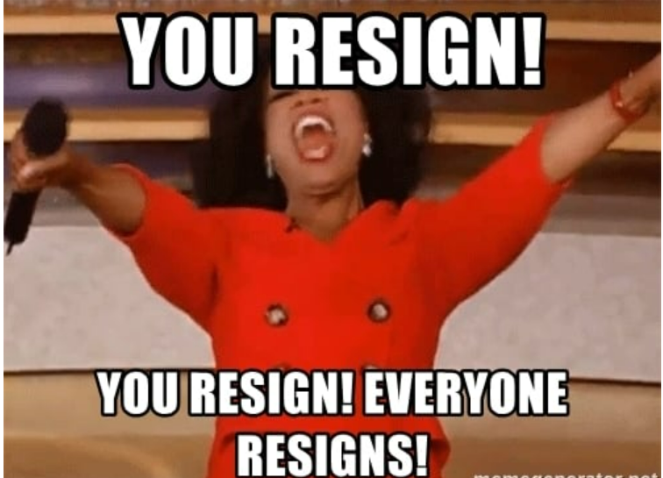
Why Care?
…heard of this?

Slide 16
Trend:
The Candidate is in
Control
The pandemic made us all re-evaluate our goals and work life balance.
  We are questioning when, where, how, and for whom we want to work.
Candidates want to know that they are being compensated well, with strong benefits, and growth opportunities.
They want trust right away; asking for flexibility, transparency, hybrid/remote opportunities. In demand candidates can go any where and they will.
Don’ts:
  complicated applications
  job descriptions with 15 required skills
  complicated tests
  long interview processes
  jobs which can be remote but are on site
Do:
  Be authentic.
  Make sure that the candidate understands: “What’s in it for me?” (WIIFM)
    What will they learn?
    What is the career path?
    Are the compensation/benefits clearly outlined?
    What will they contribute/how will they add value?

Slide 17

Trend: Diversity, Equity and Inclusion
Bringing your whole self to work
Diversity of cultures, backgrounds, experience, skills = success
Interviewing for culture add, not culture fit.
Employees want to work for companies whose cultures align with their values.
Belief that DEI is important:
76% of Gen Z (25 years old & younger)
72% of Millennials (26 to 40 years old)
63% of Gen X (41 to 56 years old)
46% of Baby Boomers (57 to 75 years old)
*Estimated that Gen Z will be 30% of workforce in 4 years
Candidates and employees want to belong, feel supported and valued.

Slide 18
Trend: Employer Branding – How to get attention in today’s market.
Employer Branding is the intersection of company brand and company culture.
Long Term investment to educate the market: Do people know who your company is, and the amazing things that you are doing? Show them, tell them. Find creative ways.
  Ex. We wrote an article about Power Solutions for the Rochester Engineering Society Magazine.
  Be visible. Be online, be relevant. Use social media.
Hiring Managers, Teams and Leaders can influence Employer Branding.
  Want to hire quickly? Work your networks, share on LinkedIn, share with groups that you belong to. Increase your employee referral bonus. Quick feedback on candidates is huge. If you don’t move fast, someone else will.
Sell the benefits of your company and role. Be realistic in your marketing, you are building trust.

Slide 19
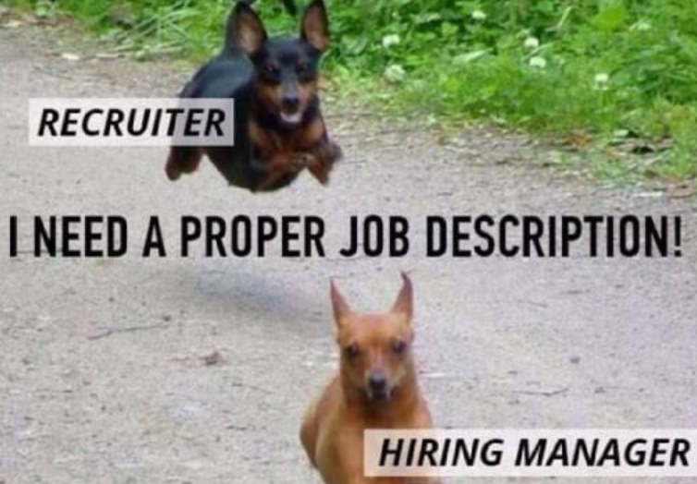
Job Descriptions: Think Like a Marketer
52% of Job Seekers say the quality of the job description is very or extremely influential on their decision to apply. (Indeed survey).
If job descriptions are so important, why aren’t we better at writing them?
Goal for a Job Description:
We want to hire the right candidate while creating brand, increasing interest and relevant applications, and staying compliant.
This is the marketing outreach for your role. If you don’t think that this is a compelling job description, a candidate most likely won’t either.
Tailor the summary to what a candidate would think was cool about the job (think like a candidate - think “What is in it for me?”).
Write like a human, not a robot.
Take the time, do it right.

Slide 20
Job Description – Improvement Ideas
  Job Title: Goal: Get Relevant Attention
  Make it specific and relevant to the candidate market. Use Keywords for Search Engine Optimization.
  Keep in mind that 36% of Job Seekers Search by Job title.
  Opening Line: Goal: Grab Attention –opening line should grab and interest the candidate
  Ex. For an Electronics Engineer role: “Explore the 4th state of matter – Design high power RF generators to transform gas into plasma”
  Company Summary:
  Make it relevant, interesting and exciting.
  Summary and Duties:
  What are the duties and why does the candidate want this job?
  Use inclusive and gender sensitive wording and job descriptions
  An Indeed survey found that 72% of job seekers say it’s extremely or very important to see details about company culture in job descriptions.*
  Required Skills:
  Minimum required skills, no laundry list

Slide 21
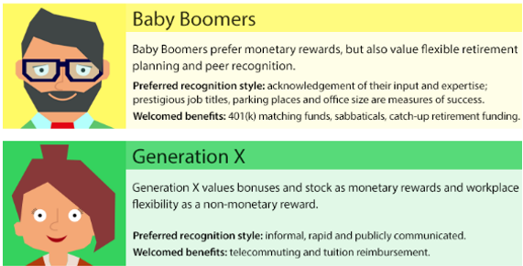
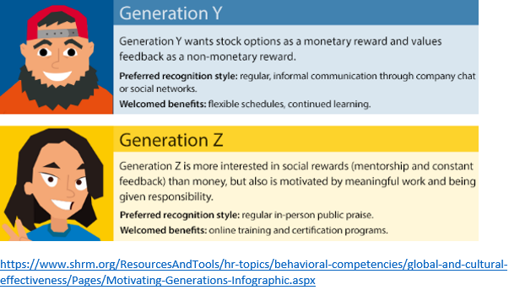
Trend: 4 Generations at Work
Four Generations at Work who may have very different attitudes/values about work.
Think about these differences when it comes to interview teams, candidates, responses to interview questions, candidate priorities, etc.
  Baby Boomer (57 to 75 years old)
  Generation X (41 to 56 years old)
  Millennial (26 to 40 years old)
  Generation Z (25 years old and younger)

Slide 22

Trend: Building Trust:
Caring will be a crucial part of candidate (and employee) decision making
Employees who feel cared for at work are 3.2x more likely to be happy at work.
Happy employees are 3.7x more likely to recommend working for their company.
Candidates and employees want to be viewed as people, not numbers. They expect their organization to support the needs that come from their life experience, not just their work experience. Employees and candidates everywhere are reevaluating their professional goals in the context of the life they wish to lead, not just the career track they are on.

Slide 23
Wrap Up
In Demand Candidates are in control
  Candidates have multiple offers.
  Companies need to provide a strong candidate interview experience, strong comp and benefits, show learning opportunities and growth.
  There is a need for speed.
  Diversity Equity and Inclusion
  Employees want to bring their whole selves to work and feel included in the organization.
  Employer Branding is more important than ever
  Be Creative.
  Think like a Marketer when creating Job Descriptions and Company Summaries.
  4+ Generations
  4 generations at work with different attitudes/expectations from work/employers.
  Trust and Caring
  Are/will continue to be an important part of decision making.
  Candidates need to trust in their new employer and Manager.
  Treat people well.

