Slide 1
Partners PEX and the Baldrige Ecosystem
Laura Kinney, MBA
Executive Director

Slide 2
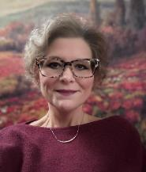
First and foremost, a Baldrige Geek
Laura enjoys working with leaders, organizations, and communities to use the Baldrige Framework to improve and become the best versions of their Mission, Vision and Values while delivering benchmark-level results. She is the Chair of the Board and acting President for Partners in Performance Excellence - a regional Baldrige non-profit that serves MA, NY, RI, DE, NJ, Eastern PA, and CT. In June 2025, Laura was recruited back to the original region and program where she discovered her passion for this work, the Pacific Northwest. Laura started her Baldrige career in 2002 as a first year WSQA Examiner and has taken (or taught!) examiner training either at the regional or national level almost every year since. Laura is now the Executive Director for Performance Excellence Northwest (PENW) serving AK, WA, ID, and OR. In the past, Laura had the privilege of being an executive in healthcare where she was able to use the Baldrige framework and lean transformation to develop and execute the organization's strategic plan (MultiCare (WA), Yakima Valley Memorial FOS (WA), Geisinger (PA), and Signature Healthcare (MA). Laura is also the Marketing Chair and a board member for the Alliance for Performance Excellence.
For over 10 years, Laura served as the Chair of ASQ's Conference Council and on the World Conference Technical Program Committee for years prior. Laura served as the chair for both Spokane and Seattle Sections for ASQ in the past. She is also active in ACHE – The American College for Healthcare Executives.
Laura has also served as an examiner for Communities of Excellence 2026 and AHCA-NCAL - Both Baldrige-based programs and partners within the Baldrige Ecosystem.
Recently, Laura has spoken or been on panels for ASQ's World Conference on Quality and Improvement, Quest for Excellence, ASQ's Lean and Six Sigma Conference, and the Medical Device Innovation Consortium in Boston. Laura hosted her first PENW Annual Learning Symposium in 2025 and looks forward to hosting many more!
Laura lives next to a cranberry bog in Halifax, MA and you can find her walking her Labrador, Basil, each night or tending her garden. Laura loves the Maine Coast as it most reminds her of the Pacific Coast with all her energy, ruggedness and beauty.
Laura M Kinney, MBA Executive Director Organization: Performance Excellence Northwest – PENW Organization: Partners in Performance Excellence – Partners PEX Locations: Seattle (PNW) and Boston (New England and New York)

Slide 3
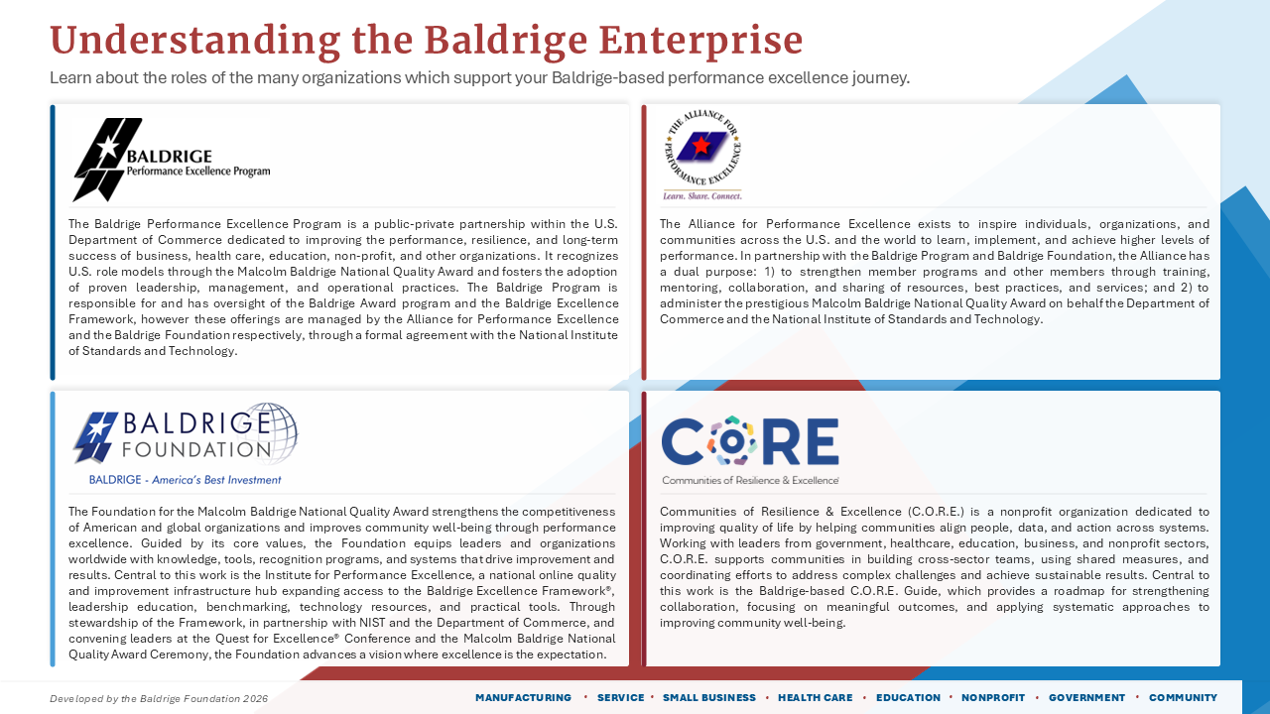
National Historical Program – 1987 Act of Congress, US Dept of Commerce, Presidential Award!
The Alliance – Network of State and Regional Programs – the new manager of the national award program
Historically an advocate and fundraiser for the Baldrige program, now manager of the Framework Updates
The Baldrige Framework adapted for Communities – a new sector within the Baldrige Award

Slide 4
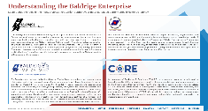
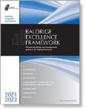
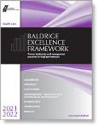
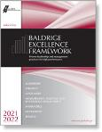
An Act of Congress to Establish Baldrige
Created in 1987 by Public Law 100-107
Part of the Dept of Commerce, National Institute of Standards and Technology
Mission is to identify, recognize and stimulate excellence
Shifted operations to private sector partners in 2026

Slide 5
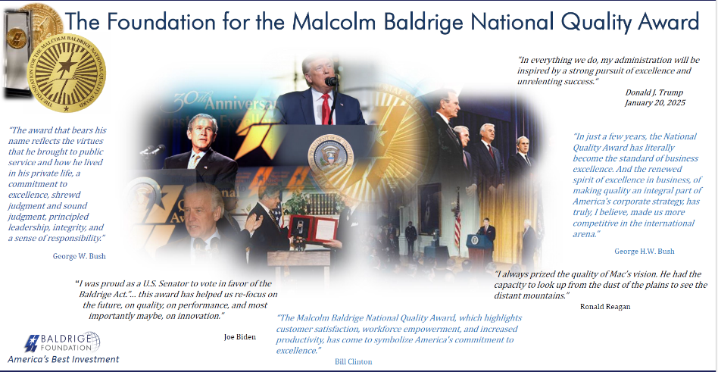
The Baldrige Foundation
Traditionally: Advocacy & Fundraising
Recently added Education
And now added Baldrige Framework Revisions, Quest, Baldrige Fellows

Slide 6

Communities of Resilience &
Excellence (C.O.R.E.)
Vision: A network of thriving, resilient communities where every resident can live well and feel they belong
Was COE 2026
Provides CORE Guide, Impact Pathway, Assessment & Recognition, Scorecard

Slide 7
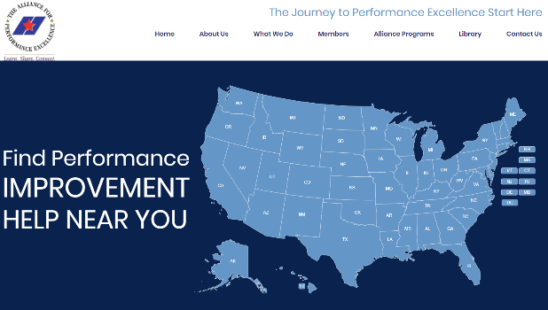
The Alliance for Performance
Excellence
Founded in 2005
Purpose is to inspire individuals, organizations, and communities across the US and the world to learn, implement, and achieve higher levels of performance.
https://baldrigealliance.org/membership/
programs/

Slide 8
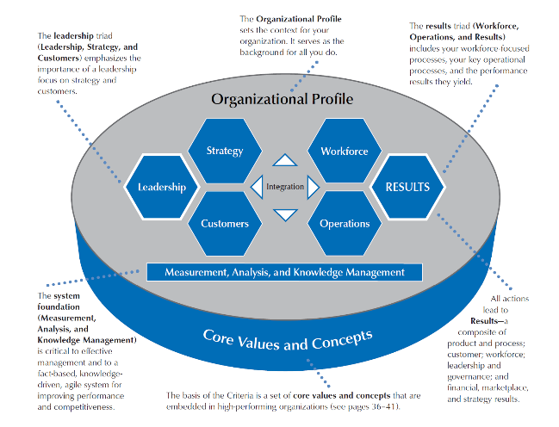
The Baldrige Framework
Non-prescriptive – not a standard, no shalls or musts
Beyond Operational Excellence – full maturity model
From Governance and Leadership to People and Operations and everything in between!
Systems Thinking backed by Excellent Outcomes and Results

Slide 9
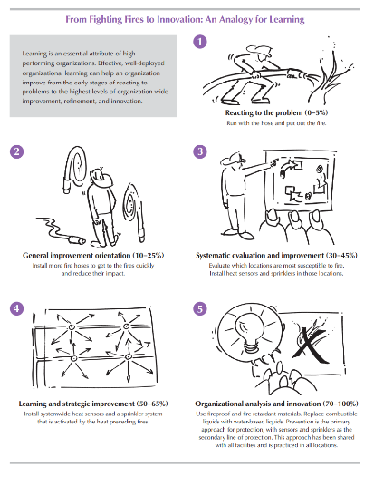
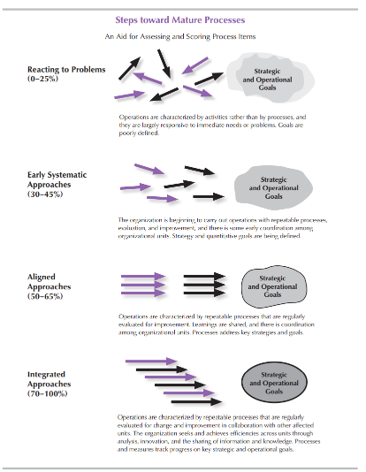
From Reactive to Proactive and Integrated
Where are we now?

Slide 10
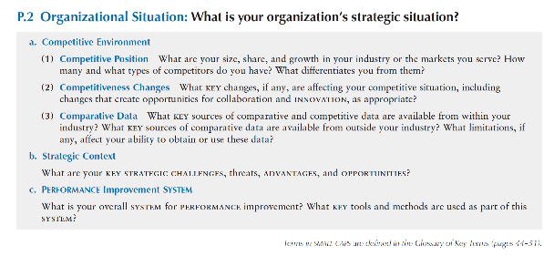
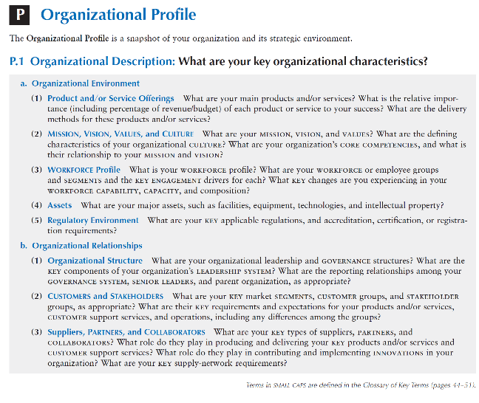
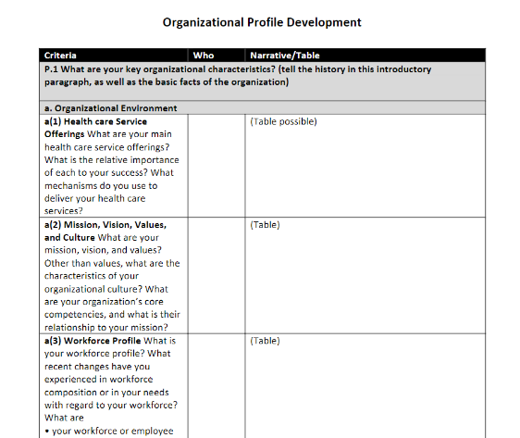
Org Profile Development
Why are key factors important to an organization?
Why are key factors important to examiners?

Slide 11
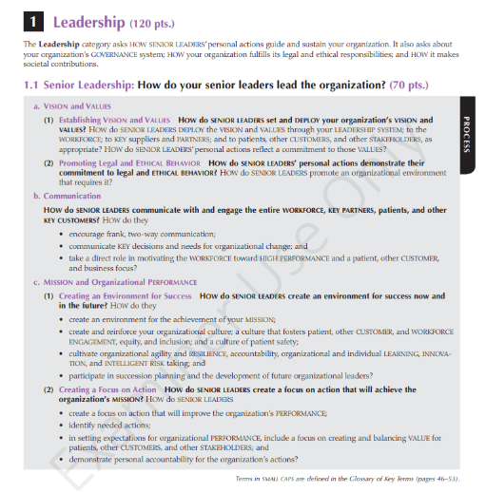
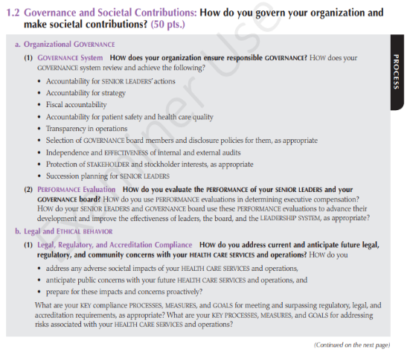
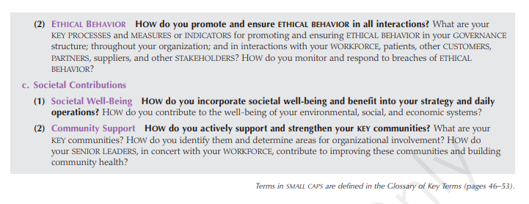
Baldrige Category 1 – Leadership
What is the approach?
How well is it deployed?
What cycles of learning have occurred?
And why is this process important to the organization?
HOW do you?

Slide 12
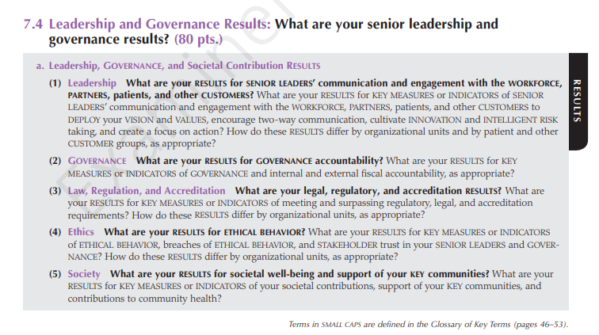
Baldrige Asks ‘How do you know?’
HOW do you KNOW?
DATA!!
What are your Levels, Trends, Comparisons, Integration?

Slide 13
Partners in Performance Excellence
Established as the Massachusetts Council for Quality
Expanded to include NY, CT, RI
Expanded in 2024 to include Eastern PA, NJ, and DE
We help develop and support high-performing leaders, organizations and communities by using the
Baldrige Framework for Performance Excellence as the source for organizational excellence.

Slide 14
Partners PEX Offerings and Support
Examiner Training
Application Evaluations and Reports
Advising and Partner Services to support
Executive fellows program
Programming
Home | Partners PEX
Our new partner program:
Performance Excellence Northwest | PENW

Slide 15
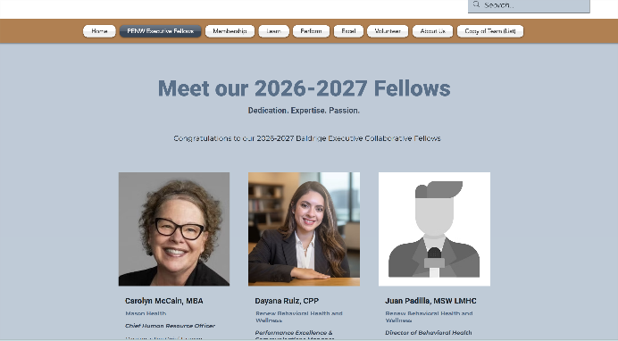
Baldrige Executive Fellows Program
PENW Fellows (List) | PerformExcelNW

Slide 16
Baldrige Fellows Program
2026-2027 Calendar
Jun | Program Intro, Leadership Systems & Personal Inventory
Jul | Paul Grizzel – Baldrige Foundation – Core Values
Aug | Southcentral Foundation – Customer Focus
Sep | Leadership and Culture Impact – Michael O’Brien
Oct | Workforce engagement & high performance
Nov | 2027 PENW Learning Symposium; Project Presentations
Dec | Operations design, management & improvement
Jan | National Recipients Baldrige Journey Designs
Feb | Putting It All Together & Project Sharing
Mar | National Baldrige Recipient Learning Site Visit (Optional, Extra Travel Expense)
Planned speakers include Northwell Glen Cove Hospital, Nor-Lea Health District, Elevations Credit Union, Alamo Colleges, Mid-America Transplant, Pewaukee School District, Pagliacci Pizza, Southcentral Foundation

Slide 17
Other Offerings
Fall Examiner Training – starts in October, finishes by Thanksgiving Become an Examiner | PiPEx
PENW and Partners PEX Fellows Program
Baldrige Fall Conference – New Orleans Oct 12-13
30th Annual Learning Symposium – Seattle Nov 18th
Application and organization review Q1 2027
We help develop and support high-performing leaders, organizations and communities by using the
Baldrige Framework for Performance Excellence as the source for organizational excellence.

Slide 18

Aligning & Integrating Framework & National Award Criteria
New in 2026!

Slide 19
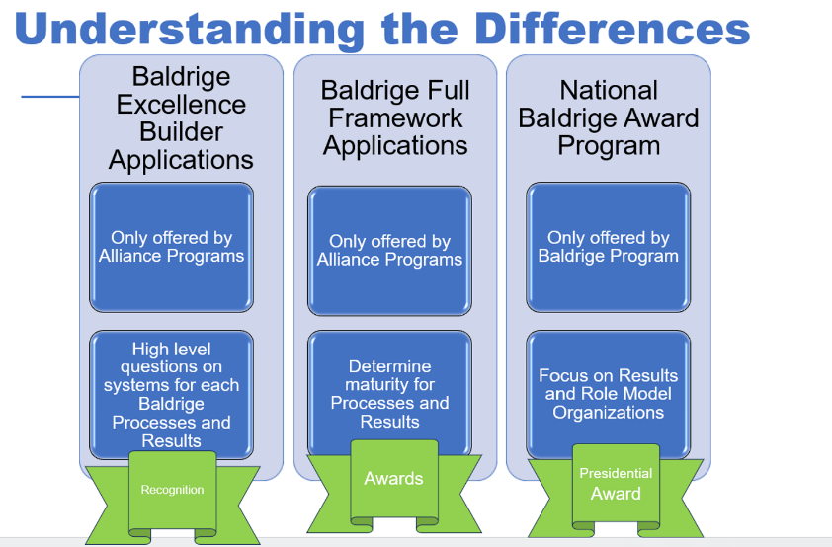
From Regional to National

Slide 20
Questions?
Save until end of session
Contact Information:
Laura@partnerspex.org
425.761.8409
www.partnerspex.org
Performance Excellence Northwest | PENW

Slide 21





RE
Our Excellence Journey
How it (re)started…
Over 20 years ago, ABC participated in an “Award for Excellence” program within the national Community Action network. The Award was based on Baldrige standards and used a Baldrige style review framework. The effort was unsuccessful.
In 2023, ABC considered participating in the Community Action Pathways to Excellence program (an updated version of the former Award program). We decided to re-engage in Excellence, having learned some lessons from the past 20 years….

Slide 22
RE
Our Excellence Journey
Why we decided to take the journey again
The “bad taste” from 20 years ago had passed… very few people remember that as a failed effort, we could start fresh
Leadership staff recognized that the agency’s major challenges had to do with too much knowledge residing in individuals, not institutionalized in effective systems
The Board recognized that fundraising and raising the agency’s profile would be bolstered by making excellence a focus of our strategic efforts (incorporated into the Strategic Plan)
The agency’s culture had been an ongoing concern – some staff felt that not enough accountability, inequitable/inefficient systems were entrenched in a culture that did not always strive for improvement

Slide 23
RE
Our Excellence Journey
The Pathways to Excellence Program
ABC formally enrolled in the Pathways to Excellence program, a Baldrige-based excellence program tailored specifically to Community Action Agencies in spring 2023.
The program has four levels of awards:
  Bronze – commitment to excellence
  Silver – emerging practices in excellence
  Gold – agencywide focus on excellence
  Platinum – full demonstration of the adapted Baldwin standards
  As of July 2026, our agency has completed the Bronze and Silver tiers. We have learned the standards, have done some self-assessment and have achieved some standards.

Slide 24
RE
Our Excellence Journey
Where we are now
We have not yet started to pursue the Gold level – it requires doing a complete self-assessment and meeting a substantial proportion of the standards of excellence
Why are we not moving forward with Gold yet?
  We realized that we do not have formal processes in place in many areas of our agency (or are not regularly and consistently implementing them where we did identify processes)
  We realized we need to do more leadership development work among our management team to establish a common understanding of what excellence looks like and why it matters
  Our purpose is do this right, not to seek the awards/honors. We are very comfortable taking time to make the changes we need to make

Slide 25
RE
Our Excellence Journey
Key learnings (so far)
Approach. Implementation. Results.
Excellence is less about implementing the specifics of the Standards and more about adhering to a philosophy in everything we do. This has resonated powerfully with us:
  Do we have a formal approach, a written plan/process?
  Do we have data showing we are implementing approach with fidelity?
  Do we have data showing this approach is achieving results?
Culture eats strategy for lunch
To make excellence “stick”, we need to focus on our agency culture. Otherwise, excellent practices will give way to old habits.
It’s a journey, not a destination
We are clear with our agency stakeholders that excellence is seen in how we do our work, not achieving a status. The key is staying on the journey, not asking “are we there yet?” There is no “there”!

Slide 26
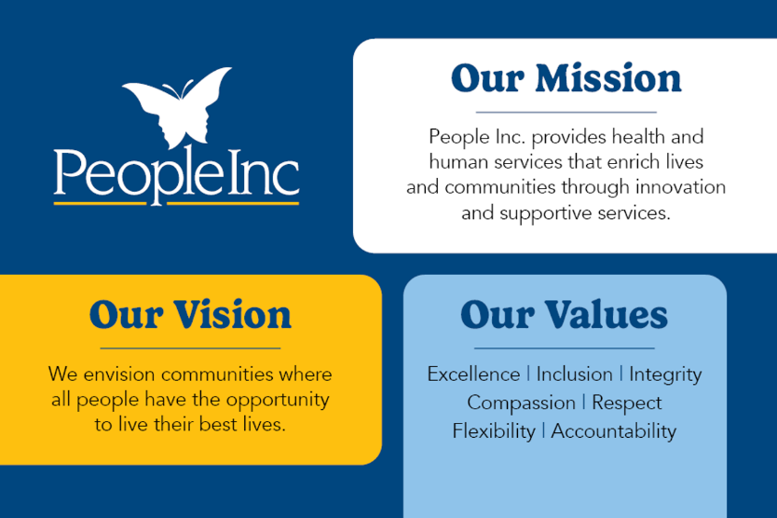
Notes:
People Inc. provides a diverse array of support for people with intellectual and developmental disabilities and their families, as well as health care services, services for seniors, services for the Deaf and hard of hearing, and affordable housing.

Slide 27

Why Performance Excellence
Move People, Inc. from “Good” to “Great”
Serious safety event occurred spring 2025
Variation in performance between programs and sites
  Decision: focus on quality, safety and accountability
  Path to transition accreditation (COA) and pursue Baldrige
Performance Excellence department created
Baldrige and accreditation will work together to drive organizational excellence
Notes:
This work is about moving us from ‘good’ to ‘great.’
Systematic approach
Discipline with how we think and decide and provides a shared language
Helps us identify what matters the most
Connecting our daily operations into long-term goals
Identify the gaps in our operational structure to allow for a formalized and structured pathway to address and resolve issues
Improve reliability, strengthen engagement, reduce inefficiencies to position ourselves to compete and succeed in increasingly complex environments
Build a resilient organization that relies on sustainable processes to prosper long into the future
We’re creating a more disciplined way of thinking and making decisions, with a shared language across the organization.
For leaders, the biggest benefit is clarity. We are formalizing the informal so expectations, processes, and priorities are clear and consistent.
Our approach is to intentionally combine Baldrige and COA.
These are not competing systems — together they help us build an integrated approach that improves efficiency, strengthens our mission, and ensures long-term sustainability.
Performance excellence is really about how we operate as a system to consistently achieve strong results and continuously improve.

Slide 28
Implementation Steps
1
2
3
4
UNDERSTAND
DEVELOP
COMMUNICATE
IMPLEMENT
Agency-wide deep-dive into processes, governance, foundational practices and documentation
Cross-walk accreditation standards, regulatory requirements, and Baldrige criteria; design integrated council structure
Explain the “why,” tailor messages by audience and build early buy-in through training
Complete Baldrige Org Profile, launch councils, self-assess and prioritize improvement areas
Outcome: aligned governance, readiness, and prioritized improvement actions
Notes:
This is long-term work — we are building sustainability, agility and resilience.
As part of our governance structure, we also identified a need for standard governance documents such as charters, agenda, minutes templates and need for measurable outcomes for each council

Slide 29
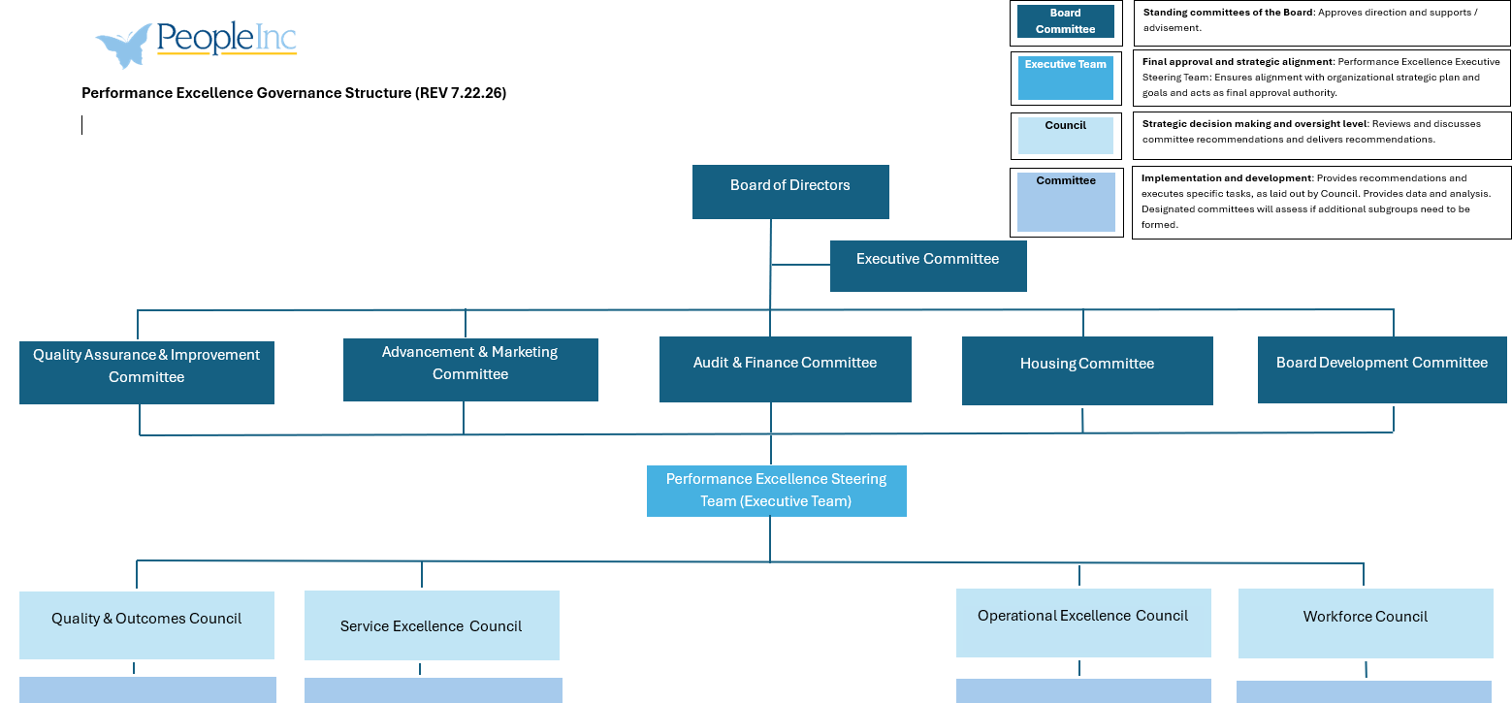
Notes:
Created a cross-walk with focus area for each council that summarized the cross-walk details (COA, Baldrige and regulatory requirements) so we knew the work of each council and what workgroups would need to report up through this structure
Overlayed policies and procedures into this council structure

Slide 30
Critical Success Factors
A four-step leadership sequence for adopting Baldrige as an operating discipline
DRIVE
ALIGN
REITERATE
SUSTAIN
→
→
→
1
2
3
4
Executive & Board
Leadership
Senior Leadership
Buy-In
Audience-Specific
Repetition
Take Time
Before Launch
Understand the shift
and model the new
operating expectations
Connect the change
to how each group’s
work improves
Build readiness and infrastructure first;
do not simply start
“doing” Baldrige
Championed and led at Executive level
Leadership commitment + repeated context + patience = sustainable performance excellence
Notes:
Must be driven by executive leadership and Board of Directors
Senior level leadership need to understand and buy-in, this will change the way the organization operates
Constantly reiterate, based on audience what this will do to improve their work
Realize this will take time – cannot just start “doing” Baldrige
Now, turn it over to Jerry Carley from Benedictine

Slide 31
Benedictine

Slide 32
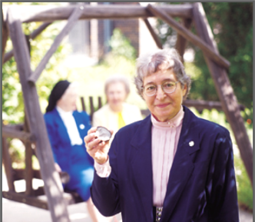
Mission
Benedictine is a Catholic, faith-based organization entrusted with advancing the life-enhancing senior care ministry of the Benedictine Sisters of Duluth, Minnesota.
We witness to God’s love by creating inclusive communities, supporting those we serve to live well and with purpose, with special concern for the underserved.
Vision
We create Benedictine Living Communities where health, wellness and choice come to life.

Slide 33
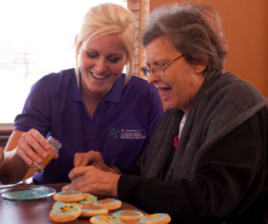

History
1888 – The Benedictine Sisters of St. Scholastica Monastery opened St. Mary’s Hospital in Duluth, MN
1985 – Benedictine was created to:
  Streamline back-office functions
  respond to changes in the health care marketplace.
  Consisted of 2 hospitals and 1 nursing home
2007 – After growing for 20 years, the acute care division separated from Benedictine with the senior care division retaining the Benedictine name

Slide 34
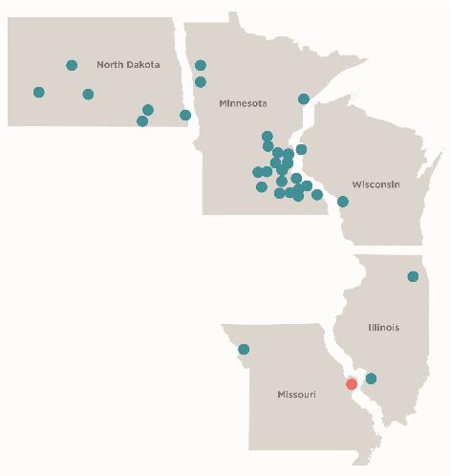
Benedictine – Today
35 Members and Partners
  27 Nursing Facilities
  38 Housing – AL, IL, MC
  Adult Day, Home Health, PACE
Benedictine Support Center
Benedictine Foundation
Benedictine Insurance Services SPC, Ltd.
Benedictine Groups Self-Insurance Association
Benedictine Staffing, LLC
Notes:
10th largest non-profit senior care organization
Largest stand-alone Catholic sponsored senior care ministry
Serve 5,000 residents daily
Employ over 5,000 associates
$850 million assets
$500 million revenue

Slide 35
Performance Excellence Journey

Slide 36

Value Proposition – The “Why”
Consistency at Scale
Common practices
Shared definitions
Aligned processes across every community
Proven Framework
Integrates leadership, strategy, and operations into one system
Drives measurable, sustainable results in care, satisfaction, and finances
Lasting Impact
Fact-based decisions that reduce variation and sharpen accountability
Stronger workforce engagement and retention
Scalable best practices and benchmarking

Slide 37

Performance Excellence Journey
2012
Excellence Level Award
2020
Revisited program
COVID delay
2023
Commitment Level Award
2025
Performance Excellence Strategic Initiative
35 applications in process

Slide 38

Lessons Learned
Executive sponsorship keeps the initiative prioritized
Dedicated person for implementation and continued oversight
Turnover in key leadership is high risk for continuation
Embedding the framework into onboarding and daily routines protects against turnover
Consistent measurement and regular reviews keep progress on track
Celebrating and sharing early wins builds momentum
Downplay award recognition
Easy to cut with budget challenges

