Slide 1


GRQC Performance Excellence Forum:
“Lean Six Sigma – It's Not Just For Manufacturing”
Hillside’s Journey to Building an Award-Winning Lean Six Sigma Certification Program
January 24, 2023

Slide 2

Agenda
History of Hillside
Lean Six Sigma Implementation
Examples of LSS projects
Resources
Question & Answers
Notes:
Chris

Slide 3
Hillside
Mission: Hillside provides community-based services, education, and residential treatment to positively impact lives, in partnership with youth and families who have experienced trauma.
Vision: Youth and families overcoming challenges to heal and thrive in their communities.
Values:
  Caring -Hillside builds a culture of trust and support by focusing on the wellness and resiliency of our staff, and the youth and families we serve.
  Inclusion: Hillside believes all people should be accepted for who they are, have a voice, and be listened to and valued while striving for equity, trust and belonging.
  Excellence: Hillside utilizes high-quality, evidence-based/informed practices, seeks input from employees, and strives for continuous improvement in order to achieve the best possible results and outcomes.
Notes:
Chris

Slide 4
Hillside
Started in 1885 as Rochester Orphan Asylum (www.hillside.com)
Now serves Children & Families in Western New York, Central New York, Finger Lakes, Southern Tier, and Prince George’s County, Maryland
Program Array: Residential, Foster Care, Day Treatment, Preventive, Group Homes, Care Coordination, Crisis Services
Licensed: Office of Mental Health, Office of Children and Family Services, Dept. of Health, State Education Dept., Office for People with Developmental Disabilities
Accredited: Council on Accreditation (COA)
Almost 10,000 youth and families served annually
Over 1600 employees
Notes:
Chris

Slide 5

The journey begins….. Leadership Support
Since 1979, Hillside has had a long career in Quality Assurance and Quality Improvement and in the early 1990’s included adoption of Deming’s Total Quality Management (TQM) approach.
As a leading human service provider in NYS licensed by various regulatory agencies,
Hillside is required to abide by many regulations including regulations focused on quality and compliance.
In 2012…. with approval and support of Maria Cristalli, then Chief of Strategic Planning and Quality Assurance, and LSS Black Belt, Hillside launched its Lean Six Sigma program under the direction of Darlene Ryan, Lean Six Sigma (LSS) Master Black Belt practitioner, and then Director of Quality and Risk Management. Lean Six Sigma became part of Hillside’s Quality model.
Notes:
Chris

Slide 6

Launch
February 2012: 8 LSS Green Belt students (Hillside employees) began training.
Employees from all functional areas invited and encouraged to participate in Hillside’s LSS Green Belt program including: Human Resources, Facilities, Quality & Compliance, Admissions, Business Intelligence, Social Work/Operations/Program, Nursing, Food Service and Administrative.
Each student paired with Hillside LSS mentor (Black Belt or experienced Green Belt)
2012-2018: 41 Hillside employees received LSS Green Belt Certification.
To be certified, student (employee) must:
  successfully complete a project
  complete a final knowledge check
  deliver presentation about project to management meeting
Upon certification, many continue on and complete 2nd, 3rd , and 4th projects, an expectation of Hillside’s LSS program.
Notes:
Chris

Slide 7

Expansion
Learning from the success of the Green Belt program, Hillside launched a Yellow Belt program in 2018.
WHY???
Primary Reason: Many projects did not require the data analysis and statistics typical of a Green Belt project. Most projects aligned with the tools and methods taught in LSS Yellow Belt.
March 2018: 8 LSS Yellow Belt students (Hillside employees) began training
As with Green Belt training, each Yellow Belt candidate paired with a Hillside LSS mentor
2018-2023: 17 Hillside employees received their LSS Yellow Belt Certification.
Notes:
Chris

Slide 8

Continuous Learning
New employees: introduced to Quality model including LSS in first 120 days
Annually: all employees re-trained in Hillside’s Quality model
Daily Student Feedback during LSS training
LSS Reunions
Spreading Lean Six Sigma- TIMWOOD
Notes:
Chris

Slide 9

Recognition & Celebration
Over 125 LSS projects completed
58 employees certified LSS Green Belt or Yellow Belt
2 employees sought LSS Black Belt certification
Project completion celebrated at multiple management levels of the agency
Project presentation (certification project) or Executive Summary shared with Chief Executive Team
GRQC Performance Excellence Awards:
  Awards in the Team Excellence category
  2022, Gold in the Organizational Excellence category
Notes:
Chris

Slide 10
Benefits /Challenges from LSS Implementation
Benefits:
Increase in data driven decision-making
Financial Savings (increased revenue, decrease payback, reduced costs)
Improved efficiencies
Agency culture of continuous quality improvement
Empowered Staff
Challenging problems solved
Challenges:
Project management of LSS projects- numerous projects going on at once
Belt Candidates moving on to other opportunities
Requires resources to teach, mentor, and manage the LSS program
Employee bandwidth to dedicate time for training, or participation in a project
Notes:
Chris

Slide 11
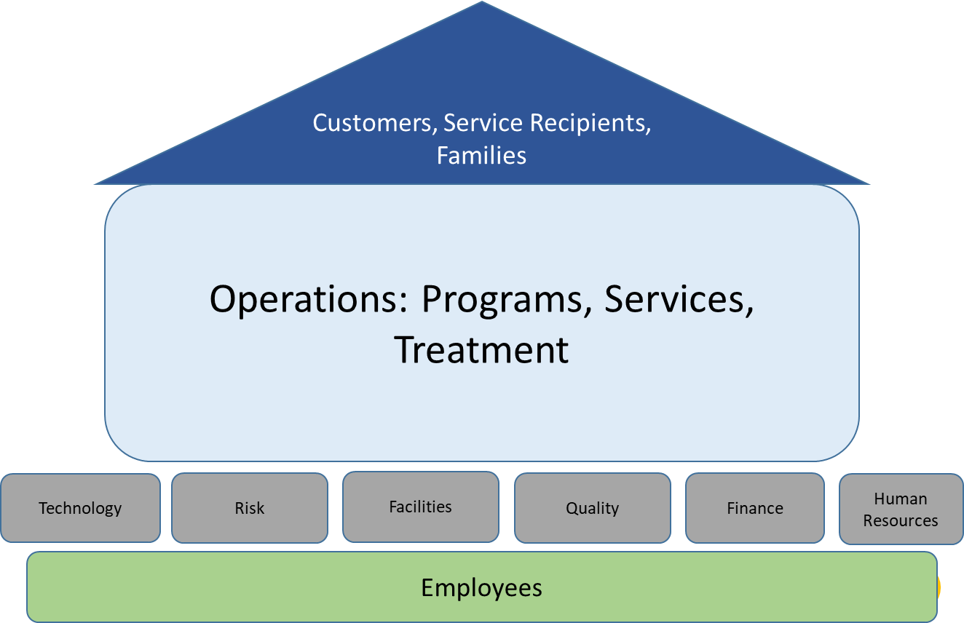
Common Not-for-Profit Functions
Functional Areas Impacted by LSS Projects
Notes:
Chris

Slide 12
Customer Focused Project Examples
Project Title | Key Measure | Baseline | Goal | Most Recent Results | Key Improvement Idea:
Improve Family Satisfaction with Problem Handling | % family satisfaction with problem handling | 66% Satisfaction | 76% Satisfaction | 86% Satisfaction | Created a best practice model where none existed.
Improve Family Satisfaction survey response rate at Monroe - OCFS | increase response rate for family satisfaction surveys for OCFS Residential Monroe Ave Campus | 38% return rate per year | 50% per survey month (April and Oct) | 86% return rate per year | Two dedicated survey months. All staff asked to encourage families to respond to survey.
Notes:
Chris

Slide 13
Operations Focused Project Examples
Project Title | Key Measure | Baseline | Goal | Most Recent Results | Key Improvement Idea:
Improvement of the Cycle Time from Service Approval to Billable Service Delivery | Average time from approval to billable service delivery for basic services | 38 days | 23 days | 15 days | Many required steps were moved to the pre-enrollment phase. Planning time made available to the WSP Supervisors was greatly increased. A detailed “wish-list” of client preferences implemented. Information was provided to the entire WSP Supervisor team. Digital versions of all service plans and documents were made available to the WSP staff. 7 redundant and/or unnecessary steps were removed.
Overnight Census | # of monthly errors | 122/month | 73/ month (40% reduction) | 68/month (44% reduction) | Two major changes were implemented: 1. Power Point Census Training was developed and provided to staff. The Power Point Training was added to Right Start for new residential direct care staff. 2. Census Form was changed from a daily form to a monthly form and updated to use form functionality to mistake-proof completion.
2
Notes:
Chris

Slide 14
Operations Focused Project Examples
Project Title | Key Measure | Baseline | Goal | Most Recent Results | Key Improvement Idea:
OCFS Referral Process | Referral to Decision Cycle Time | 8 days | 5 days | 3.8 days | Integration based morning meeting where referrals reviewed and Residential point person assigned. Utilization of communication board to indicate the person not taking triage calls, allowing them to focus on steps 1-4 without interruption. Utilization of tracking sheet to track the number of handoffs per referral. Installed more sophisticated switchboard which improved efficiency and work flow.
Medication Access and Administration in Community Based Foster Care | To reduce the number of medication incidents/errors per month | 0.83 incidents per month | 0.62 incidents per month | .67 incidents per month (POCA in place) | Foster Parent Foster Care Health Services Training Updated to emphasize storage safety, insurance and prescription coverage considerations, and Upstate Pharmacy Revised two forms: Appointment Summary Sheet – now includes request for information to be faxed right on the form, so the community based provider known we need it asap Medication Transfer Form – easier to read and complete
2
Notes:
Chris

Slide 15
Technology & Risk Focused Project Examples
Project Title | Key Measure | Baseline | Goal | Most Recent Results | Key Improvement Idea:
Technology: Electronic Medical Record Security Audit follow up process | Improve % of EMR Security Audit Attestations returned | FY21 Q3 = 66% FY22 Q1 = 76.5% | 100% | 100% | Implemented step to disable EMR accounts if audit/attestation is not completed. Expanded return time of the attestation 3. Updated the supervisor guide to help supervisors better understand the process.
Risk: Attorney-Client Privilege Blitz | # of high level issues | 2-3 per month | 0 per month | 5 issues per month (plan of corrective action in place) | Created guidance document for staff describing when to use Attorney Client Privilege for an email communication. Provided template for staff to follow so as to include all required elements of an ACP protected email.
Notes:
Chris

Slide 16
Facilities Focused Project Examples
Project Title | Key Measure | Baseline | Goal | Most Recent Results | Key Improvement Idea:
Facilities Service Requests Completed "Within 14 Days" Timeliness | % of 14 day service requests completed on time | 74% | 85% | 93% | 1. Facilities Manager Prioritizes Technician’s Daily Hillside Tasks Report 2. Implemented Morning Market for each territory - Facilities Managers distribute Tasks Report and review any service requests at risk of not getting done within 14 days.
Facilities Service Request Quality | % of painting, drywall and door service projects meeting quality standards | 51% | 75% | 96% | Implemented Facilities Quality Inspection form to rate quality of work completed. Feedback provided to technician and individualized plan to increase skill set of technician created as needed.
Notes:
Chris

Slide 17
Quality Focused Project Example
Project Title | Key Measure | Baseline | Goal | Most Recent Results | Key Improvement Idea:
Case Record Review | Cycle time | up to 10 weeks | 4 weeks | <4 hours | Created standard CRR tool Created an electronic version of the tool allowing multiple staff do conduct review simultaneously E-Tool calculated compliance score in real-time and identified areas requiring a POCA.
Notes:
Chris

Slide 18
Finance Focused Project Examples
Project Title | Key Measure | Baseline | Goal | Most Recent Results | Key Improvement Idea:
Iron Mountain Annual Costs | Annual IM Cost | $ 102,000/yr. | 10% Reduction of Cost = $91,800/yr. | $72,516 for FY 22 | Online retrieval process only Single agency invoice Defined Destruction plan Executive Services, Foundation and Finance records to be stored at Hillside
Reduce Outpatient No Shows - all sites | % of held appts/ % No Shows | 65% / 30% | 75% / 25.2% | 80% / 20% | Open Access- Offer open hours for Intake or appointment by preference Fewer steps in intake process (From 78 to 12) 48 hours for Reminder calls Create and Implement No Show policy
Notes:
Chris

Slide 19
Finance & Human Resources Focused Project Examples
Project Title | Key Measure | Baseline | Goal | Most Recent Results | Key Improvement Idea:
Finance: Outpatient Billing | % of services delivered that are not converted for billing | 22% | 10% | Oct: 6% Nov 7% Dec 6% | 1. Clinicians required to submit progress notes on a weekly basis (by the close of business on Monday, all notes for the prior week must be submitted). 2. Progress notes submitted electronically to a folder on network drive. This created a consistent process across all clinic sites and created greater efficiency by eliminating duplicate copies of progress notes.
Human Resources: New Hire Forms (Forms used to request items such as phone, keys, swipe card, computer for new employees) | # of Forms | 2 - 11 Forms | 4 forms | 1 form | Single new employee resource request form created with drop down lists added to eliminate guesswork as to what should be entered. Help assist pop ups were added across the entire form providing instructions on how to properly enter information.
2
Notes:
Chris

Slide 20
Employee Focused Project Example
Project Title | Key Measure | Baseline | Goal | Most Recent Results | Key Improvement Idea:
Reduce staff stress and burnout (Employee) | Employee Survey Question: Compared to 6 months ago, my ability to manage my feelings of stress/burnout is: (scale from much worse to much better) | N/A | 35% report better ability to manage their stress and burnout. | 37% reported better ability to manage their stress and burnout. | Education regarding informal/formal work scheduling & PTO/Leave options Educate staff regarding Peer Support Pet therapy - Staff Utilize resource library Utilize Consultation and Support Team Implement monthly self-care refreshers @ Staff Meetings Implement quarterly self-care training Quarterly building wide team building Building Town Hall
Notes:
Chris

Slide 21
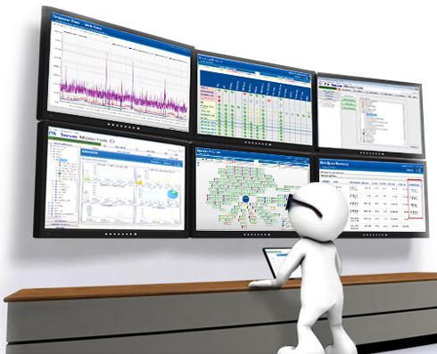
Control: Monitoring Success
Projects monitored quarterly for 2 years
POCA required if under target goal
Results shared annually with Senior Management
Projects continue to reach individual target goals 63%-83% of the time
2
Notes:
Chris

Slide 22
What employees are saying about LSS….
“…a methodical way to dig down on some of the intense problems and come up with practical and efficient solutions… eliminates random problem-solving... time commitment is difficult but worth it in the end. Decisions are easier to explain and since we listen to the voice of the customer they will also see that what we have implemented is most likely something they will favor… “ - Program Manager
“The lean Six Sigma program at Hillside is robust. Applying the concepts and using the tools in my everyday job as project manager, set the stage for gaining positive recognition from Hillside staff which allowed me growth opportunities at Hillside. “
-Project Manager
“…always looking at how we do the work we do, and opportunities for improving our processes.”
-Program Supervisor
“LSS has impacted the way in which I look at problems and inefficiencies. LSS has also given me the courage to speak up and vocalize when I see this occurring in hopes to make a change or a plan.”
-Program Supervisor
“… provided me with a framework that I use in my daily work to address process issues or initiate quality improvement projects. I love how you can start with a very complex problem and work it through the process and come out with a very successful solution. Staff that participate help develop the solution, so that in itself encourages buy in and long term success. “
-Executive Director
Notes:
Chris

Slide 23
What employees are saying about LSS….
“LSS is a model of quality improvement that has given me the ability to look at obstacles as opportunities for quality improvement, it gets you into an overall systems mindset. Typically if something isn’t working correctly, it’s not just one particular thing not working correctly, it’s likely a number of process steps (or missteps) that need to be identified. As a leader, looking at opportunities for improvement through the LSS lens allows me to get the whole picture. And I need the whole picture to ensure that the end product or service is quality. Because at the end of the day, I need to know that the service I am leading is making positive differences in the lives of those served.”
-Sr. Nurse Manager
“Lean Six Sigma has moved my confidence to a new level. I am able to take the lead on projects that sit outside my natural comfort zone. I also find I ask better questions when working to identify solutions for problems.
Organizations are looking for people who can solve problems. Being a Lean Six Sigma practitioner gives me a methodology and the tools to effectively do that.”
-Director
“…project management is a huge part of my role. After having participating in and contributing to 5 other peoples projects, it was clear that this was what I wanted to do for my continuous development. LSS has had a huge impact on my professional development in a space that I take great interest in and that is process improvement… I love streamlining systems and creating, implementing, and assessing standard operating procedures for increased efficiency and effectiveness at work….I love data. It tells the story and helps us to determine what improvements can be made. I am so excited to be a LSS candidate. I am always seeking to answer the question-‘How do we make things better?’. I believe that focusing on this question helps to improve the quality of experience for everyone and makes us that much more successful. “
-Operations Manager
Notes:
Chris

Slide 24
Training/ Resource Opportunities
Companies interested in helping employees obtain local Lean Six Sigma Belt certification training can visit:
Monroe Community College- Economic and Workforce Development Center
https://workforceforward.com/professional-development/
Rochester Institute for Technology-
https://www.rit.edu/processimprovement/overview-lean-six-sigma
Already a LSS Belt but would like to access LSS or other process improvement tools? Check out GRQC’s Resources webpage. Many process improvement tools are available for download from the site.
https://www.grqc.org/tools-and-templates
Notes:
Chris

Slide 25

Questions ??
Thank you for your interest in learning how a not-for-profit such as Hillside adopted Lean Six Sigma.
Lorynda Bender
Director of Quality & Risk Management
lbender@hillside.com
Notes:
Chris

