Slide 1
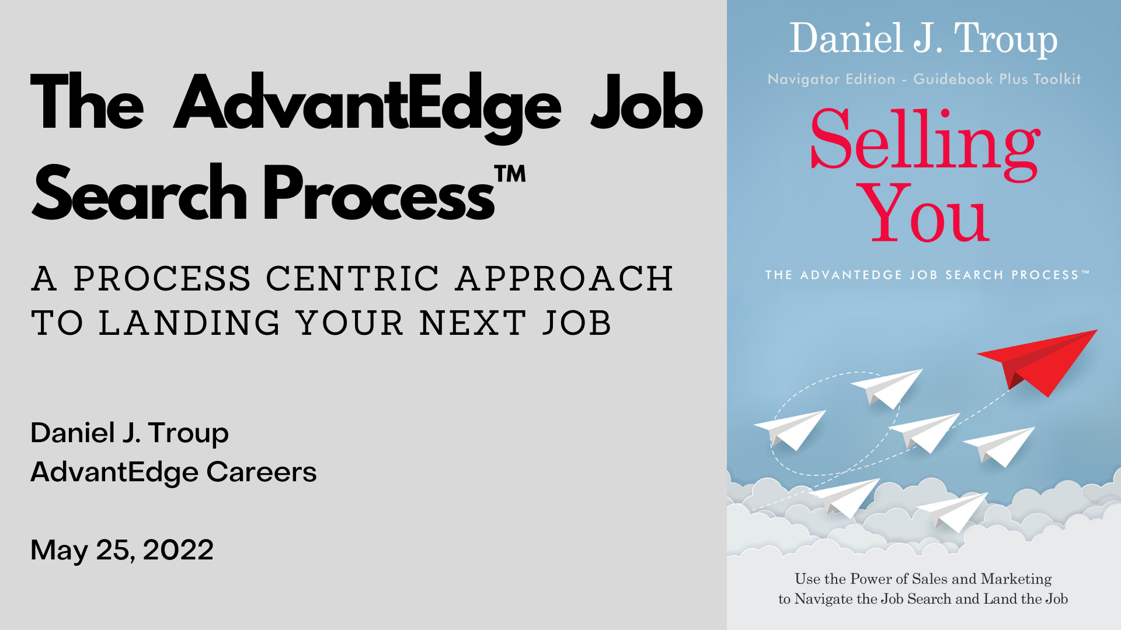

Slide 2

If Job Boards are Your Job Search…Switch to the Lottery
AdvantEdge Careers - 2
Notes:
If your primary job search strategy revolves around Indeed or LinkedIn or any of the other major job search boards, my recommendation is to just take your money and go buy a scratch off lottery ticket.
Job search technology today is both a blessing and a curse.
A blessing because job sites make applying for openings relatively quick and easy.
A curse because these job boards create the false impression that they represent the universe of all available jobs.
And most importantly, a curse because they allow us to take the path of least resistance.
It is far easier to sit behind a keyboard and submit job applications all day than it is to build a job search plan, research your targets, contact strangers, get out in the community, build a professional network and get referrals for the jobs you want.
The most successful sales reps understand that time is a precious resource. They plan each week understanding exactly where and how they will spend their selling time each day.
When it comes to your job search, you need to think like a sales rep and consider time as one of your most valuable assets.
Specifically to plan where and how are you going to invest the time that you have each day for your job search.
On average, every online job posting receives in excess of 250 applications. And of those 250, 220 are never seen by a human and eliminated automatically by applicant tracking software. 30 get seen by an HR professional for on average 6 to 10 seconds per resume. 10 get called in for a screening interview. 3 make the cut for 2nd round interviews. And 1 person gets the job.
Your odds of buying a winning scratch off ticket in the state lottery are better than getting an interview through an online job posting.
But, if you create a formal job search plan, take inventory of your talents, build a resume and LinkedIn profile and strategy around those talents and develop a professional network, your odds of winning the job search increase dramatically to somewhere approaching 1 in 2 or even better.
Add to that the fact that the Department of Labor estimates that fully 80% of jobs are filled without ever being advertised and the answer is clear.
You need to invest your job search time in a proactive strategy where you will get the greatest return on your investment.
I am not saying job boards are bad. The question is how much job search time do you spend applying online and what do you do with the rest of your day?
To use an analogy…
Do you want to spend all your time fishing in the pond where only 20% of the fish live?
Or do you want to take your boat and spend your time in the pond where 80% of the fish are swimming and just waiting for your hook?

Slide 3
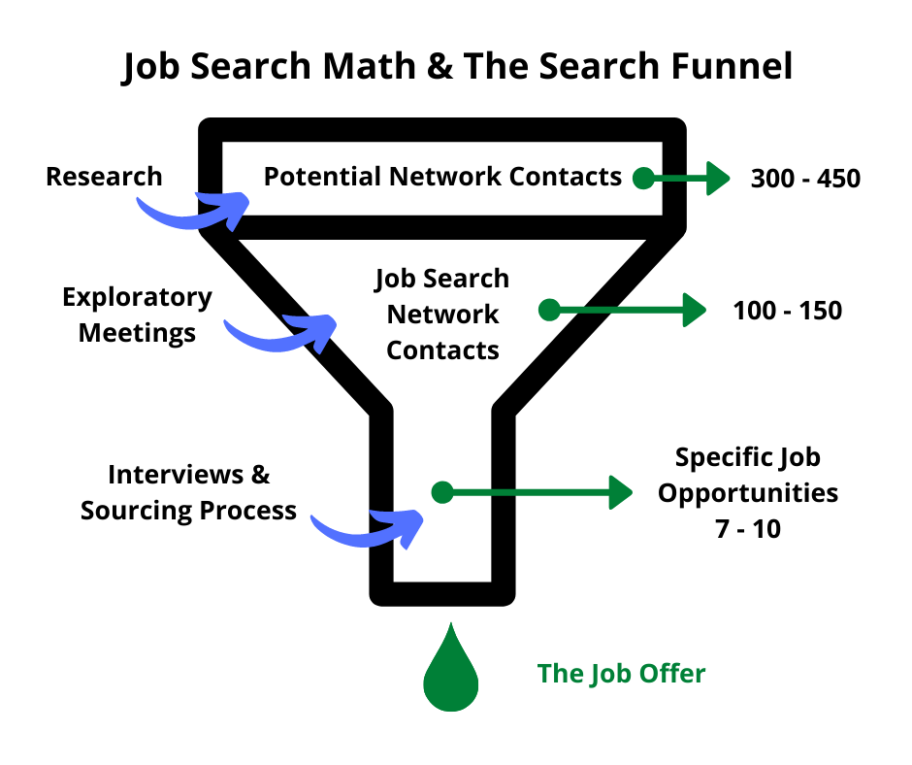
To Win the Job Search You Need a Sales Funnel
AdvantEdge Careers - 3
Notes:
Sales reps think about their business in terms of a funnel. They need lots of prospects at the top of the funnel. Not every prospect will want to buy so as potential customers move through the sales cycle, some drop out, the funnel narrows and at the bottom of the funnel out come the winning deals.
Your job search works the same way. It really is a numbers game.
One of the most important steps in your job search process is to build that professional network.
Think about that that network just like the sales rep looks at the prospect funnel.
Here is how your job search funnel will work.
On average…
You are going to need to identify somewhere between 300-450 potential network contacts.
These are not necessarily going to be your current connections. So if you look now at your LinkedIn connection count and see 500+, don’t sit back and relax.
These have to be people directly connected to the industries, companies and positions that you are targeting in your job search.
My rule of human nature is that a third to half of us are good and decent people open to helping and mentoring others.
So if done correctly, you will likely succeed in connecting with 100 to 150 of your targets through exploratory meetings and informal conversations.
That will put about 150 contacts in your corner and on your team and into your job search professional network.
150 professionals that know you, your value proposition and are on the lookout to refer you for job opportunities.
From that network, on average, you will secure approximately 7 to 10 job interviews
And with 7 to 10 interviews, if you have practiced and refined your interviewing skills, you will most likely secure that next job.
The numbers may seem large and intimidating but not when you break them down by month, week and day.
Remember that your job search can be a full time job all by itself.
If you are between jobs now, you should be dedicating at least 30 hours per week to the search for a full time job.
If you are employed today, then plan on an extra 10 hours per week for your job search process.

Slide 4




The AdvantEdge Job Search Process™
Process Centric with 4 Phases across 12 Steps
Personal Selling
Interview Preparation
Screening Interview
Hiring Manager Interview
Job Offer Evaluation & 1st 90 Days
Personal Networking
Job Search Network Funnel Development
Exploratory Meetings & Network Maintenance
Personal Branding
Elevator Pitch Development
Resume Development
Cover Letter Development
LinkedIn Profile Development & Engagement
Plan & Research
Action Plan Development
Target Position & Company Research
AdvantEdge Careers - 4
Notes:
Like many things in our lives, a successful job search strategy requires a process, discipline and dedicated focus.
I have developed the 12 step job search system on the foundational principles of winning sales strategies.
Think about your job search as a systematic progression across four key phases.
First comes the Plan and Research phase. Do not pass Go. Do not collect your $200 until you have a detailed job search plan in place.
Then comes Personal Branding. You should think of your brand as the image and message you present online and in person to potential employers. Your Personal Brand is what makes you different and unique and enables you to stand out from other job seekers with a compelling value proposition for a future employer. There are four essential components in the Personal Branding process: The Elevator Pitch, Resume, Cover Letter, and the LinkedIn profile.
Next comes Personal Networking. Your network is your very own public relations firm. Once established, the network will help market your brand to potential employers. There are two critical steps required to develop a robust professional network: Researching and Contacting Your Network and then Conducting Exploratory Meetings to lock in your network contacts.
And finally comes Personal Selling. The definition of Personal Selling in the job search process is interviewing. The interview process is where you get to “sell” the most important product in your portfolio, specifically yourself. With training and practice, you can excel at the two most important types of interviews: Screening Interviews and Hiring Manager Interviews.
The steps you take in each phase are logical building blocks for the work and activities you will complete in the subsequent phases of your job search. And across all three phases you have the constant of planning, research, practice and preparation.
What is critical here is the actual progression through the phases. I see too many prospects that immediately pass GO and proceed directly to: update my resume, apply to job on line, go to the interview without any preparation or referral. Then months go by without any job offers. They get frustrated, lose motivation and give up on the job search.
If you were trying to sell your house, would you put it on the market before it is fixed up and looking as good as possible? No. Same with your job search.

Slide 5

Complete Book + Toolkit + Videos: advantedgecareers.com
AdvantEdge Careers - 5
Notes:
If what I have shared with your briefly in the last few minutes makes sense and is of interest to you, I recommend that you check out my website at advantedgecareers.com.
There you will find a wide variety of resources to help you plan and execute your job search process.
Access to my book which walks you step by step through your job search, including detailed instructions and tools to use at each point along the way to the job offer
And a complete video series where I cover each step in the AdvantEdge job search process.
And beyond the book and video series, you can also schedule a no charge 1:1 consultation session with me. I would welcome the chance to connect.

Slide 6

Recruiter's Perspective on Job Search, Planning and Resumes...
Lynn Prytula – NuCareers & Lee Hecht Harrison (LHH)
Executive Career Coach & Personal Career Coach
Wednesday, May 25, 2022

Slide 7
Background
Career Coach with Lee Hecht Harrison and owns NuCareers Consulting.
Certified Career Coach and Branding Specialist with over 20 years of experience. Former Technical Recruiter.
Specializes in career coaching, resumes, cover letters, LinkedIn, salary negotiations for recent grads up to executives (all industries/disciplines).
BS degree from RIT in Electronics, Quality Management and Small Business Management.
Worked in multiple industries including manufacturing, optics, banking, academia and started a not for profit. Multinational to family owned.
No nonsense, direct and practical approach.
Connect with me on LinkedIn!! - linkedin.com/in/lynnprytula

Slide 8
Plan Your Work and Work Your Plan!
A job search is a project – Planning and tracking your progress is key!
Organization is a must! Chart progress/use calendar. Cloud storage.
Define career goal, job level, alternate job titles, radius & salary ranges.
Develop results driven resume with metrics that supports career goal.
Develop target list of 30-50 companies and multiple industries (3).
Track # submissions, # contacts, research, job salary ranges, dates, etc.
Develop 3-7 job search priorities weekly (action items/to do's). Do them!!
Must be actionable and measurable! This keeps you moving forward!
Networking groups/Job Search Work Team for accountability & support.
Talk to industry or company insiders, thru contacts or searching LinkedIn.

Slide 9
Resume Tips
Resume should not read like a job description!
Not just a laundry list of job tasks.
Copy and pasting lines from job description is a snoozer! Don't do it!
You are a product, what are your benefits or features you are selling?
Use industry terms/wording to support industries you are targeting...
Written to focus on where you want to go, NOT where you been...
Use > examples to support where you want to go, to type of job targeting.
List past 10 – 15 years of work experience.
Remove graduation date, use both degree title and acronym (BS, MBS, etc.).

Slide 10
Bullet Tips
Skills that you are trying to show you have/combined with an example.
Quantify (use metrics: $ # %) positive or anticipated outcomes or results.
Value added, how did it help? Customer, colleague, division or company.
Estimate even if you don't remember exact numbers (over, about, exceeding).
Use solid bullets for the Applicant Tracking Systems (ATS) scanning.
Tie a skill with example of how well you did it, use metrics! Examples:
Redesigned the production line increasing daily output by 2K units.
Developed a training program that led to a 35% reduction in errors.
No embedded tables. No indented bullets. No internet templates.
Define acronyms and put acronyms in () after 1st use, then alone later on.

Slide 11
Chapter Title Slide Layout
Christina Fraser, Employment Counselor
Christina.fraser@labor.ny.gov

Slide 12
Basic Slide Layout
CAREER PIVOTING
Making a career shift is the same process as job search – but with more reverse engineering.

Slide 13
Photo Slide 1 Layout
RESEARCHING FOR CAREER CHANGE
Labor Market Information from DOL includes occupational descriptions, alternative job titles, related positions, wages, outlook, and required skills and credentials.
  What is this occupation, and are there jobs out there?
Career Assessments about interests, transferable skills, work values, and work context
  What occupations might fit me, my experience, and my goals?
Business Research including using directories of businesses (from DOL, RBJ, industry sites etc) to track down potential employers and their websites
  Where could I work?
People Research – networking in person, on LinkedIn and other social media, industry publications, etc.
  Who does this work and where do they come from?
Notes:
www.onetonline.org
www.careeronestop.org
www.jobzone.ny.gov
https://statistics.labor.ny.gov/bdirector.shtm

Slide 14
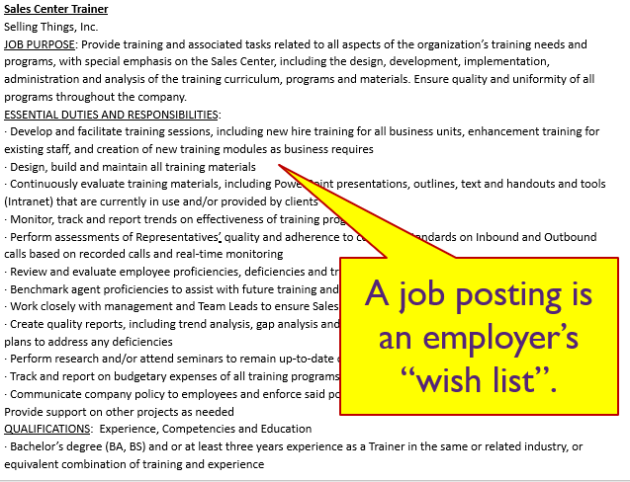
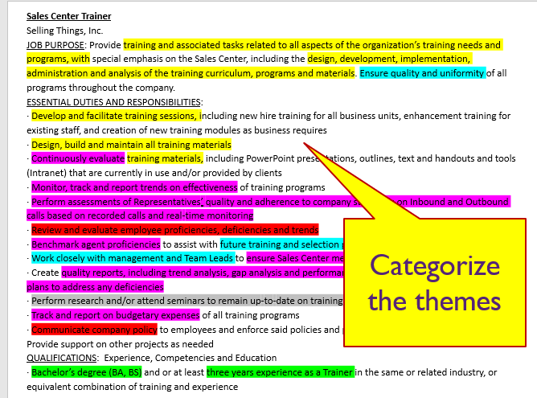
Bulleted Slide Layout
JOB POSTINGS FOR CAREER CHANGE

Slide 15
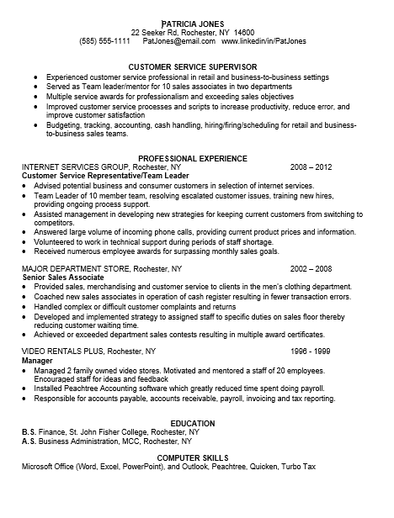
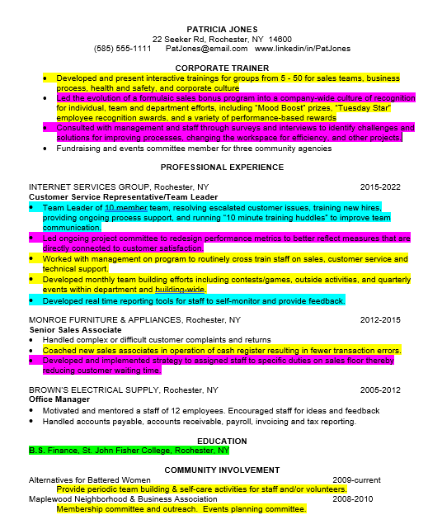
RESUMES FOR CAREER CHANGE
A traditional resume looks like the past
Your career change resume looks like your future!
And your cover letter CANNOT do this much heavy lifting

Slide 16
NETWORKING FOR CAREER CHANGE
Even the best career change resume & cover letter may not be enough
Refocus your LinkedIn profile to reflect as much of your career shift (of any size or direction) as you can safely do
Use your About section to talk about your broader goals and focus
Use your Activities on LI to reflect your new interests with or without substantive change of your profile
Join Groups on LI (or in real life!) and participate in discussions.
Find like-minded or potentially helpful humans and connect with them for 1-on-1s. Or just read their profiles to learn more.

Slide 17

NEW HORIZONS NETWORKING GROUP AND NETWORKING 101
Pete Chatfield

Slide 18
NEW HORIZONS BACKGROUND
Helping each other transition to the next phase of our lives
About the group
New Horizons Network is a network support group, founded in January 2003 by several downsized Xerox employees in the Rochester area. Meetings opened to anyone in 2005, in an effort to bring more diversity and resources to the group. New Horizons Network currently has 1500+ registered members.
New Horizons Network is committed to assisting people who are pursuing employment, primarily with Rochester area companies. This includes those out of work, about to be laid off, transitioning to a new career, interested in self-employment, retirement alternatives, volunteer opportunities or just refining networking skills.
Our Mission: 1) Help each other navigate the Separation / Retirement Process associated with being
’Liberated’ to ensure all resources are utilized to assure requirements and timelines are achieved for Medical, Financial and other pertinent benefits.
2) Provide help with transition skills and researching employment opportunities for Job seekers.
New Horizons Network provides a forum for assistance in the areas of Transition Skills [resume and elevator speech preparation, interviewing, networking, etc.] as well as self employment opportunities [eg. Franchising]. Subject matter experts are brought in to provide information on health insurance, investment decisions, etc.
New Horizons Network is not an employment agency. It utilizes its members and professional subject matter experts to facilitate the sharing and processing of information.

Slide 19
NEW HORIZONS NETWORK MEETINGS – OPEN TO ALL
Normally, the group meets every Tuesday in Penfield at The Episcopal Church Of The Incarnation, 1957 Five Mile Line Road, in the basement meeting room, with networking starting at 8:00 am and business starting at 8:30 AM. However, during the pandemic, meetings are every Tuesday starting at 8:30 AM on Zoom.
Meetings feature structured, attendee-driven discussions, allowing experience / expertise sharing. Weekly agenda sent to members Sunday evenings, has scheduled rotation of topics, including ‘LinkedIn Public Profile' and ‘Resume' reviews, ‘Open Discussion', as well as other transition skill topics of periodic interest to job seekers. Individual member attention / support is available as requested. Once ‘live’ in-person meetings resume, a one dollar per meeting donation is encouraged to help defray expenses, provide a donation to the church and offer scholarship assistance to those interested in taking a seminar or workshop to further their job search.
Become a Member! Attend a Meeting, provide your e-mail to Receive the Weekly Agenda.
Stay Connected!
When you move to your next career adventure, come back and tell us how you did it. Keep in touch. Continue the Mantra “Network for Life And Pay it Forward When You Can" by notifying us when you find opportunities of interest to others.
Questions? Contact Pete Chatfield at NHNowner@gmail.com

Slide 20
NETWORKING 101
Click below for a detailed outline of New Horizons group’s Networking 101 tips
https://4405d1a5-70b2-4605-b93a-865869279236.usrfiles.com/ugd/4405d1_e91e789501fa4a9faa0ba9fb1d5e7322.doc

