Slide 1


Therese Costich
The Costich Group
GRQC
Surfing the Tsunami of the Digital Transformation Journey
Notes:
Never will the pace of change be as fast as it is now and never will the pace be this slow again !!
This is not a passing storm after which we will return to a comfortable “normal”.
“You are rightly anxious about how quickly our existing business models are being disrupted. Still, if you’re anxious, imagine how the folks who aren’t in this room are feeling.” Canadian PM Justin Trudeau

Slide 2
Agenda
DEFINING DIGITAL DISRUPTION AND DIGITAL TRANSFORMATION
Process, People, and Technology
What are YOUR organization’s challenges ?
Common challenges and ways to overcome these challenges
Lessons learned from global iconic industrial leaders
"We are now faced with the fact that tomorrow is today. We are confronted with the fierce urgency of now."
- Martin Luther King Jr
Notes:
Discuss how data analytics plays a critical role in today’s business and in every industry from healthcare to financial services to manufacturing
Define the difference between “doing” digital vs “being” digital
Understand and define a Digital Transformation Journey
Introduce and learn how self-service analytics and interactive dashboards can help an organization drill down within seconds for RCA and better data driven decisions
Discuss how self-service analytics and interactive dashboards are critical tools to an organization’s digital transformation journey and being digital

Slide 3


What is Digital Transformation and
What is it Not?
IS
IS NOT
Creating digital platforms and data strategy to create a centralized, operational excellence umbrella
Simply moving files from analog to digital or replacing people / processes with robots and new technology
Notes:
IS
The process that surrounds an organization as it creates its digital platforms
Enabling and empowering employees to be more efficient and sufficient at making timely data-driven decisions
Linking data bases and data strategy to create a centralized, operational excellence umbrella
NOT
Simply moving files from analog to digital
Replacing people / processes with robots and new technology
Solely “owned” by the IT department – it is an organization-wide effort
Digital Transformation is a component of Disruption 4.0
Digital disruption describes various changes that impact technology markets and how they relate to (or impact) other markets.

Slide 4
3 Critical Components of a successful digital transformation journey
for Any Organization

Slide 5
3 Critical Components
Technology
Process
People
Any Organization
Any Industry

Slide 6

People
Notes:
A company’s culture is comprised of their people
Considered the most valuable asset of an organization
The right people with a clear vision of their digital transformation in leadership position
The skill set to develop and implement a digital transformation initiative

Slide 7


A study by Dell Computers found two of the key reasons for digital transformation initiatives failing are people-related. One is a lack of executive support, and the second is a lack of skills within the business to develop and execute on the digital strategy.
Notes:
A company’s culture is comprised of their people
Considered the most valuable asset of an organization
The right people with a clear vision of their digital transformation in leadership position
The skill set to develop and implement a digital transformation initiative

Slide 8

Process
Notes:
A complex component of the transformation effort
The way an organization “works”, goes to market, innovates, etc....to stay agile and be prepared for the next turn of events
Many organizations think "digital transformation" or "digitizing” their company is nothing more than throwing technology at their existing processes and automating processes across their business
The spirit of digital transformation is to improve existing or create new processes that are efficient and effective for a fast pace climate

Slide 9
Processes, coupled with the people component, need to be designed so that people work more effectively, make smarter decisions based on insights that available data provide, and utilize the right tools that enable them to be self-sufficient.
Notes:
A complex component of the transformation effort
The way an organization “works”, goes to market, innovates, etc....to stay agile and be prepared for the next turn of events
Many organizations think "digital transformation" or "digitizing” their company is nothing more than throwing technology at their existing processes and automating processes across their business
The spirit of digital transformation is to improve existing or create new processes that are efficient and effective for a fast pace climate

Slide 10

Technology
Notes:
Data Provides Clarity
Data Provides Efficacy
Data Provides an Insight into Innovation Pathways

Slide 11
Technology
Tailored technology supports, and is supported by an organization’s people and process thus creating a single point of truth
Notes:
- Linking all levels and disciplines
- Common language across organization
- Diverse collaborative teams
- Vendor portals for transparency
- Self-service and citizen’s analytics for
employee empowerment

Slide 12
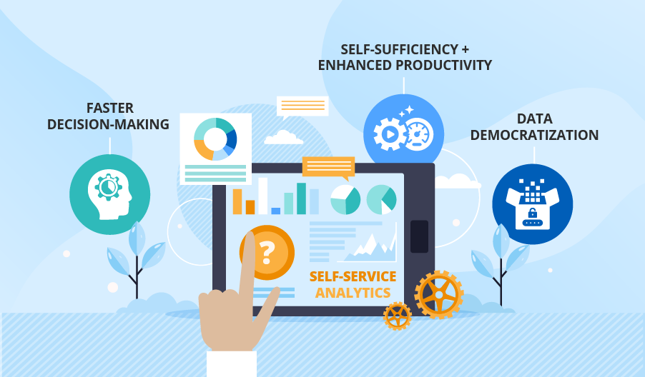
Opportunities For Companies To Redefine Their Organization
Technology
Process
People
“When it is obvious that the goals cannot be reached, don’t adjust the goal, adjust the action steps.” - Confucius
Notes:
A single, complete source of truth (synchronized data, with end-to-end governance)
Self-sufficiency (self-service analytics, citizen analytics, vendor portals, client transparency) is critical
Constantly innovating, and doing it in a way that customers care about
Aligned with strategic goals and objectives

Slide 13
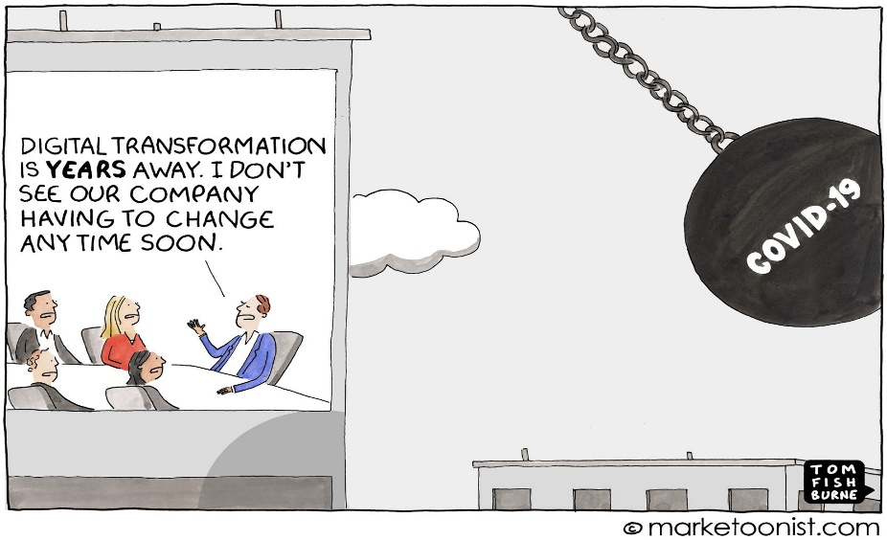
What are your organization’s
challenges
with digital transformation?

Slide 14





Common Challenges Regardless of the Industry
ORG-WIDE
DIGI. TRANS STRATEGY & OWNERSHIP
LEADERSHIP
TECHNOLOGY
CULTURE
CONFLICTING PRIORITIES

Slide 15







Lessons Learned From Others
Best Buy
Coca-Cola Germany
Canadian Financial Institution
Cedars-Sinai Medical Center
Jefferson Health
Gorbel
McDonald’s
Notes:
BestBuy - Technology, Leadership Vision and "Digital" Customer Focus
CC Germany – centralized their reporting systems and analytics for entire org regardless of functional group, Technology and Culture buy-in key to digital transformation success, push reporting process to a pull reporting process via self-service and citizen analytics
Canadian Fin Institute - Company Culture and 100% Leadership Support
Cedars-Sinai – self-service model for analytics and reporting, org culture

Slide 16
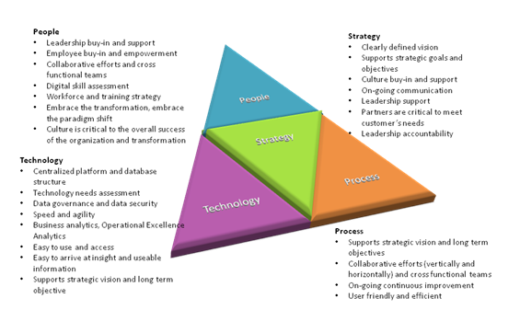
Overcoming the Challenges
Leadership support, buy-in, and shared vision tying back to strategic objectives and operational excellence umbrella
People, process, technology interaction…. understand legacy systems and the impact to the people and process
Collaborative effort across the organization and empower employees via self-service analytics
“Digital” customer centric
Communicate, communicate, communicate….everything
Notes:
BestBuy - Technology, Leadership Vision and "Digital" Customer Focus
CC Germany – centralized their reporting systems and analytics for entire org regardless of functional group, Technology and Culture buy-in key to digital transformation success, push reporting process to a pull reporting process via self-service and citizen analytics
Canadian Fin Institute - Company Culture and 100% Leadership Support
Cedars-Sinai – self-service model for analytics and reporting, org culture

Slide 17
Initial Steps to a Successful Digital Transformation
Establish a Strategic Vision and Team to lead the transformation.
Identify your organization’s Current State in terms of People, Process, Technology and Infrastructure.
Determine your organization’s Ideal State in terms of People, Process, Technology and Infrastructure.
Gap and Bridge Analysis of Current and Ideal States.
Develop a transformation plan.
Communicate, communicate, communicate, etc.

Slide 18
“In today's world of digital disruption, it is not enough for organizations to merely be ‘up-to-date’. They need to be ahead of the curve and embrace the future before it even comes. Forward thinking, risk-taking, staying on the offense of decision making, and being resilient to always think bigger of what is possible will be the organizations who are leaders in the global industries.”
- Excelling on a digital transformation journey - A field guide that will help you define your success

Slide 19

Defining Terms
  Doing vs. Being
    Doing – to participate in or execute an activity
    Being – a way of existing
Notes:
Doing – to perform an act or duty; to execute a piece or amount of work
Being – the fact of existing; existence; a living thing

Slide 20
Defining Terms
  Doing vs. Being
    Doing – to participate in or execute an activity
    Being – a way of existing
  Change vs. Transformation
    Change - incremental differences made over time to an existing process
    Transformation – a radical rethinking and reconstitution of an existing process, almost always large and significant.
Notes:
Change - can be small and incremental, or it can be large and complex; it is something that needs to be constantly monitored and maintained. A conscious external effort is needed to maintain the actions required to achieve the desired result.
Transformation - almost always large and significant. Transformation is an internal fundamental change in your beliefs of why you perform certain actions. Transformation does not require any external influence to maintain because of its fundamental nature.

Slide 21
Defining Terms
  Doing vs. Being
    Doing – to participate in or execute an activity
    Being – a way of existing
  Change vs. Transformation
    Change - incremental differences made over time to an existing process
    Transformation – a radical rethinking and reconstitution of an existing process, almost always large and significant.
  Change starts from the same mental framework and looks for incremental improvements.
  Transformation requires a base paradigm shift, and leads radical improvements
Notes:
Change uses external influences to modify actions, but Transformation modifies beliefs so actions become natural and thereby achieve the desired result.
Change - can be small and incremental, or it can be large and complex; it is something that needs to be constantly monitored and maintained. A conscious external effort is needed to maintain the actions required to achieve the desired result.
Transformation - almost always large and significant. Transformation is an internal fundamental change in your beliefs of why you perform certain actions. Transformation does not require any external influence to maintain because of its fundamental nature.

Slide 22

How to “Transform” by “Being”
Embrace a Paradigm Shift
Have the clarity of your Current State, AND the vision to think BIGGER about the possible for your Ideal State
Democratize, Delegate and Empower everywhere you can
Speed and agility are critical to the future of organizations
Notes:
The companies that will survive moving forward are those that have clarity and vision of their future; have the courage to embrace the data and leverage technology and opportunities to stay on the "offense"; be decisive in this digital disruption; and finally, be resilient to think Bigger of what is Possible.
To survive in this fast pace world, an organization must “Be Digital” – this is what CC Germany did and others who are dominate in their field
Paradigm Shift
Be fluent
Part of your DNA, fabric
Don’t just throw technology at it
Have the courage to embrace the data and leverage technology and opportunities to stay on the "offense";
What is your current state and what do you want your ideal state to look like
Be resilient to think BIGGER of what is possible
Get as close to the consumer and decision point as possible
The center of gravity is moving closer and closer to the consumer

Slide 23
The REAL question isn’t
“what will happen if we pivot digitally?” but rather
“what will happen if we DON’T ?”
Notes:
The companies that will survive moving forward are those that have clarity and vision of their future; have the courage to embrace the data and leverage technology and opportunities to stay on the "offense"; be decisive in this digital disruption; and finally, be resilient to think Bigger of what is Possible.
To survive in this fast pace world, an organization must “Be Digital” – this is what CC Germany did and others who are dominate in their field
Paradigm Shift
Be fluent
Part of your DNA, fabric
Don’t just throw technology at it
Have the courage to embrace the data and leverage technology and opportunities to stay on the "offense";
What is your current state and what do you want your ideal state to look like
Be resilient to think BIGGER of what is possible
Get as close to the consumer and decision point as possible

Slide 24

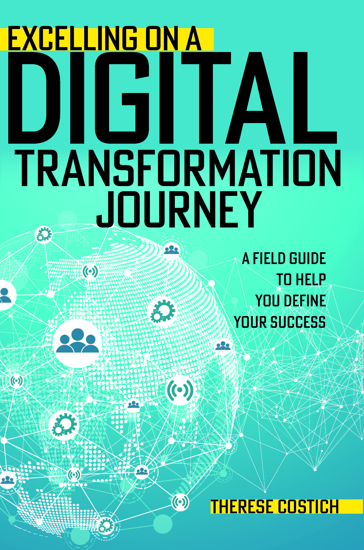

Therese Costich
President and Managing Partner of The Costich Group
Has 25+ years experience in Digital Transformation, Lean Six Sigma and Continuous Improvement working for companies including General Electric, Ford Motor, DuPont, Dominion Energies, L3-Harris Corporation, Lenovo, Merck Pharmaceuticals, Bausch & Lomb, Salient Management Company and Syracuse University
Uses her expertise in operational excellence, business analytics and digital transformation to guide organizations to be leaders in their industry while sustaining continuous improvement and transforming their businesses to world class
Author of Excelling on a Digital Transformation Journey - A Field Guide That Will Help You Define Your Success (available on Amazon and ASQ.org)
Co-author and project manager of The Black Belt Memory Jogger - A Pocket Guide for Six Sigma Success, First Edition
Microelectronic Engineering, BS - Rochester Institute of Technology
Finance and International Business, MBA – University of Rochester, Simon School of Business
Email – therese@costichgroup.com
Phone – 585-314-1579

