Slide 1
Michael Caceci
GRQC Performance Excellence Forum
Using Qualitative Data to Supplement
Quantitative Data in Telling a Story
February 27, 2024

Slide 2
Market Research Basics:
  Primary data
    Information collected for the first time
    Collected from a sample population for specific uses
    Collection methods: qualitative &/or quantitative
    Generally, more expensive & time consuming to gather
    Advantage: specific to needs of a firm & within its control
  Secondary data
    Data that already exists, often collected by market research firms, industry associations, government agencies, etc.
    Can be data from previous internal primary market research.
    Useful, but with limitations
    Can offer a no or low-cost option compared to primary data collection

Slide 3

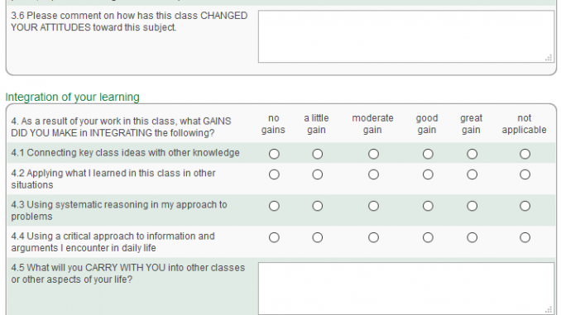
Market Research Basics:
Qualitative research:
  Focus groups: facilitated group interviews
  One-on-one meetings / interviews
  Write-in comments on surveys
  Observational research
  Open-ended questions on surveys
Quantitative research:
  Surveys
  Close-ended & scaled response questions

Slide 4
The Physics of Market Research
Physics:
  The act of measuring a physical property will change its position.
Marketing:
  The act of collecting data can affect human behavior
    People respond differently if they know they are being observed.
    Data collection methods should de designed to minimize or eliminate this effect.

Slide 5
The Internet & Data Collection
Anonymous
Quick
24/7 - in real time.
Observe what people actually do vs. what they say they do.
Large samples at lower cost
Software & AI: create, administer & analyze results

Slide 6

Traditional Market Research Example:
XBS Total Satisfaction Guarantee
  Qualitative: focus groups in four US cities
  Quantitative: surveys mailed to 200+ customers
Responses organized & analyzed to inform:
  “Go-no go” decision
  Specific guarantee language
  Contracts: addendums and new contract T&Cs
  Marketing and Promotion strategy
  Train, educate & ‘calm’ the XBS sales force

Slide 7
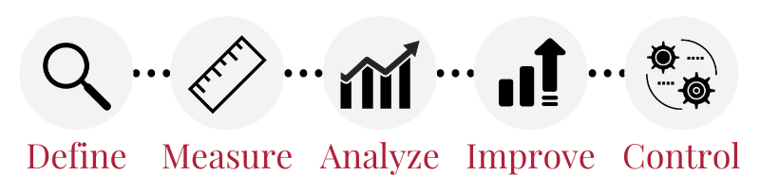
Lean & Six Sigma / Project Management:
Examples of qualitative data collection:
  Go to the Gemba
  Walk the process
  Observation: in-person or videos of work processes
  Focus groups / brainstorming sessions
Quantitative Data collection:
  Surveys
  Checklists
  Sampling

Slide 8
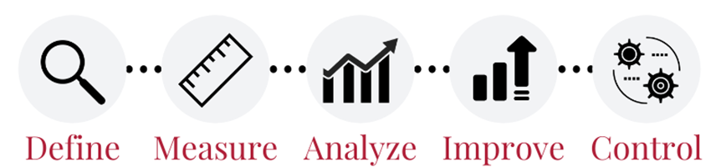
Lean & Six Sigma / Project Management:
  Primary data
    Often required across the DMAIC phases of LSS Project Management
  Secondary data
    Can be beneficial for benchmarking, setting goals, etc.

Slide 9
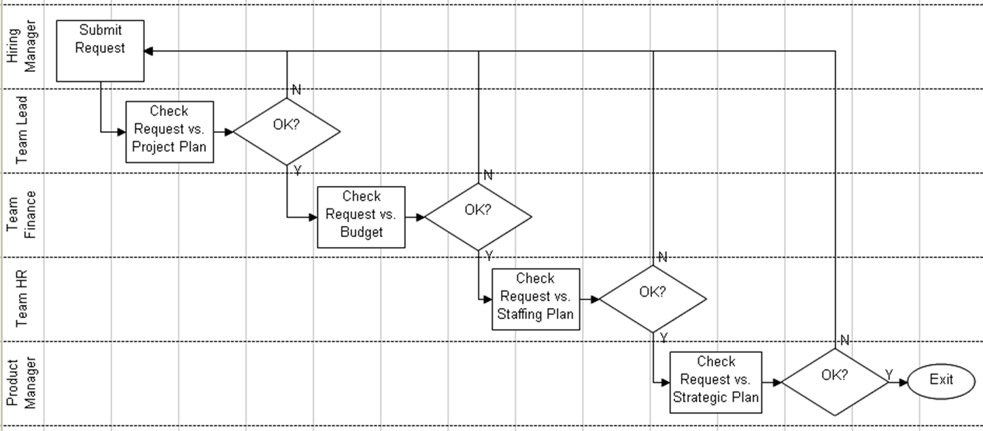
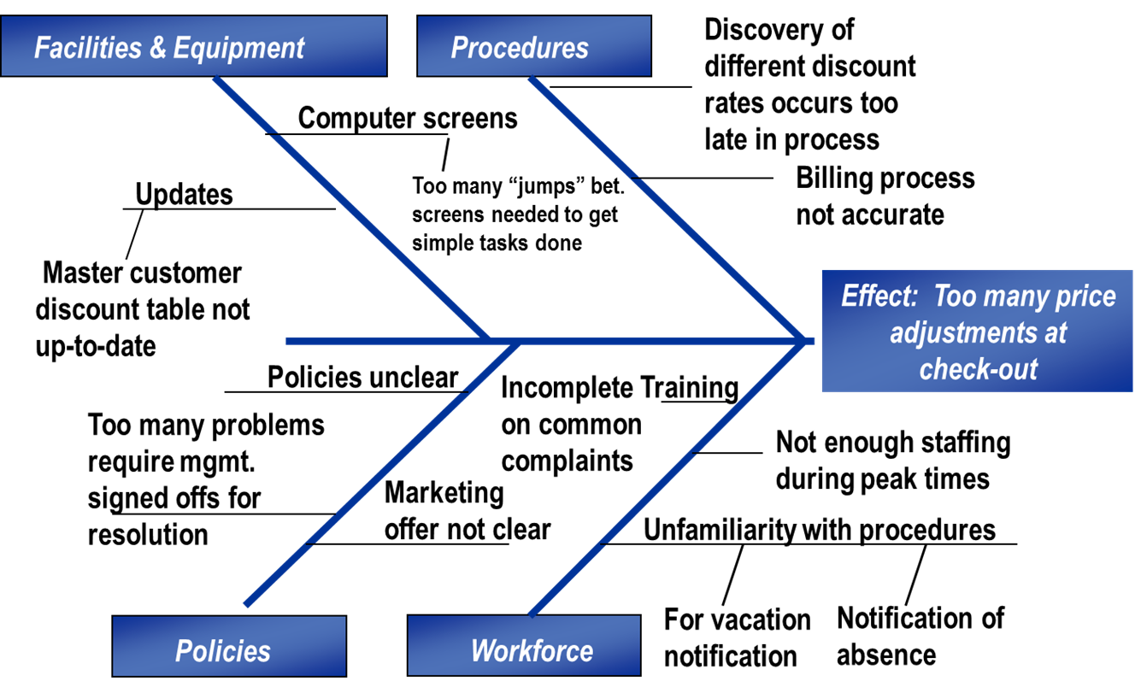
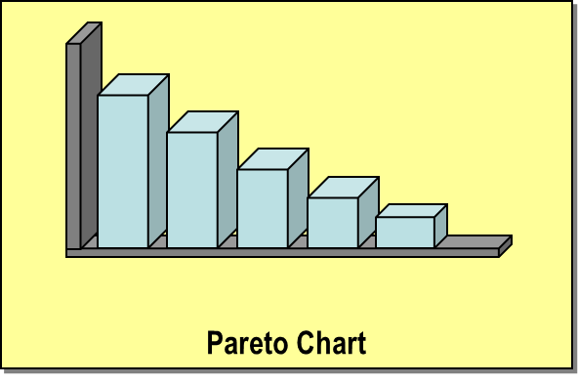
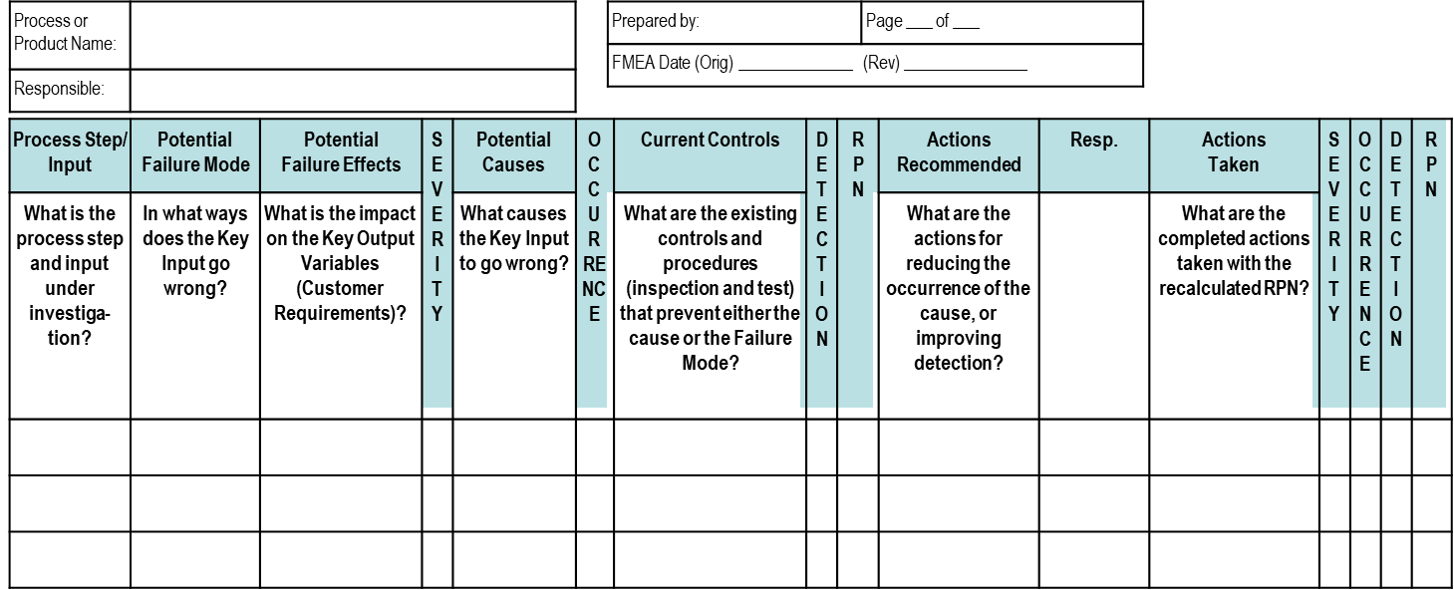
Lean & Six Sigma / Project Management:
Qualitative data uses:
  Process mapping
  Pareto charts
  Affinity Diagrams
  C&E Fishbone
  FMEA

Slide 10

Anurag Khare
GRQC Performance Excellence Forum
Using Qualitative Data to Supplement
Quantitative Data in Telling a Story
February 27, 2024

Slide 11
Context Setting
Data, the fuel of the digital age, exists in two primary forms: structured and unstructured.
Current Landscape
Data Explosion
Dominance of Unstructured
Hidden potential
Security and Privacy concerns
Future Trends
Convergence
Focus on insights
Democratization of data
AI/ML dominance
Real-time insights

Slide 12
Side by side comparison of structured and unstructured data
Category | Growth Rate (%) | Volume (% of total data) | Processing Tools | Examples
Structured | 10 | 20 | Traditional databases & analytics | Customer databases, sensor data, transaction records
Unstructured | 80 | 80 | NLP, ML, big data platforms | Social media posts, emails, images, videos

Slide 13
Key takeaways
Both structured and unstructured data are valuable, but require different approaches.
The future lies in integrating and analyzing both for comprehensive insights.
AI and ML will be key drivers of data analysis and unlocking its potential.
Ethical considerations and responsible data governance will be crucial.

Slide 14
Case study: Early sepsis detection (Bayesian health)
Use case: Bayesian Health's AI platform, analyzes various patient data
Result:
Type of data used:
5.7 hrs Lead Time: earlier detection on the most severe sepsis cases | 89%Adoption: frontline user adoption over 2+ years | 18.2% Mortality: relative reduction in sepsis mortality
Structured | Unstructured
Vital signs: Vital signs like heart rate, respiratory rate, temperature, and blood pressure etc Laboratory data: Various blood tests and other laboratory measures, such as white blood cell count, C-reactive protein (CRP), and lactate levels etc Demographic data: Demographic details like age, gender, and comorbidities | EHR Electronic health records (EHRs) containing clinical notes, discharge summaries Sensor data: Continuous monitoring of vital signs etc. through wearable devices or bedside monitors provide real-time insights into patient status. Imaging data: Chest X-rays and other imaging studies

