Slide 1
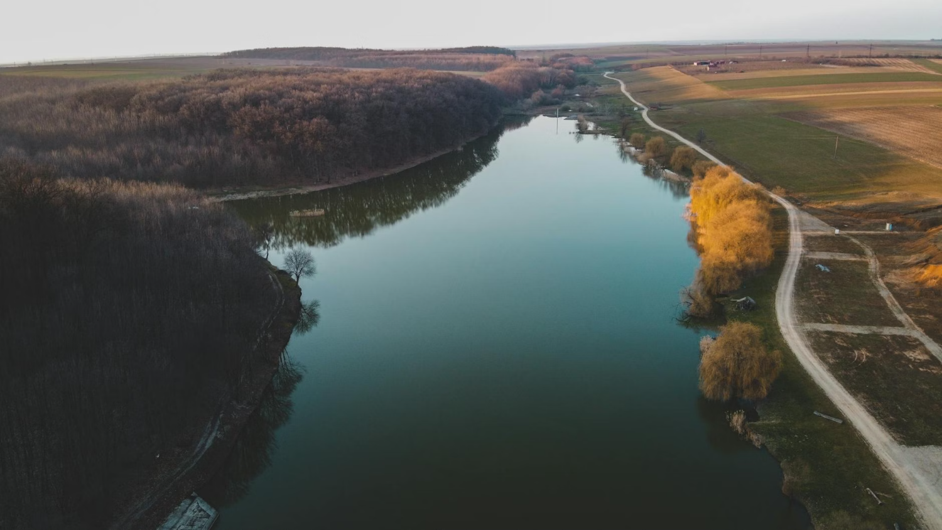
Deep & Calm:
Navigating the River of Change
Gerianne Puskas, MBA, CFRE, CNPM
Mission Advancement Group, LLC
Make Hope Happen.

Slide 2

Close your eyes for just a moment.
Picture the river you are leading from right now.
TURBULENT AND SHALLOW
DEEP AND CALM
Leading with intention
Decisions made with clarity
Longer view even in the storm
A stabilizing force for others
Sustainable over the long haul
Reacting, not responding
Decisions made under pressure
Short horizon thinking
Eroding trust without meaning to
Exhausting to lead from
The river moves either way.
The choice is which leader you are while you are in it.
Notes:
4 minutes. Invite the chat: 'Which river are you in right now? Drop it in the chat.' Read a few responses. Acknowledge without judgment. 'That is exactly where we are starting. Thank you for being honest. Let's get to work.'

Slide 3
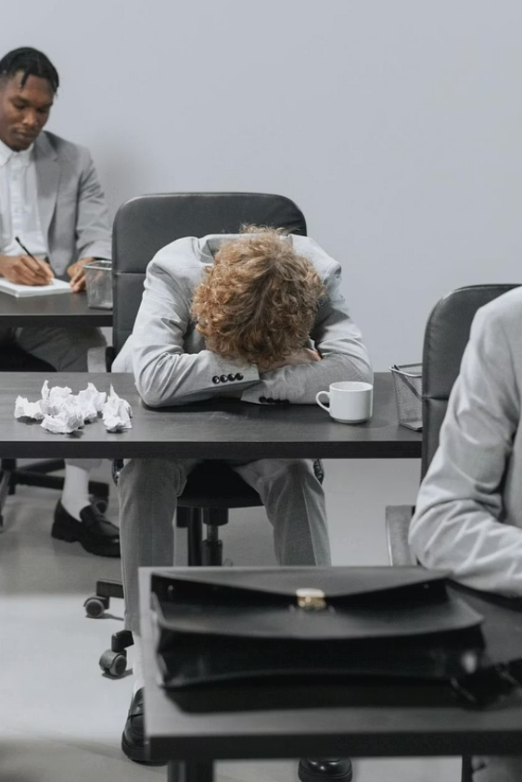
Why This Matters Now
45%
Experiencing Burnout
of social sector employees report experiencing burnout (Nonprofit HR, 2022)
48%
Likely to Leave
are likely to leave their organization within two years (Nonprofit HR, 2022)
This is not a wellness conversation. It is a strategy conversation.
Notes:
2 minutes. Whether your audience leads a nonprofit or a business, the biology is the same. Your most important leadership tool is your brain, and chronic stress is quietly degrading it.

Slide 4
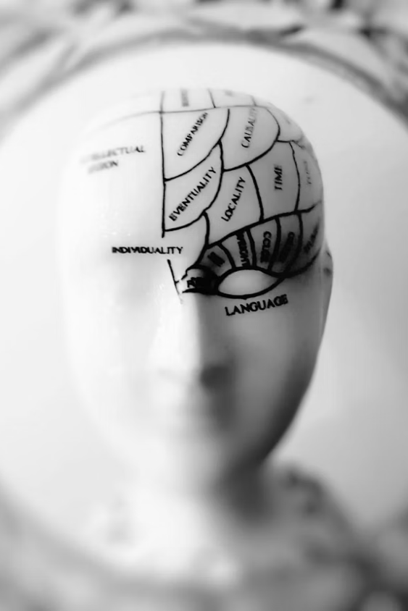
What Chronic Stress Does to Your Leadership
HPA Axis Activation
Prefrontal Cortex Goes Offline
Your stress response was designed for short bursts. When it never fully switches off, it begins to damage the systems it was built to protect.
Chronic stress takes your prefrontal cortex offline. This is where empathy, strategic thinking, sound judgment, and relational capacity live.
Allostatic Load
The cumulative physical cost of sustained stress. It shows up as degraded decision-making, reduced emotional availability, and diminished cognitive performance.
This is not a character flaw. It is biology.
Notes:
3 minutes. They already read the research foundation before coming in, so they know HPA axis, prefrontal cortex, and allostatic load by name. This is confirmation and visual anchoring, not a lesson. Move through it briskly: 'You read why this matters. Here is what it looks like in your leadership.'

Slide 5
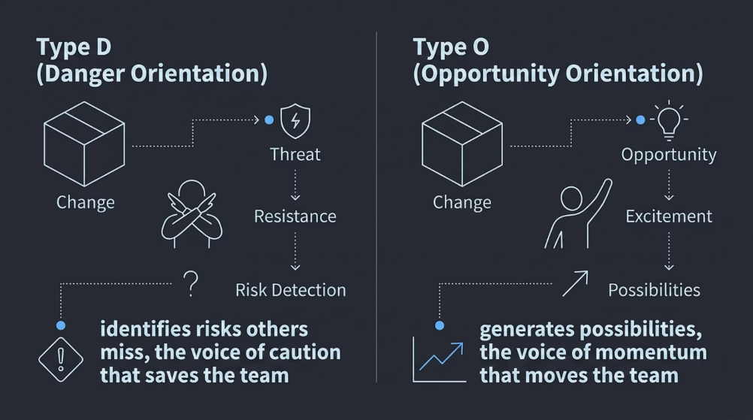

Get to Know Your Change Orientation: D vs. O
Neither type is better. Teams need both. This is self-awareness, not judgment.
Notes:
4 minutes. Quick chat drop: 'Type D or O, which feels more like you?' Affirm both. 'D-types catch what O-types miss, and vice versa.' This is the lens they will use when they look at their dimension scores in a moment. 'Keep your type in mind as we look at your results.'

Slide 6

Four Dimensions of Resilience Capacity
Psychological
Thought patterns, reframing, relationship to uncertainty
Emotional
Self-regulation, emotional availability, recovery time
Physical
Energy management, sustainable pace, recovery systems
Community
Connection, support systems, belonging and trust
Notes:
2 minutes. Quick orientation before the debrief. 'You have scores across all four of these. And you now have a D/O orientation, while it does not determine your scores, it does shape how stress shows up for you when your capacity is depleted. A D-type in the red tends to go quiet and brace. An O-type in the red tends to keep moving and ignore signals. Same low score, different expression.
Another example: Physical resilience.
A D-type with a low physical score tends to deplete through hypervigilance. They are always monitoring for what could go wrong, which keeps the nervous system activated even when nothing is actively happening. They are tired because they never fully come off alert. Their depletion is quiet and chronic.
An O-type with the same low score depletes through overcommitment. They say yes to everything because it all feels exciting and possible, they underestimate how much they are carrying, and they hit a wall they genuinely did not see coming. Their depletion is fast and surprising.
Same score on the assessment. Completely different path to get there. Completely different recovery strategy needed.
That is the value of the layer. It does not change the number, but it tells you something important about the why behind it, and it makes the strategies feel personally relevant rather than generic. A D-type needs to learn to come off alert. An O-type needs to learn to audit their yeses before they are depleted, not after.

Slide 7
Let's talk about what you discovered.
20–40
41–60
Turbulent and Shallow
Moving Current
61–80
81–100
Deepening
Deep and Calm
Drop your overall zone in the chat. Which dimension scored lowest? Does your D/O orientation show up in that pattern?
Notes:
5 minutes. Community moment. People see they are not alone. Normalize all four zones. Connect D/O: 'Notice whether your orientation shows up in which dimension is lowest. D-types often score lower on psychological resilience. O-types often underestimate physical depletion.' Then: 'Now let's talk about what to do about it.'

Slide 8
Psychological Resilience
Thought patterns | Reframing capacity | Relationship to uncertainty Score: ___ / 25
The Three-Step Reframe
Set Your True North Daily
Practice Both/And Thinking
When a stress-driven thought hits:
Each morning, name the one outcome most connected to your mission or your people. Use it as a decision filter. When the current gets strong and everything feels urgent, come back to: does this move us toward or away from that? That is your compass.
Psychological resilience is not optimism. It is flexibility. When you face an ambiguous situation, deliberately generate two possible outcomes instead of one. This is not pretending things are fine. It is refusing to let one interpretation close all the doors.
Challenge it. Is this objectively true, or a stress assumption?
Replace the language. 'Challenge' instead of 'threat.' 'Learning' instead of 'failure.'
Reframe toward what is possible. Name one thing you can still influence.
Notes:
3 minutes. Ask who scored lowest here. Normalize catastrophizing and all-or-nothing thinking under stress. The prefrontal cortex is offline. That is why these patterns show up. Now let's rebuild the pathway.

Slide 9
Emotional Resilience
Self-regulation | Emotional availability | Recovery time Score: ___ / 25
Know Your Stress Signals
Name It to Tame It
Build Micro-Recoveries In
Before stress reaches your team, it shows up in your body. Shorter sentences. Tighter shoulders. Less patience. Faster pace. Learn your personal early warning system. Catching it early gives you a choice about what happens next. That is the whole game.
Research by Daniel Siegel shows that labeling an emotion reduces its intensity by calming the amygdala. Try: 'I notice I am feeling...' instead of spiraling into the feeling. This is a skill, not a personality trait. You can build it.
Recovery does not happen on vacation. It happens in the 10-minute walk, the lunch you actually take, the meeting you end 5 minutes early. Schedule at least one intentional micro-recovery every day. Put it on the calendar like a meeting. It is one.
Notes:
3 minutes. The amygdala labeling research is powerful and often new to this audience. It validates that naming feelings is not soft. It is neuroscience. Connect to the HPA axis slide: this is how you interrupt the cycle.

Slide 10
Physical Resilience
Energy management | Sustainable pace | Recovery systems Score: ___ / 25
Sleep Is a Leadership Decision
Move to Reset, Not to Perform
Audit Your Unsustainable Yeses
Sleep deprivation at 17 to 19 hours produces cognitive impairment equivalent to a blood alcohol level of .05. This is not a metaphor. Protecting your sleep is not self-indulgence. It is protecting your judgment, your empathy, and your ability to lead.
Even a 10-minute walk breaks the cortisol cycle and partially restores prefrontal cortex function. Movement is not a reward for finishing. It is a strategy for leading well. Schedule it like the strategy session it actually is.
List three things you are currently doing that deplete without replenishing. For each one: can it be delegated, delayed, or dropped? Sustainable pace is not a personality type. It is a leadership practice. It is also the thing that keeps you in the river long enough to carve canyons.
Notes:
3 minutes. The sleep research stat lands every time. Physical resilience tends to score lowest. Leaders in this audience have been trained to treat depletion as a badge of honor. Reframe it as a strategy failure.

Slide 11
Community Resilience
Connection | Support systems | Belonging and trust within teams Score: ___ / 25
Name One Trusted Relationship
Connection Before Task
Model the Ask
Ask one team member a non-task question this week. Not 'how is the project going' but 'how are you actually doing?' Amy Edmondson's research on psychological safety is clear: connection does not follow performance. It precedes it.
The fastest way to create permission for your team to be honest is to be honest yourself. The next time you are unsure, say so out loud. 'I am still working through this' is not weakness. It is exactly the kind of leadership that earns trust when the water gets rough.
If you cannot name one person at work you can be genuinely honest with, that is your first action item. Psychological safety does not just happen. It is built through small, consistent moments of honest exchange. Start with one person. Go first.
Notes:
3 minutes. Community resilience is often the most underrated. Leaders are trained to project certainty. Reframe vulnerability as a leadership strategy. Edmondson and Brown are your research anchors here.

Slide 12



A Tool You Can Use Tomorrow: The Three-Step Reframe
1, CHALLENGE
2, REPLACE
3, REFRAME
Is this thought objectively true, or is it a stress assumption? All-or-nothing thinking. Self-blame. Catastrophizing. Dismissing what is going well. Ask: what is actually true right now?
Swap the language intentionally. 'Challenge' instead of 'threat.' 'Learning curve' instead of 'failure.' 'Figuring it out' instead of 'struggling.' Words signal your nervous system.
Find the objective view and the possibility. What can you still influence? What is one thing that is going right, even now? Viktor Frankl: even in the hardest circumstances, we can choose our response.
Grounded in positive psychology research by Martin Seligman and Barbara Fredrickson.
Notes:
4 minutes. Walk through a real example. Ask if anyone has a situation they could apply this to right now. This is the 'strategy you can use the very next day' you promised in the session description.

Slide 13
Your 30-Day Commitment
Use this reflection to anchor your next step. Be specific, vague intentions don't survive the current.
1
My Strongest Dimension
My strongest resilience dimension right now is:
2
The Dimension to Strengthen
The dimension I most need to strengthen is:
3
My One Specific Action
My one specific 30-day action is:
4
My Accountability Partner
I will ask this person for support or accountability:
5
How I'll Know I'm Progressing
I will know I am making progress when:
Notes:
3 minutes. Give 90 seconds of quiet writing time. Then invite 2 to 3 people to share what they wrote in the chat. This is where the session lands in the body.

Slide 14

Your Questions
What are you taking into the river with you?
We'd love to hear your reflections, questions, and commitments. This is your space to process, connect, and carry something meaningful forward.
Notes:
3 minutes. Give 90 seconds of quiet writing time. Then invite 2 to 3 people to share what they wrote in the chat. This is where the session lands in the body.

Slide 15

"
The river is moving. It always will be.
The question is where you choose to lead from.
Choose deep and calm.
missionadvancementgroup.com
Notes:
15 minutes Q&A. Open with: 'What are you taking into the river with you today?' Then open the floor.

