Slide 1

GRQC Healthcare Forum
Safety in the Workplace

Slide 2

UPCOMING EVENTS
Performance Excellence Forums
  Wednesday, December 17, 12-1 pm. ” From Continuous Improvement to Continuous Reinvention: The Next Frontier of Process Excellence”, Yoni Stern
  Wednesday, January 28, 12-1 pm. ”Scaling Succession Planning at Excellus”, Tim Lippincott
Quality for Leaders
  January 8-29, four live half-day sessions at MCC. Instructor: Cheryl Adas
Holiday Networking Event. Thursday, January 15, 2026, 5-7 pm. Flight Wine Bar
PEN Webinars
  Thursday, December 11, 9-10 am. “Managing Stress, Conquering Burnout, Igniting Leadership”
Visit www.grqc.org for more information and to register

Slide 3
GRQC Healthcare Forum
Safety in the Workplace
12:00 – 12:05 pm Welcome and background for today’s forum
  Robert Panzer, MD, GRQC Healthcare Committee Chair, Professor, URMC
12:05 – 1:05 pm Speakers, Bios and Topics to be Covered
  Tim Tull MBA CEM-IAEM Vice President of Safety, Security and Emergency Preparedness, RRH
    Topic: The Rochester Regional Health Peace Officer Program
  Joe Hayflinger – Captain and Commanding Officer of Public Safety, URMC
    Topic: URMC Safety and Security Initiatives
  Barbara Williams MS – Director of Crisis Specialist Team, Department of Psychiatry, URMC.
    Topic: De-escalation
  Jaclyn Wilmarth RN MS – Associate Healthcare Safety Officer, URMC
    Topics: Violence Risk Assessment Tool(s): A Workplace Safety Initiative
    Psychological Safety: How To Support Staff When Bad Things Happen
1:05 – 1:30 pm Panel Discussion, Q&A

Slide 4
GRQC Healthcare Committee
Forum planning subgroup and panel discussion moderators
  Kristin Dobranski, RRH
  Jan Schriefer, URM
  Tina Sosa, URM
  Meghan Train, URM
  Helen Vanderlan, URM
Other committee members
  Jeffrey Allen, RRH
  Kiera Kuhn, URM
  Amiee Story, RRH
  Joseph Vasile, RRH
  Marielena Velez de Brown, MCHD

Slide 5
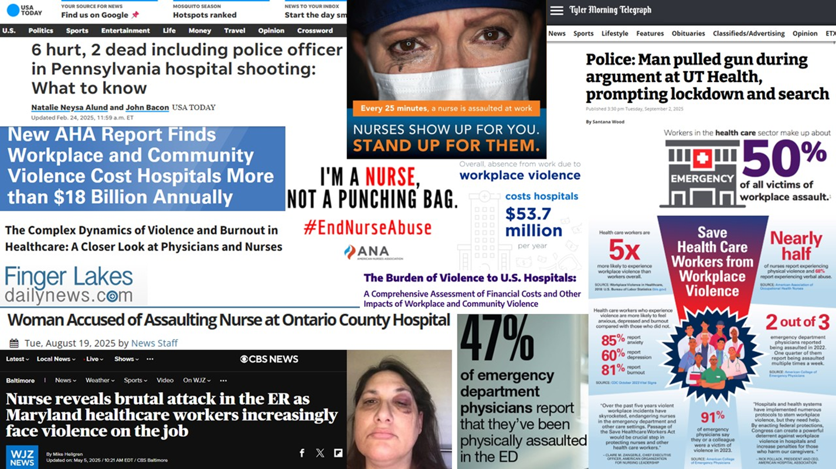
Workplace Violence

Slide 6
GRQC Healthcare Forum
Safety in the Workplace
12:00 – 12:05 pm Welcome and background for today’s forum
  Robert Panzer, MD, GRQC Healthcare Committee Chair, Professor, URMC
12:05 – 1:05 pm Speakers, Bios and Topics to be Covered
  Tim Tull MBA CEM-IAEM Vice President of Safety, Security and Emergency Preparedness, RRH
    Topic: The Rochester Regional Health Peace Officer Program
  Joe Hayflinger – Captain and Commanding Officer of Public Safety, URMC
    Topic: URMC Safety and Security Initiatives
  Barbara Williams MS – Director of Crisis Specialist Team, Department of Psychiatry, URMC.
    Topic: De-escalation
  Jaclyn Wilmarth RN MS – Associate Healthcare Safety Officer, URMC
    Topics: Violence Risk Assessment Tool(s): A Workplace Safety Initiative
    Psychological Safety: How To Support Staff When Bad Things Happen
1:05 – 1:30 pm Panel Discussion, Q&A

Slide 7
Tim Tull MBA CEM-IAEM Vice President of Safety, Security and Emergency Preparedness at Rochester Regional Health
Tim Tull MBA CEM-IAEM is the Vice President and Chief Security Officer (CSO) for Rochester Regional Health System. With over 26 years of combined experience providing executive level leadership, organizational development, and strategic planning in the fields of public safety, emergency management, disaster planning, business continuity, risk assessment, threat analysis, organizational security, executive protection, law enforcement, fire fighting, public health, and safety. Tim has intentionally developed a career focused on providing high level executive leadership for multifaceted and complex healthcare systems and universities with confidence and distinction.
Tim earned four separate academic degrees and a multitude of supporting trainings and certification. He currently hold an MBA with a dual concentration of Strategic Leadership and Human Resources Development, and a graduate certificate in Emergency Management and Executive Leadership. Tim also holds two undergraduate degrees in Healthcare Administration and Criminal Justice.

Slide 8

RRH
Peace Officer
Program
Dec 4, 2025
RRH PROPRIETARY CONFIDENTIAL INFORMATION
FACT FINDING REVIEW FOR LEGAL ANALYSIS ONLY

Slide 9

Peace Officer Role Defined
Under New York State law:
Specifically Criminal Procedure Law § 2.10, peace officers are defined as individuals who have been granted certain powers and responsibilities that allow them to perform law enforcement duties. This includes the authority to make warrantless arrests, issue appearance tickets, and carry firearms under specific conditions.
Improvements for RRH Public Safety:
Conduct Criminal Investigations
Write Criminal Complaints
Request Arrest Warrants from the Prosecutor
Write Appearance Citations
Make Physical Arrests for Specified Crimes
Investigate Traffic Accidents on RRH Property
Write Civil Citations for Traffic Violations

Slide 10


Legislation and Legal Authority
§ 2.10 “Persons Designated as Peace Officers” - Section 87 (11-22-24)
Specific powers as signed by the Governor
§ 2.20 “Powers of Peace Officers” (10-04-05)
General scope of power for Peace Officers in NYS
MOU’s - MOU’s are required with the following local law enforcement agencies to establish agreed upon procedural protocols and mutual aid standards:
The following Law Enforcement Agency will be included in the MOU process:
      Monroe County Sheriff’s Office (MCSO)
      City of Rochester Police Department (RPD)
      City of Greece Police Department (GPD)
      City of Irondequoit Police Department (IPD)

Slide 11

Program Development
Accomplished to Date:
Passed State Assembly and Senate
Signed by Governor
Develop Program Budget
Present and Attain Internal Executive Leader Approval
Identify Security Staff Who are Currently Certified Peace Officers
Organizational Review and Update for Security / Peace Officer Department
Develop Peace Officer Job Description
Internal Peace Officer Application & Selection Process
Applicant Background Investigations (Performed by RPD)
Applicant Medical Clearance
Develop RRH General Orders for Peace Officer Procedures
Finalize MOUs with Local Law Enforcement Agencies
Determine Academy Curriculum
Applicant Psychological Exam (All armed staff are complete)
Appointment to Academy Class (Begins in Jan)
Internal Comms for Leadership and General Staff
Academy Class Begins
Marketing Campaign to the General Public
Academy Graduation / In Seat Promotions to Peace Officer

Slide 12

Staffing
Peace Officer Staffing:
Aligned Workday Titles and Job Descriptions
Systemized Departmental Review of Organizational Structure
Develop Peace Officer Job Description Based on State Requirements
Identify Currently Certified Peace Officers on Staff (4 Currently)
Review Transitional Costs and Impact of Staffing to Budget
Develop Academy Attendance Plan
16 Current Staff to Attend the RRH Exclusive Academy
Future Academies will be Multi-Agency

Slide 13
Communications and Marketing
Internal message to general staff only highlighting the transition to Peace Officer.
External story for those chosen for the Academy.
Internal message to leaders; explaining the peace officer program, procedural differences, and highlighting the benefits for the organization.
Internal and External messages highlighting the graduation from the academy; including photos and or video.
Internal message for all staff, several months after graduation highlighting the positive impact.

Slide 14
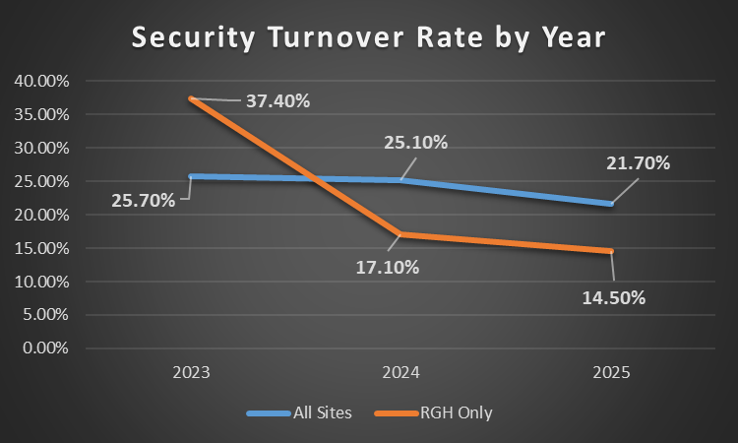

Organizational Benefits and
Procedural Improvements
Better Trained / More Capable Security Staff
No Longer Waiting on Delayed RPD Response (Typically 2 – 4 Hours)
RRH can Determine what gets Investigated / Forwarded to Prosecutor
Increased Sense of Secure Environment for General Staff
Improved Public Image with a Proper Marketing Campaign
Increased Retention Rates
  All Sites – 2023 = 25.7% / 2024 = 25.1% / 2025 21.7%
  RGH Only – 2023 = 37.4% / 2024 = 17.1% / 2025 = 14.5%

Slide 15
Questions?
RRH PROPRIETARY CONFIDENTIAL INFORMATION
FACT FINDING REVIEW FOR LEGAL ANALYSIS ONLY

Slide 16
GRQC Healthcare Forum
Safety in the Workplace
12:00 – 12:05 pm Welcome and background for today’s forum
  Robert Panzer, MD, GRQC Healthcare Committee Chair, Professor, URMC
12:05 – 1:05 pm Speakers, Bios and Topics to be Covered
  Tim Tull MBA CEM-IAEM Vice President of Safety, Security and Emergency Preparedness, RRH
    Topic: The Rochester Regional Health Peace Officer Program
  Joe Hayflinger – Captain and Commanding Officer of Public Safety, URMC
    Topic: URMC Safety and Security Initiatives
  Barbara Williams MS – Director of Crisis Specialist Team, Department of Psychiatry, URMC.
    Topic: De-escalation
  Jaclyn Wilmarth RN MS – Associate Healthcare Safety Officer, URMC
    Topics: Violence Risk Assessment Tool(s): A Workplace Safety Initiative
    Psychological Safety: How To Support Staff When Bad Things Happen
1:05 – 1:30 pm Panel Discussion, Q&A

Slide 17
Joe Hayflinger – Captain and Commanding Officer of Public Safety URMC. State of NY Municipal Police Training Graduate and FBI-LEEDA Law Enforcement Executive Leadership Development
Joe Hayflinger serves as a dedicated leader within the University of Rochester Department of Public Safety. With over 17 years of experience in campus and medical center law enforcement he currently serves as the Commanding Officer for the University of Rochester Medical Center. This is a unique and demanding environment that encompasses a world renowned research institute, level 1 trauma center, an NCI-designated cancer center, the children's hospital, and behavioral health services.
Joe has worked to build a reputation of integrity and compassion, and an unwavering commitment to community-focused policing. His work focuses on championing a safety-first culture while balancing the needs of healthcare workers, patients, visitors, and staff. He continues to implement forward-thinking strategies in emergency response, threat assessment, and crisis de-escalation, while ensuring that the medical center remains not only secure but also welcoming and accessible to all.

Slide 18
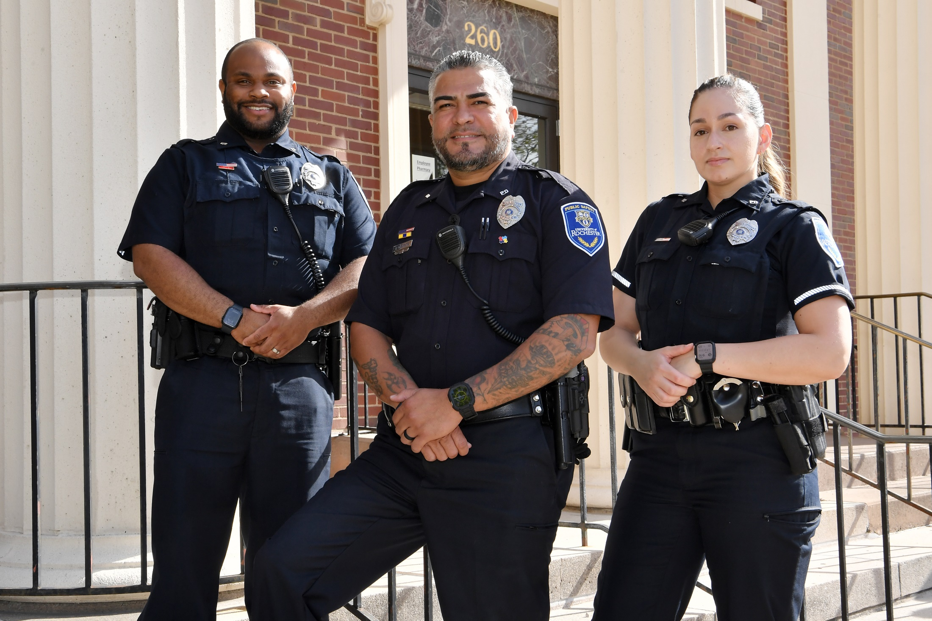

DEPARTMENT OF PUBLIC SAFETY
URMC Safety and Security Initiatives

Slide 19

URMC Safety and Security Initiatives
Physical Security Enhancements
Crowd Control and High Profile Incident
Unit Safety Plans
Innovative DPS Patrol Model and Introduction of a Robust Community Engagement Unit

Slide 20
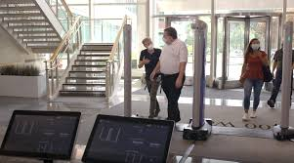
Physical Security Enhancements
Phased Implementation of the concealed weapon detection systems
SMH Main Lobby
WCC/GCH Lobby
Behavioral Health
Notes:
Post covid, maintained secure perimeter- 94 exterior doors are now fully secure or card swipe only

Slide 21
Physical Security Enhancements

Slide 22

Physical Security Enhancements
Industry Leading Consultation
COSECURE, which is a nationally recognized safety and security consulting firm which was contracted in May 2025 to lead a four-day comprehensive external assessment of the URMC enterprise. This focused on ways to bring industry leading physical security standards to URMC in effort to enhance the institutes safety.

Slide 23
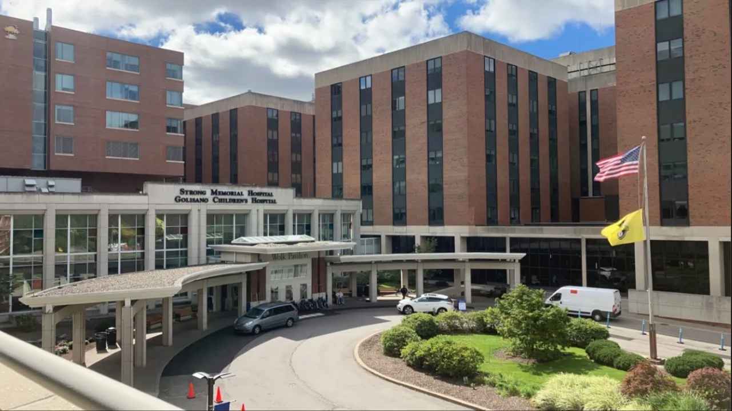
Crowd Control and High Profile Incidents
Violence in healthcare ↑ 30% (Lombardi et al, 2024)
Violent crime in hospitals ↑ 150% (Hartnett, 2023).
HCW/SW: 5x more likely to suffer non-fatal injuries from workplace violence (BLS, 2022).
Notes:
Multidisciplinary approach across the healthcare enterprise at URMC to discuss the need to manage the risk associated with these incidents not only to the institute but to our staff.

Slide 24
Crowd Control and High Profile Incidents
Impact of Violence in a Healthcare Setting
Physical Impact
  Injuries (acute/chronic)
  Fatal Incidents
  Lost workdays
Psychological/Emotional Impact
  Acute stress
  Anxiety and Depression
  Burnout
  Fear of returning to work
Professional/Organizational Impact
  Low job satisfaction
  Low morale
  Higher turnover
  Normalization of violence
  Underreporting
Impact on Patients
  Injuries
  Medical Errors
  Delayed care
  Staffing shortages
Notes:
Policy and procedures are going to guide our consistency in approach and maintain our ability to provide structure and predictability in often times of crisis

Slide 25
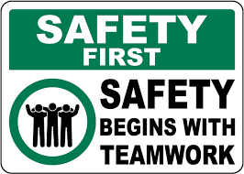
Unit Safety Plans
A checklist for DPS to go over with unit staff and leadership when they are impacted by a high profile incident. Multidisciplinary approach that outlines steps to take to best support the unit utilizing the resources available to them.
Notes:
In addition to DPS support this could be social work, guest services, patient relations, quality, ethics and spiritual care. We’re building a ecosystem of safety at the University of Rochester Medical Center and like any ecosystem it takes everyone contributing to make it successful.

Slide 26
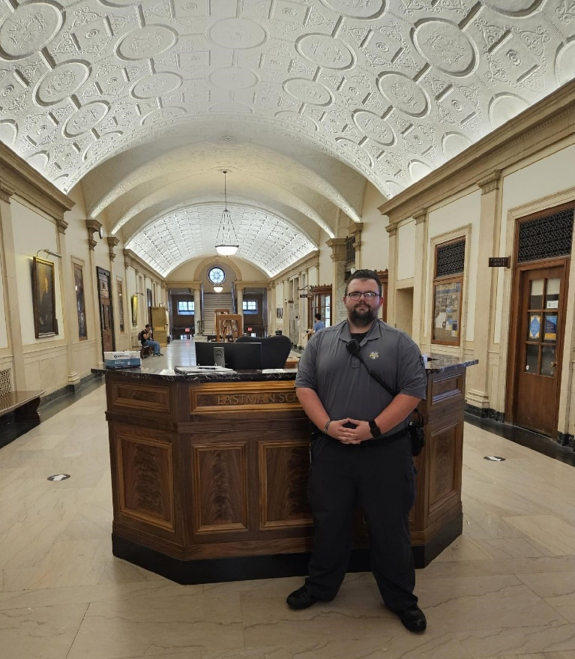

Deploying DPS Innovatively
Notes:
Peace Officers vs Public Safety officers…..non sworn officers in a clinical setting, de-escalation, clinical intervention, part of the clinical team ability to recruit and retain easier, bolster staffing, high visibility …Sworn officers- manage weapon detection systems, provide law enforcement intervention and needs.

Slide 27
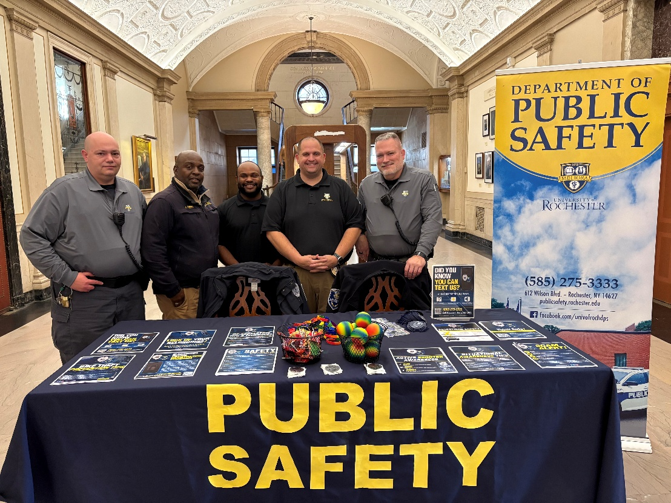
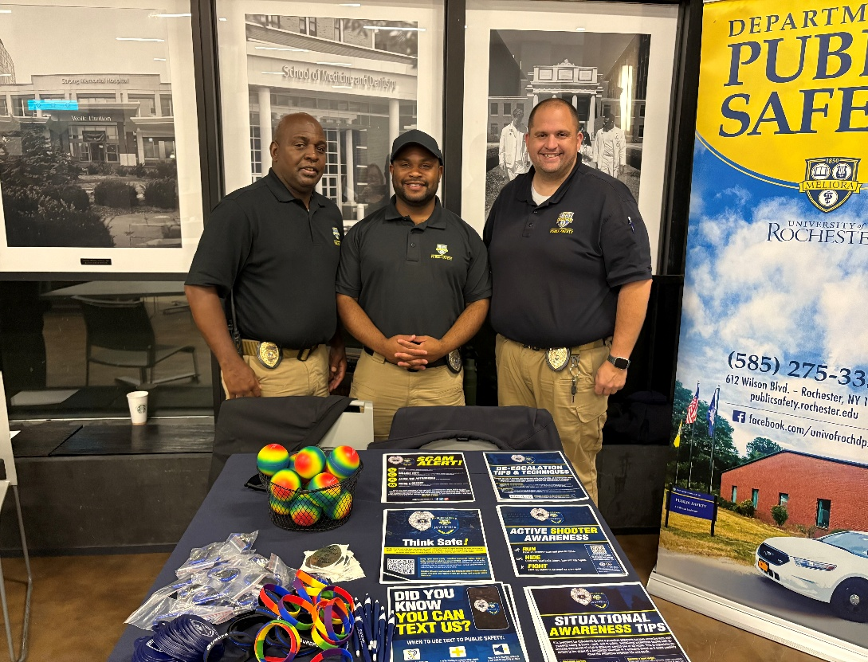
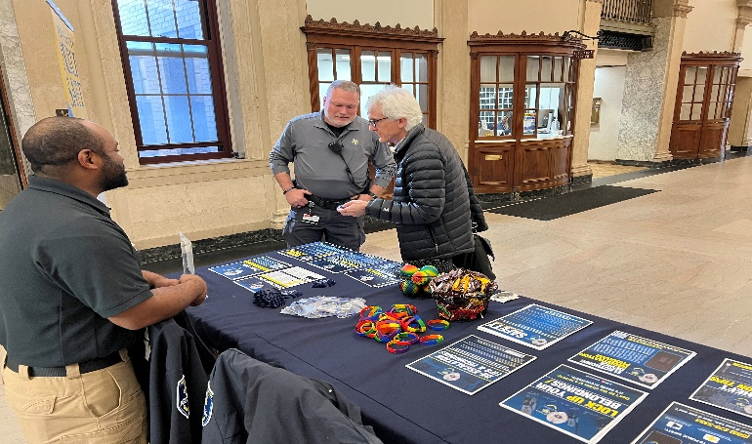
Deploying DPS Innovatively
Community Engagement
Notes:
We need to engage with our community, educate our community, listen to our community and build trust with our community. We have grown a non existent entity within DPS to a unit with 5 full time members that provide outreach that’s proactive and intentional in their efforts to raise awareness, provide support and address community needs. Now bringing to the medical center to continue to grow our ecosystem with the community.

Slide 28
QUESTIONS?

Slide 29
GRQC Healthcare Forum
Safety in the Workplace
12:00 – 12:05 pm Welcome and background for today’s forum
  Robert Panzer, MD, GRQC Healthcare Committee Chair, Professor, URMC
12:05 – 1:05 pm Speakers, Bios and Topics to be Covered
  Tim Tull MBA CEM-IAEM Vice President of Safety, Security and Emergency Preparedness, RRH
    Topic: The Rochester Regional Health Peace Officer Program
  Joe Hayflinger – Captain and Commanding Officer of Public Safety, URMC
    Topic: URMC Safety and Security Initiatives
  Barbara Williams MS – Director of Crisis Specialist Team, Department of Psychiatry, URMC.
    Topic: De-escalation
  Jaclyn Wilmarth RN MS – Associate Healthcare Safety Officer, URMC
    Topics: Violence Risk Assessment Tool(s): A Workplace Safety Initiative
    Psychological Safety: How To Support Staff When Bad Things Happen
1:05 – 1:30 pm Panel Discussion, Q&A

Slide 30
Barbara Williams MS – Director of Crisis Specialist Team, Department of Psychiatry, URMC
Barbara is the Director of the Crisis Stabilization Team for CPEP and the inpatient psychiatry units within Strong Memorial Hospital. She has worked for URMC within the Psychiatry department for 5 years where her focus has been creating and implementing a team of person-centered personnel who promote patient and staff well-being. Prior to her time at URMC, she was a leader within a crisis response team supporting individuals with intellectual and developmental disabilities.

Slide 31
De-escalation
Barbara Williams, MS
Director of Psychiatry Crisis Stabilization Team

Slide 32
Crisis Stabilization Team
A team of individuals from various prior work experience (group homes, schools, hospitals) who all come together with the mindset of supporting and promoting wellness to the patients in psychiatry.
The team focuses on:
Building trust with the patients to support future de-escalation needs
Providing accessible wants and needs to reduce the likelihood of frustration
Monitoring of the milieu to recognize signs of distress to promote early intervention

Slide 33
Crisis Prevention Institute (CPI)
Verbal Interventions:
  Verbal skills only
Nonviolent Crisis Intervention:
  Verbal skills
  Designments
Nonviolent Crisis Intervention With Intermediate Physical Skills
  Verbal skills
  Designments
  Some physical skills
Nonviolent Crisis Intervention With Advanced Physical Skills
  Verbal skills
  Designments
  Advanced physical skills

Slide 34
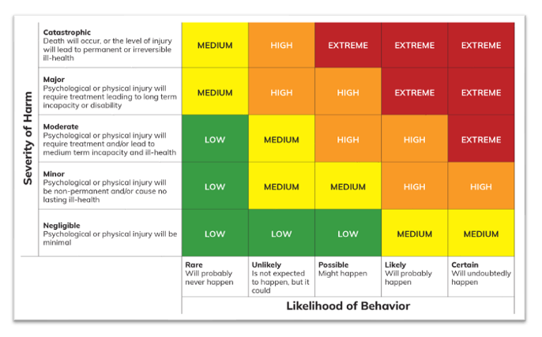

Slide 35
Proactive support
The first step to de-escalating a crisis is to build rapport
How to build rapport:
Practice active listening: stay present during the conversation, nod, keep eye contact and do not interrupt
Use clear simple language: avoid medical jargon, speak in a manner that the patient can hear and understand
Encourage questions: allows them to feel that their concerns are valid and that you respect their thoughts
Ask open ended questions: this encourages conversation and shows your willingness to engage.

Slide 36
Build Trust
Show empathy and respect: try to understand their perspective and validate their feelings
Make a positive first impression: greet someone warmly with a smile and use their name if you know it. Be mindful to use the individuals chosen name if they have one.
Be transparent and honest: clearly explain expectations and procedures that need to happen. Avoid making promises you can not keep.

Slide 37

Be trauma informed
Be cognizant of your placement within the room in relation to the patient
Consider your approach: Physical and Verbal
Offer choices when the opportunity allows
Position
Proximity
Posture

Slide 38

Understanding the behavior
Before we can de-escalate a situation, we have the first identify what they behavior is communicating
Every action taken is communicating a need, desire or belief
Listen carefully! The root cause for frustration will often be shared

Slide 39
Rational detachment
The ability to manage one's own behavior and attitude in stressful situations without taking the actions of others personally
It is important to recognize that when people are upset, they may say things that are hurtful, moments can be stressful and
It is important to recognize that:
  Experiences within the hospital are stressful for people which can cause them to act out of character
  The way they are feeling is not because of you it is because of the situation
  The patients do not know you in a manner that the things they say are a consistent representation of you as a person

Slide 41
GRQC Healthcare Forum
Safety in the Workplace
12:00 – 12:05 pm Welcome and background for today’s forum
  Robert Panzer, MD, GRQC Healthcare Committee Chair, Professor, URMC
12:05 – 1:05 pm Speakers, Bios and Topics to be Covered
  Tim Tull MBA CEM-IAEM Vice President of Safety, Security and Emergency Preparedness, RRH
    Topic: The Rochester Regional Health Peace Officer Program
  Joe Hayflinger – Captain and Commanding Officer of Public Safety, URMC
    Topic: URMC Safety and Security Initiatives
  Barbara Williams MS – Director of Crisis Specialist Team, Department of Psychiatry, URMC.
    Topic: De-escalation
  Jaclyn Wilmarth RN MS – Associate Healthcare Safety Officer, URMC
    Topics: Violence Risk Assessment Tool(s): A Workplace Safety Initiative
    Psychological Safety: How To Support Staff When Bad Things Happen
1:05 – 1:30 pm Panel Discussion, Q&A

Slide 42
Jaclyn Wilmarth RN MS – Associate Healthcare Safety Officer and MCIC Patient Safety Nurse
Jaclyn Wilmarth is the Associate Healthcare Safety Officer at University of Rochester Medical Center. In that role, Jaclyn provides leadership for and oversight of patient safety, loss prevention and workplace safety initiatives. She guides, directs and supports managers and staff throughout the organization with implementation and evaluation of staff safety efforts, including but not limited to workplace violence and psychological safety. Jaclyn provides oversight and clinical expertise to ensure safety of staff, patients, and visitors in emergency preparedness planning, process, and policies. She coordinates and supports patient safety and loss prevention initiatives in Emergency Medicine, and works to develop and integrate initiatives between a leading medical professional insurer, the hospital and the UR Medicine system-wide initiatives.

Slide 43
Violence Risk Assessment Tool(s):
A Workplace Safety Initiative
Jaclyn Wilmarth

Slide 44

Wouldn’t It Be Great If…
There was better communication across encounters and the system for information related to patients who may be known to be at risk of violent behaviors
We had a validated tool to assess risk of violence based on behaviors
But… how do we do it fairly?
Notes:
The ability to fairly screen, without introducing bias or giving patients a “Scarlet Letter” forever, was a hold up for several years for our team. Then with the pandemic, this was set aside. The good news is that in the time since we first began trying to establish a screening process, our foundational EMR improved. We now had access to a validated tool that was “prebuilt”, that many of our peer institutions around the country had started using. Additional improvements, such as the ability to add an expiration date to the resulting flags, became available.

Slide 45
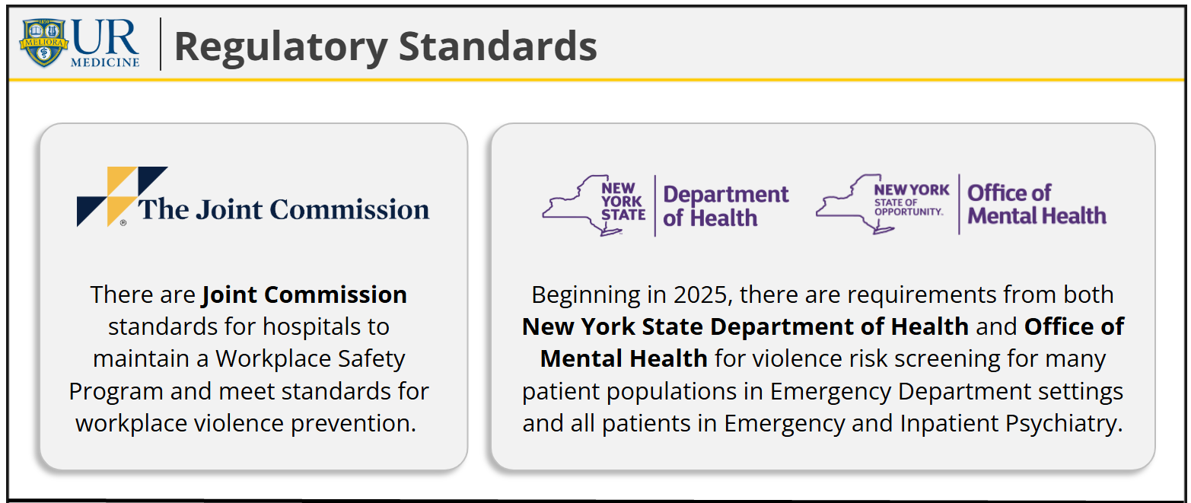

Slide 46
Background
Violence Assessment Tool is a screening tool that can provide information to share situational awareness
Currently screening is completed in all enterprise ED, Inpatient, OB, Psychiatry CPEP & Inpatient settings
Adult patients only, (except CPEP & Psychiatry, which includes Peds)
Results of moderate and high are shared via visual indicator with anyone with Epic access, including Ambulatory for follow up visits

Slide 47
Key Performance Indicators for SMH
Reduce WPV Incidents by 10%
Reduce WPV Injuries caused by patients by 10%
Improve staff perception of safety as reported in Employee Engagement Survey by 5%

Slide 48
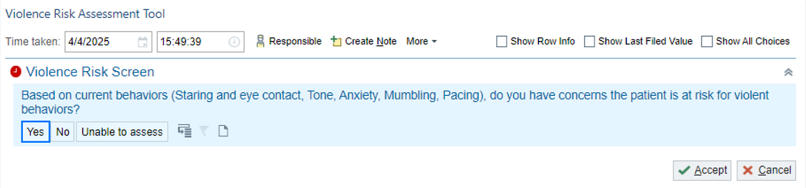
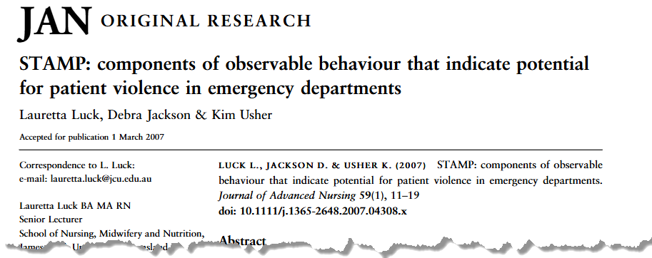
Initial Screening in Medical Areas
Notes:
Reasons for initial screening:
1. Vast majority of patients can be ruled out with one question.
2. Documentation burden (e.g., 90K ED visits at SMH each year, if only using the more in depth tool, would be a minimum of 1,080,000 assessment points for just the adult ED).

Slide 49
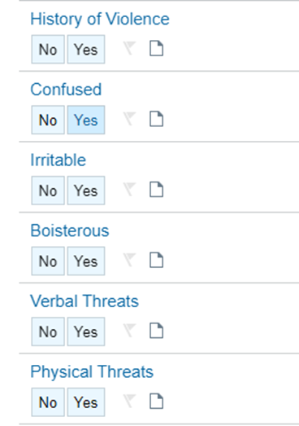

Secondary Screening in Medical Areas:
(Primary Screening in Psychiatric Areas)
Expanded screening, with prompting cues to ensure each question is answered as intended.
Score results (0-12):
  Low Risk (0-3)
  Moderate Risk (4-5)
  High Risk (6-12)
Risk Assessment Toolkit for Health Care Settings, © Public Services Health and Safety Associate (PSHSA), Ontario, Canada
Notes:
*Note- The use of 2 separate, validated screening tools leads to a decrease in false positives
This tool- named the “Violence Assessment Tool”- comes from extensive work done across Canada and is the foundational tool that Epic provides.

Slide 50
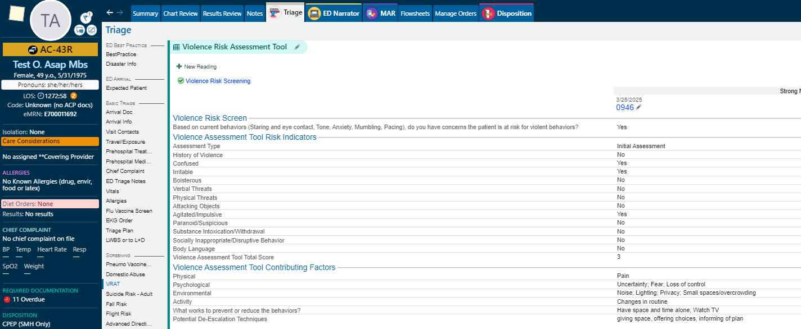
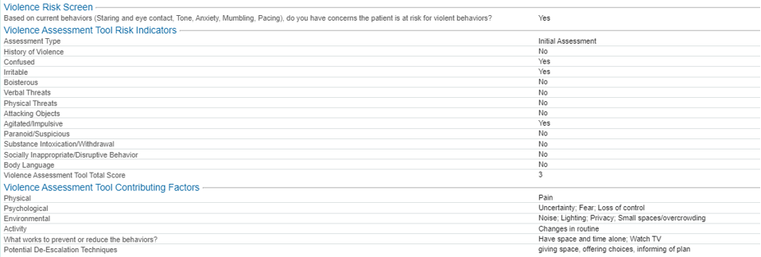
Easy Access to Additional Information:
Hover on Care Considerations in Story Board

Slide 51
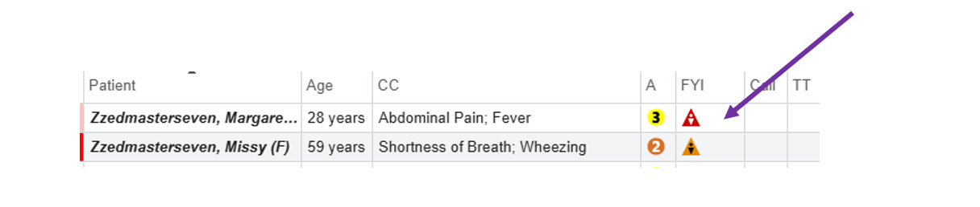
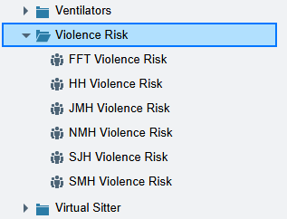
Information Easily Available:
Outside the Chart
Also available in team lists, unit lists, outpatient schedules, etc.

Slide 52
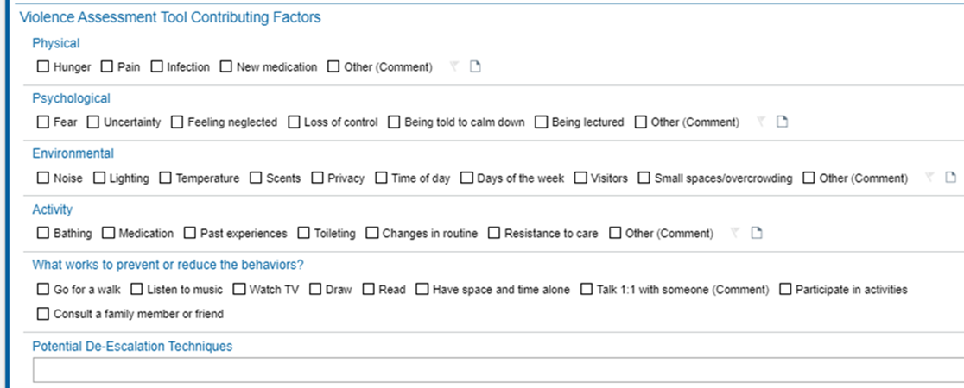
Patient Impact Potential
Change the care we provide to identify escalating factors earlier
Earlier planning for difficult dispositions…identification of contributing factors and solutions/improvement in behaviors.
Earlier involvement with behavioral consults, psychiatry consults, if available
Tracking of violence risk over time with rescreening daily
Less in notes, more in flowsheets.

Slide 53
Ethical Considerations
Bias:
The NYS required list includes patients with dementia, altered mental status, arrival via police, incarceration, substance use disorder, history of violence…
Solution:
Screen ALL adults who arrive to ED, OB, inpatient settings at least once, or more based on initial score.
Bias:
  Assumption of violence in current visit and future care
Solution:
Rescreen moderate and high-risk patients daily until either patient scores low risk or until discharge
90-day expiration on indicators for patients who are still moderate or high risk at discharge
Bias:
Screening patients at higher risk of violence based on demographics such as race, gender, age, sexual orientation
Solution:
Commit to frequent analysis of data on screenings in all locations, and including close examination of demographics
Notes:
Above and beyond peers. Other institutions– “this is a staff safety initiative only”

Slide 54
Results since Go Live (June 24, 2025)

Slide 55

A Note about Data Analysis
The data is very complex
Patients present at varying frequencies
Length of stay may impact number of screenings
Must be looked at by patient identifier, encounter level, and by all available demographics
Comparison to general ED and admission data

Slide 56

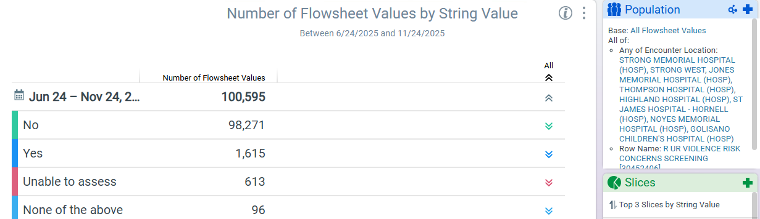
STAMP
Concern for risk of violent behaviors with first screening question (“Yes”): 1.6%
97.7% of all patients screened are not displaying behaviors concerning to staff
Notes:
Reminder about data- this is the tip of the iceberg…

Slide 57

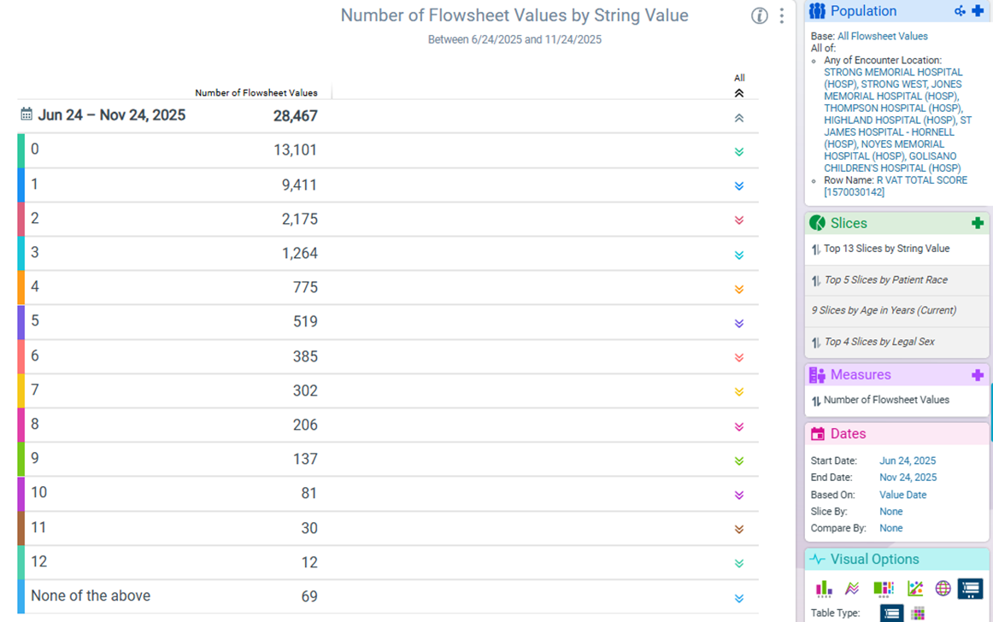
Violence Assessment Tool
No Risk: 46% of VAT screenings were scored 0
Low Risk: 45% of VAT screenings (not flagged)
Moderate Risk: 4.6% of VAT screenings (not 4.6% of all patients)
High Risk: 4.1% of VAT screenings (not 4.1% of all patients)
Note: Includes Psychiatry at SMH, which screens everyone, every day.

Slide 58
Key Performance Indicators for SMH
Reduce WPV Incidents by 10%
Reduce WPV Injuries caused by patients by 10%
3Q 2025 data, when compared to:
YTD 2025 compared to 1Q-3Q 2024:
Improve staff perception of safety as reported in Employee Engagement Survey by 5%
TBD: Results Pending
 | 3Q 2024 | 1Q 2025 | 2Q 2025
WPV Incidents | 16% | 4% | 18%
WPV Injuries | 18% | 18% | 35%
WPV Incidents | 6%
WPV Injuries | 16%

Slide 59

KPIs Have Been Met-
How Do We Optimize and Expand?
Notes:
Just because we met our goals, doesn’t mean we are done. Expansion to areas initially excluded: Ambulatory, Periop, Home Care, LTC. All of which may interact with the tools a little differently.
Use of tool to inform consults (patients with any IDD diagnosis get automatic consult to beahvior specialists; can we build order sets to support the screening results?)

Slide 60

Psychological Safety:
How To Support Staff When Bad Things Happen
Jaclyn Wilmarth

Slide 61
What Happened?
Critical Incidents
Adverse Event
Grief &
Loss
Chronic Stress
Critical Incident: An overwhelming event outside the range of usual experience has the potential to exhaust one's usual coping mechanisms, resulting in psychological distress and disruption of normal adaptive functioning.
Notes:
When we prepare for critical incident responses, it is helpful to know what kind of events may occur to help plan your response. As a reminder, it’s not a matter of if you will experience a critical incident, when, what kind, and how frequently.
“Critical incidents” is an umbrella term for any overwhelming event outside the range of usual experience has the potential to exhaust one's usual coping mechanisms. Critical incidents can result in psychological distress and disruption of normal adaptive functioning. Some examples include difficult, codes or challenging patient care episodes, events that pose a serious threat to safety of staff or patients. It is important to recognize that critical incidents are not always patient care related. For example, patient or staff injuries due to assaults. These incidents can create what are known as “second victims,” any employee who experiences physical or emotional distress due to their work in providing patient care.
Adverse event is a type of critical incident: An adverse event is unintended injury, patient harm, medical error, or complication resulting in a prolonged hospital stay, disability, or death. These events have the power to be quite distressing to individuals and teams, leaving staff feeling anxious, angry, and preoccupied with the event.
Grief and loss: Losses of patients may be an unfortunate reality of working in healthcare. Staff grieve these losses just as family and friends do, especially if they had a close connection with the patient. Even if we didn’t have a close relationship, we may feel connected in other ways, such as being the same age as the patient when they died, having a family member that shares same diagnosis. Grief can also remind us of previous losses we have experienced. As a reminder, grief and loss may not be patient care related: Some teams will unfortunately need to grieve the loss of a co-worker. This is a type of critical incident where people can connect and support each other.
Chronic stress: Often, a critical incident is a discrete event, and you know people will need critical incident stress management. However, chronic, repetitive stressors of working in healthcare can create a great deal of distress for employees, such as long work hours, low staffing, and high patient acuity. Even chronic and constant stress can benefit from critical incident stress management to connect staff with their personal sense of resiliency.
Given the work, what type of critical incidents can you anticipate in the coming year? The type of critical incident will give insight into what staff may experience and target our intervention.

Slide 62
Just Culture Organization (Blame free, systems-based solutions)
Create a culture of support around second victims
Critical
Incidents
Targeted critical incident stress management for impacted teams
YoUR Support team & EAP

Slide 63

YoUR Support Framework:
Borrowed and adapted from trauma informed care
“Today, our survival depends on our ability to face our problems artfully rather than use our prehistoric defense resources: fight, flight, or freeze.”
“…deal with trauma, its psychological and biological effects on mind and body…and treatments plans that deal with the resulting problems and transform them into growth.”
“Demobilizing, defusing, and debriefing are the three major techniques for dealing with the victims of a critical incident…”

Slide 64
Recovery and Resiliency
Critical
Incident
Healing and growth
Debriefing
Notes:
Our next steps is to move into our framework for interventions after a critical incident occurs.
We know that individuals have a natural process promoting resiliency and recovery, and we want to facilitate, and even expedite, this natural process if possible. Will unfold over the minutes, hours, and days after a critical incident.
Often, we may think that a debrief is immediately necessary after a critical incident, to try to bring people together. But, that only is only one intervention, and misses the opportunity to engage with staff over time as the response to the event unfolds. Soon after the event, work is still being done and people are not able to engage in debriefing.

Slide 65
Recovery and Resiliency
Critical
Incident
Healing and growth
Demobilization
(immediate)
Defusing
(end of shift)
Debriefing
(48 hours)
Unit Based Response
YoUR Support
Notes:
Therefore, we can consider instead not just debriefing, but interventions that can take place immediately after, defusing at the end of shift, or before people go home for the day, and debriefing.

Slide 66
Common theme throughout interventions:
Acknowledge that working in health care is really hard. We are impacted by our work.
Validate. Whatever feelings or thoughts someone has are valid.
Normalize. Your feelings are normal for you. They might not be the same as another person.
Regroup. How can we move forward as a team?

Slide 67
Who is the YoUR Support Team?
  Approximately 30 people who respond to incidents for the Medical Center
  Various backgrounds: Quality, Pediatrics, Chaplaincy, Palliative Care, Admitting Office, Critical Care, Psychiatry, and Employee Assistance Program
  For many, it is volunteer work in addition to their regular duties
  Caring individuals who believe we can make a difference in our colleagues work experience by offering support

Slide 68
Training Available
Level 1 Training:
These interventions allows support to be provided locally:
    What to do immediately after an incident
    What to do at the end of the day/shift
Appropriate for all staff
    Recommended for charge nurses, Nurse Managers, Assistant Nurse Managers
    All ICU Clinical Resource Nurses are trained, which helps for off shifts
Level 2 Training:
In depth: how to facilitate an emotional support debriefing
Pre-requisite Level 1 training required
Must be self-selected to want to do this kind of activity
Invitation to join YoUR Support Team

Slide 70
GRQC Healthcare Forum
Safety in the Workplace
12:00 – 12:05 pm Welcome and background for today’s forum
  Robert Panzer, MD, GRQC Healthcare Committee Chair, Professor, URMC
12:05 – 1:05 pm Speakers, Bios and Topics to be Covered
  Tim Tull MBA CEM-IAEM Vice President of Safety, Security and Emergency Preparedness, RRH
    Topic: The Rochester Regional Health Peace Officer Program
  Joe Hayflinger – Captain and Commanding Officer of Public Safety, URMC
    Topic: URMC Safety and Security Initiatives
  Barbara Williams MS – Director of Crisis Specialist Team, Department of Psychiatry, URMC.
    Topic: De-escalation
  Jaclyn Wilmarth RN MS – Associate Healthcare Safety Officer, URMC
    Topics: Violence Risk Assessment Tool(s): A Workplace Safety Initiative
    Psychological Safety: How To Support Staff When Bad Things Happen
1:05 – 1:30 pm Panel Discussion, Q&A

