Slide 1
Technology and Human Experience in Weather Forecasting
National Weather Service
Buffalo, New York
Presenter: Jon Hitchcock
Senior Forecaster, NWS Buffalo, NY
Email: Jon.Hitchcock@noaa.gov

Slide 2
Program Overview
Background on the National Weather Service
Cold season weather impacts: lake effect snow, Nor’Easters, and wind storms
Advancing technology in weather prediction
Future role of human meteorologists
Questions and open discussion

Slide 3
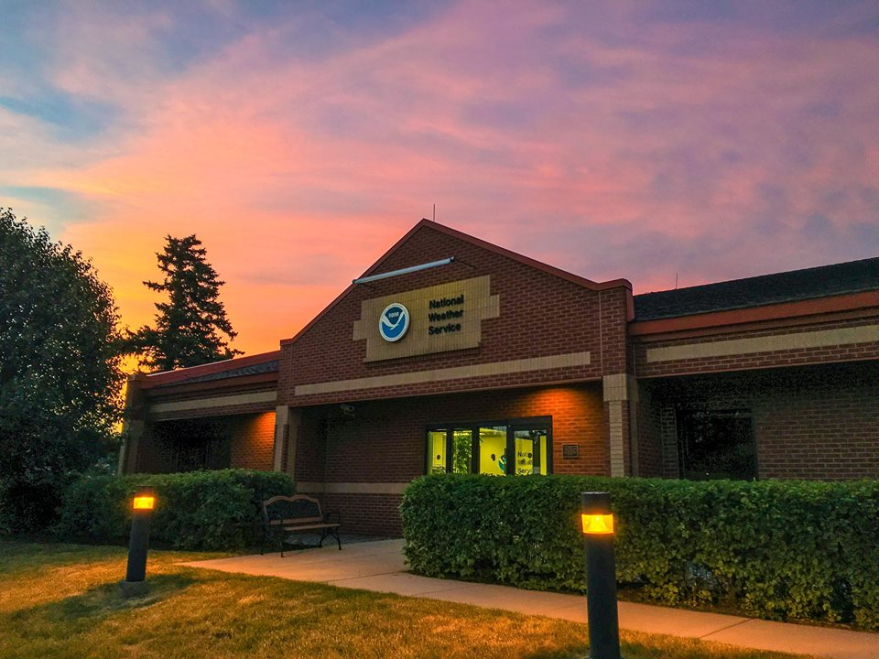
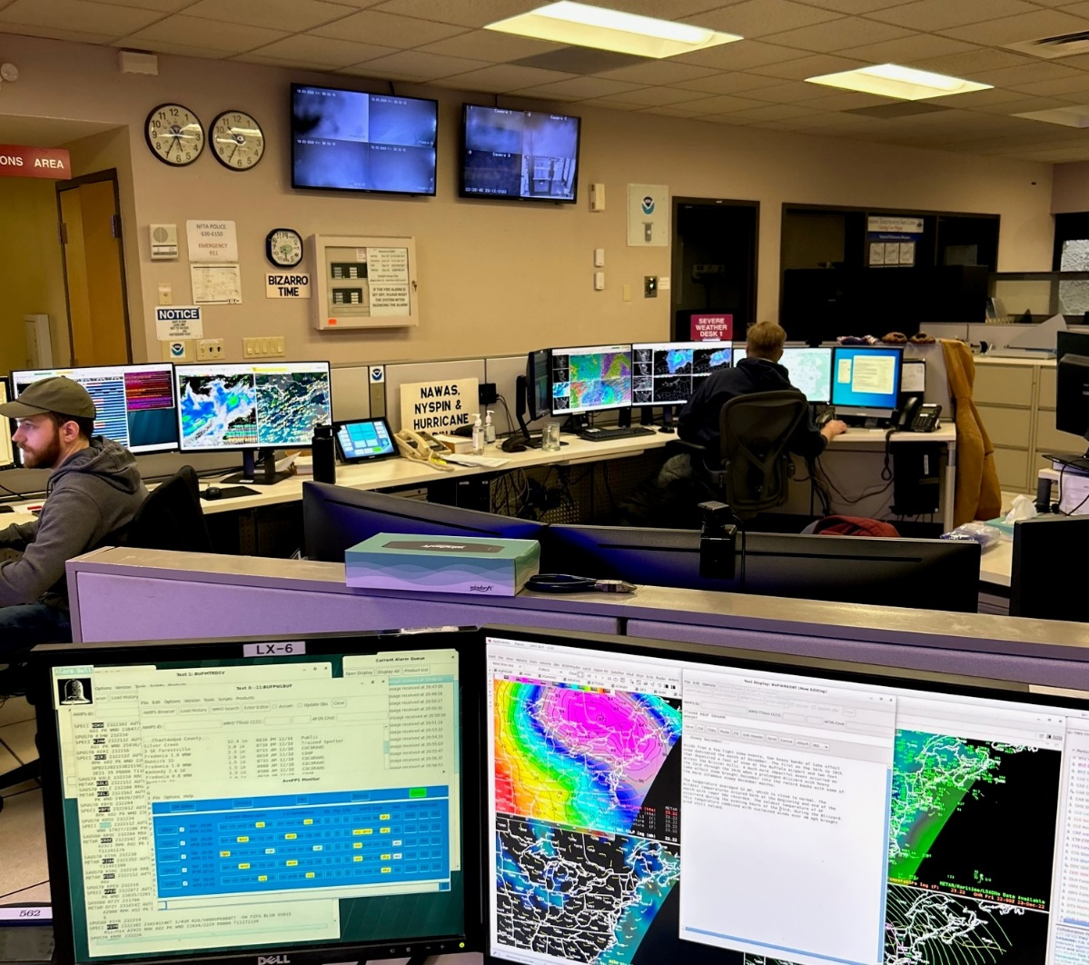
National Weather Service
A Federal Government Agency
Part of the Dept. of Commerce
NOAA – National Oceanic and Atmospheric Administration –
  is our parent organization

Slide 4
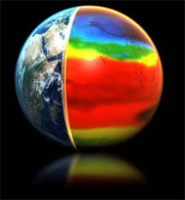

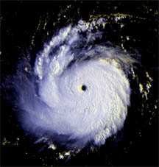

National Weather Service
MISSION
Provide weather, water, and climate data, forecasts, warnings, and impact-based decision support services to protect life and property and enhance the national economy
VISION
A Weather-Ready Nation:
Society is Prepared for and
Responds to Weather-
Dependent Events

Slide 5
National Weather Service
Forecast Office Areas of Responsibility
Burlington
Binghamton
Buffalo
Albany
Cleveland
New York
City
Pittsburgh
State College
Philadelphia

Slide 6

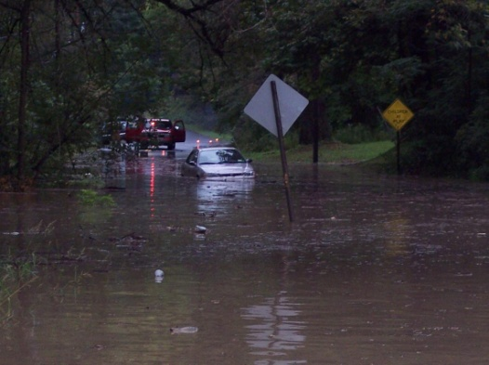

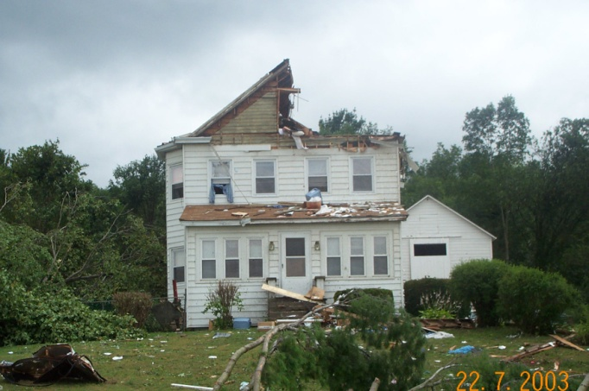
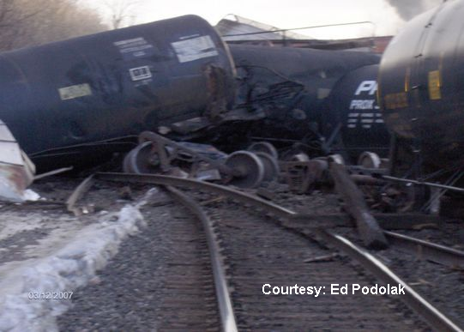
NWS Forecast Offices
What We Do
Watch/Warning/Advisory
Public Forecasts
Aviation
Hydrology
Fire Weather Forecasts
Marine Forecasts
Data Management
Climate Services
Upper Air
Hazmat Support
Systems Management
Research and Training
Outreach

Slide 7

NWS Forecast Office Operations
What We Do
NWS Offices operate 24/7/365
Always at least 2 forecasters on duty, more during busy times of day
All forecasters work rotating shifts including weekends, overnights, and holidays
Impact Decision Support Services (IDSS) increasingly important
  Communicate the potential impacts of the forecast (roads, airports, large events, etc.)
  Extensive coordination with federal, state, and local emergency management
  Email briefing packages, conference calls, on-site support

Slide 8
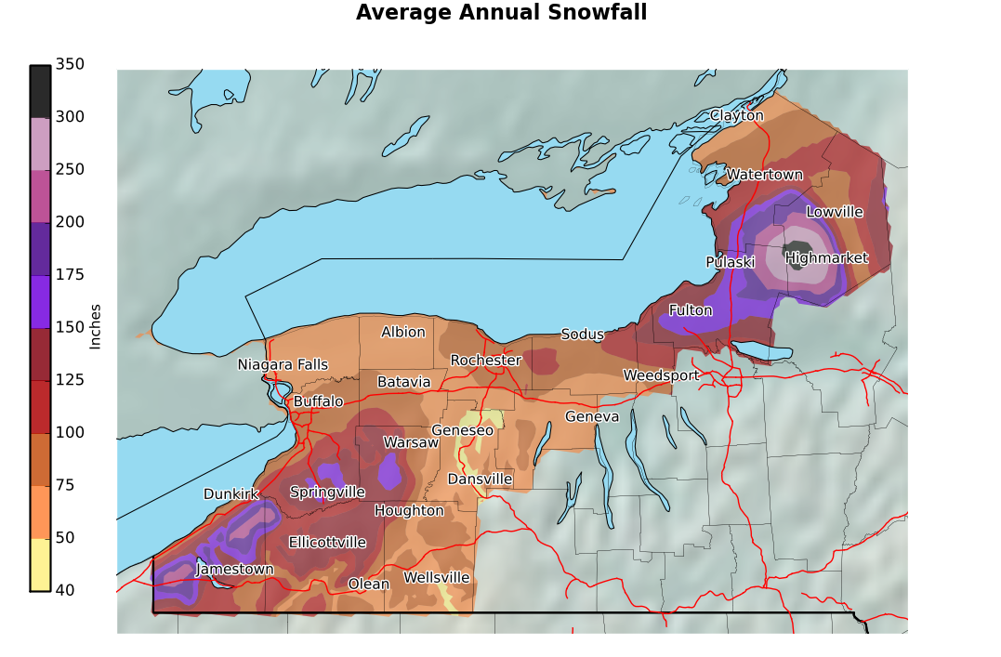
Average Annual Snowfall

Slide 9
Lake Effect Snow
Cold air flows over the relatively warmer waters of the Great Lakes
Moisture and Instability is released by the warm lake
Bands of clouds and eventually snow form over and downwind of the lake
Bands form parallel to the winds in the 2 to 5 thousand foot layer, so forecasting wind direction is critical
Intense snowfall rates

Slide 10
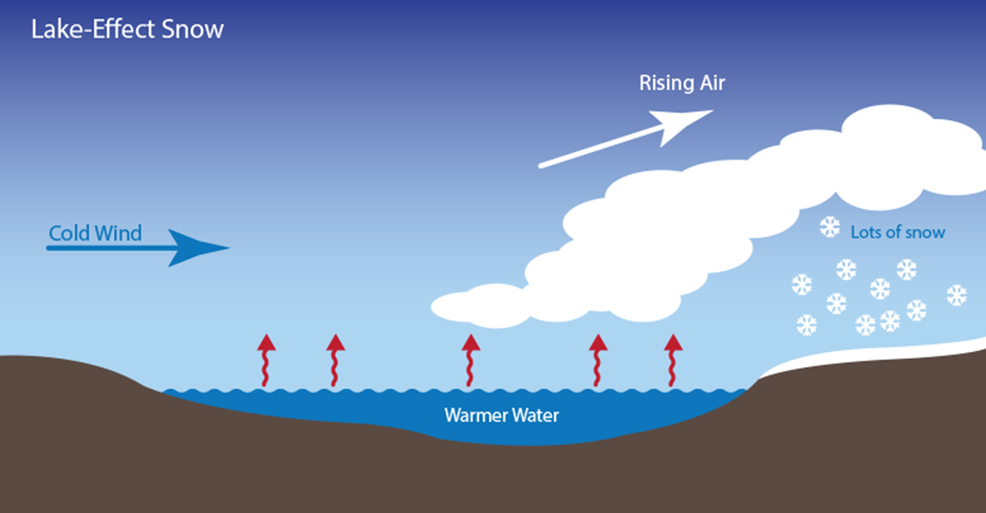
How Lake Effect Works

Slide 11
Forecasting Lake Effect Snow
Fetch – How much open water will winds pass over (need at least 40 miles)
Large temperature difference between the warm lake and cold air 5-10 thousand feet up
Amount of moisture available
“Help” from a large scale weather system
Wind direction determines where the band will set up

Slide 12
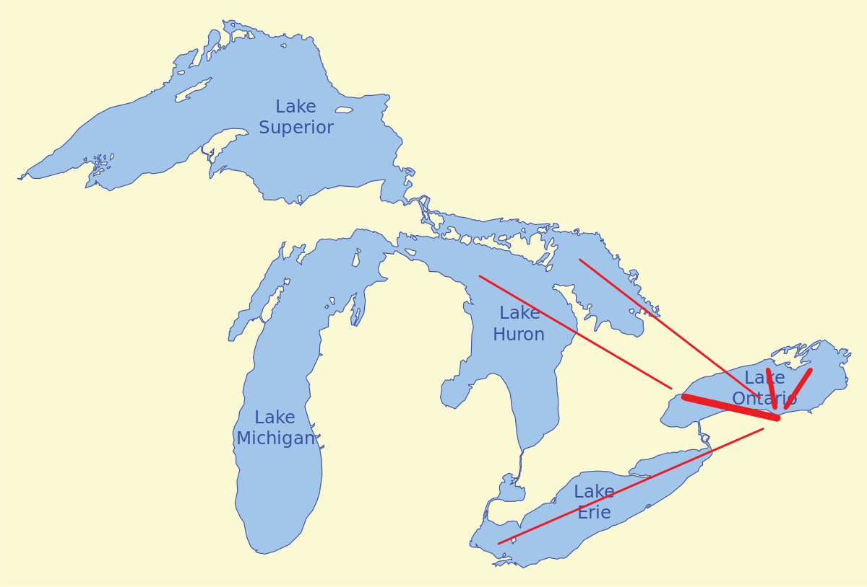
Lake Effect Snow in Rochester

Slide 13
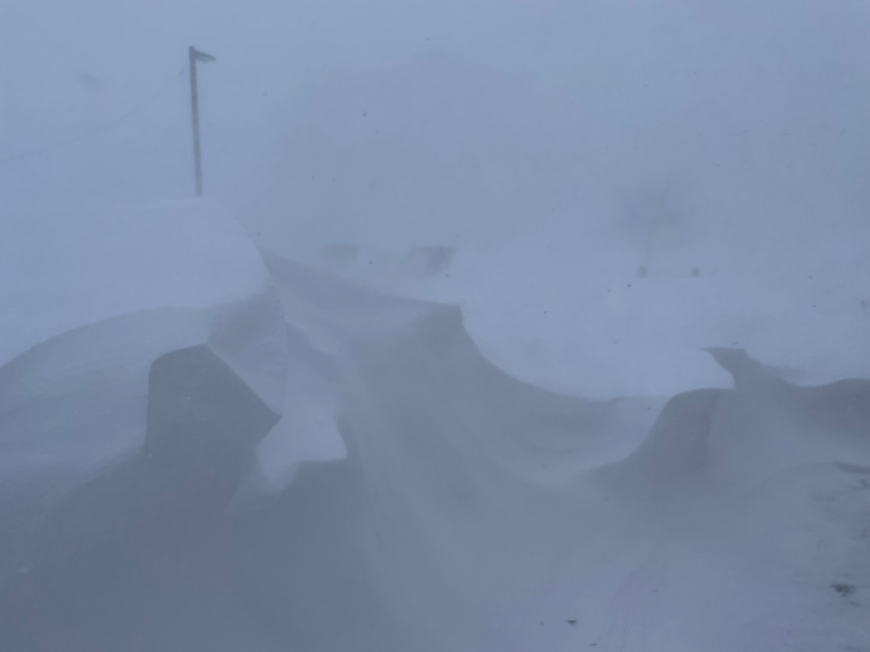
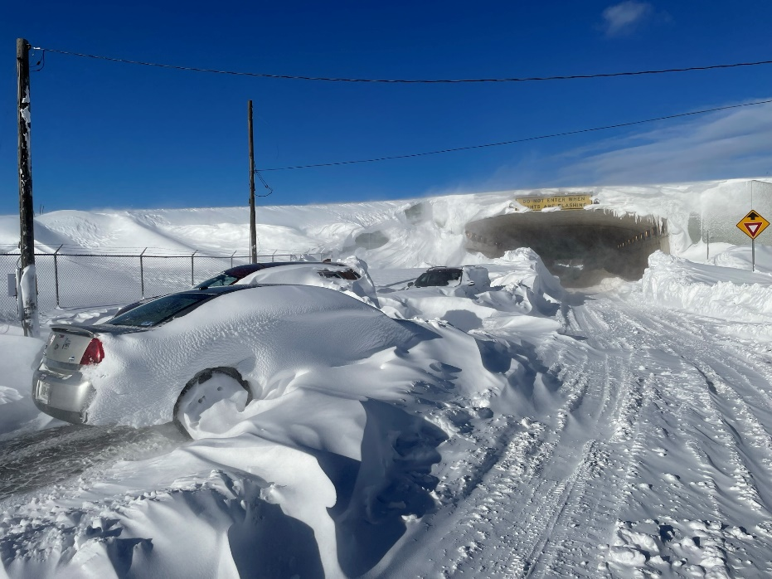
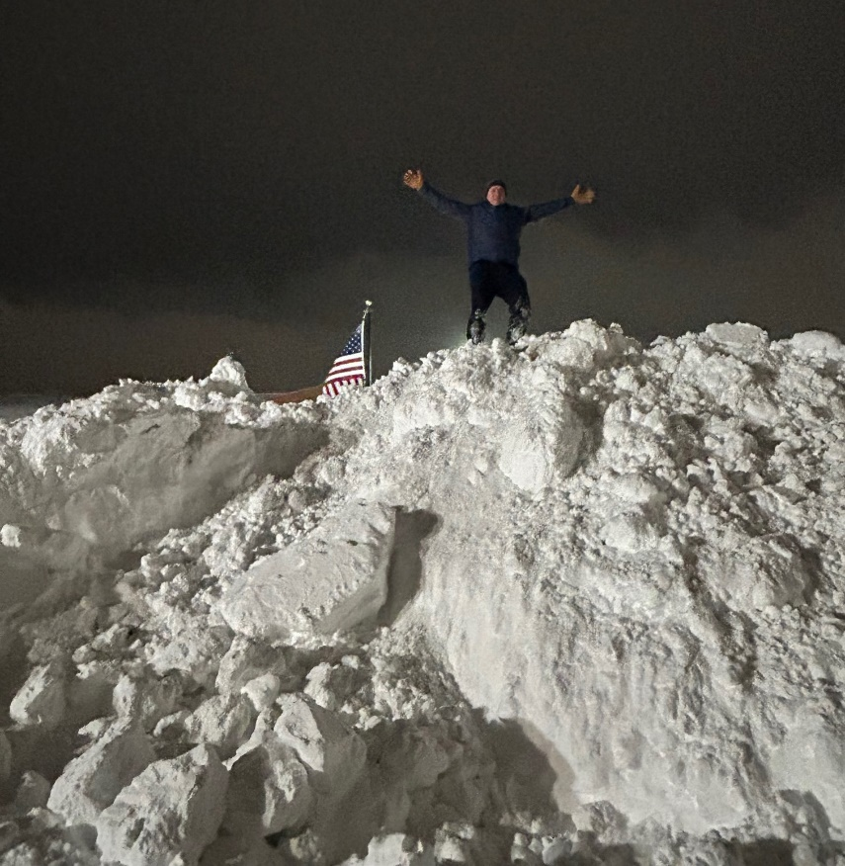
December 2022 Buffalo Blizzard
Photos by: NWS Buffalo

Slide 14


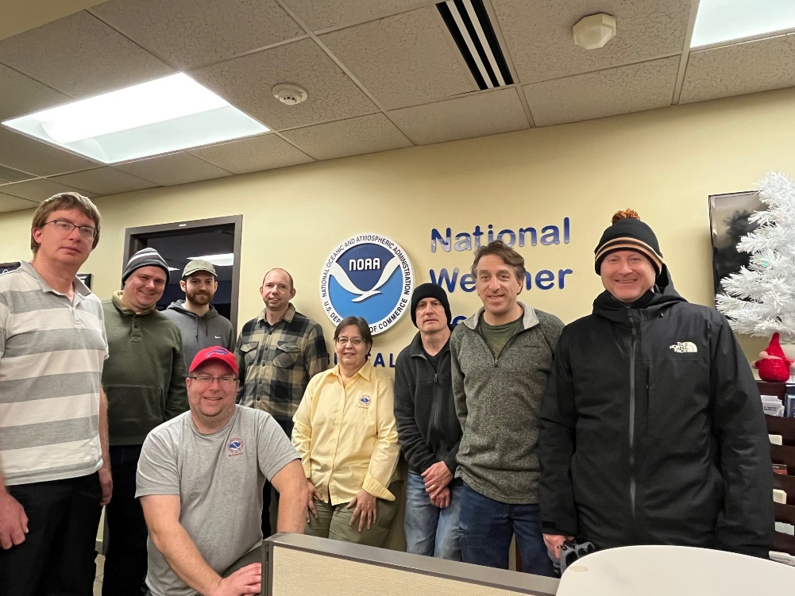
December 2022 Buffalo Blizzard
Photos by: NWS Buffalo

Slide 15
Lake Effect Snow –
Role of the Human Forecaster
20+ years ago, computer model guidance did not have sufficient resolution to resolve small scale features such as lake effect snow
Today, high resolution model guidance can resolve bands of lake effect snow, but are still prone to errors in band placement and intensity
For example: Model guidance is too far south with bands of snow off Lake Erie near Buffalo the majority of the time, and too fast moving lake effect snow south off Lake Ontario into Rochester
Human forecasters with local expertise adjust the placement and intensity of lake effect bands routinely to improve the forecast

Slide 16
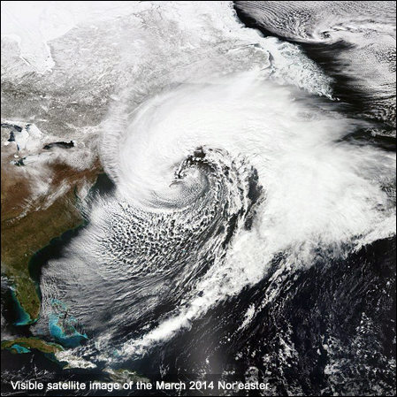
Nor’Easters

Slide 17
Nor’Easter Impacts
Most move up along the east coast
We occasionally are brushed by the western edge of the storm with moderate to heavy snowfall, especially in Central NY
Can produce gusty winds out of the north and northwest with cold temperatures behind the system

Slide 18
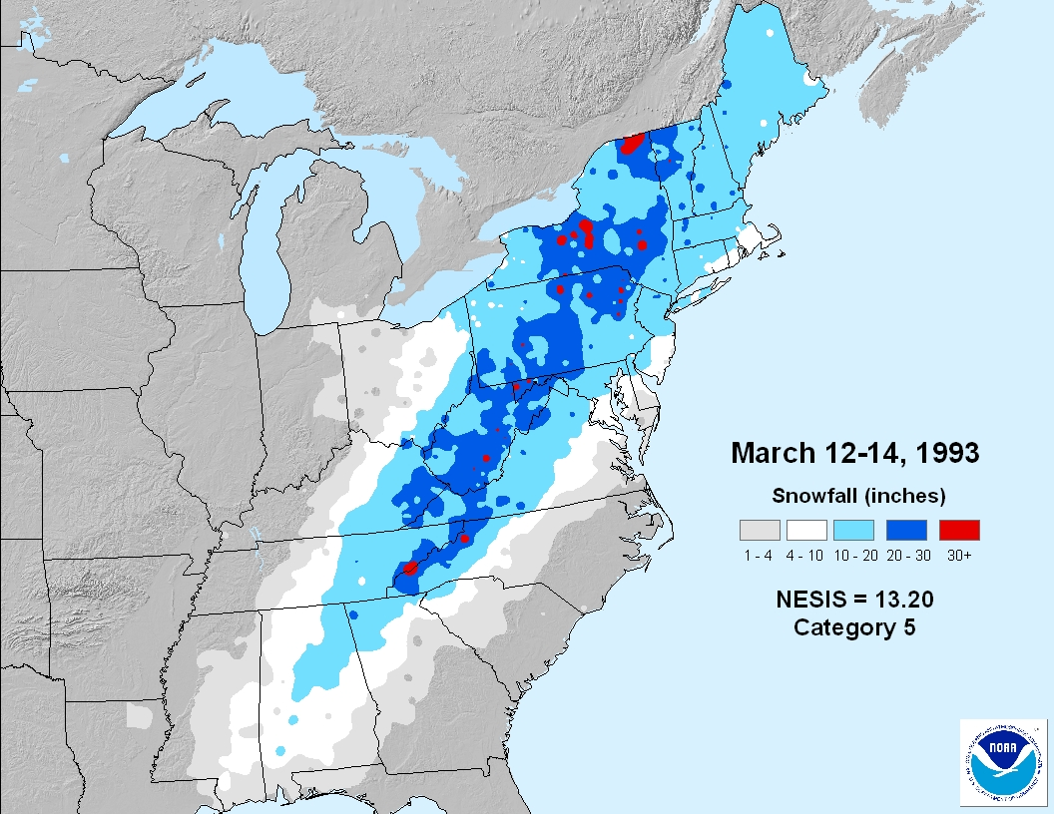
March 1993 Superstorm

Slide 19
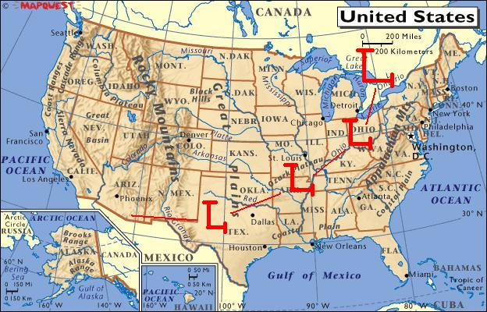
Great Lakes Cutter

Slide 20
High Winds
Most often associated with Great Lakes Cutter systems
Strongest winds typically occur behind the system as cold air rushes back into the area
Strongest winds typically found northeast of Lakes Erie and Ontario
  Southwest winds tend to funnel and speed up at the northeast end of Lake Erie due to the shape of Lake Erie and surrounding terrain

Slide 21
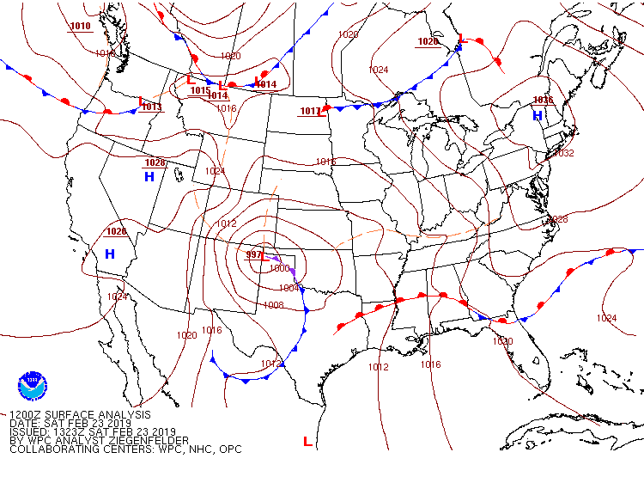
February 24-25, 2019 Wind Storm
7AM EDT February 23, 2019

Slide 22
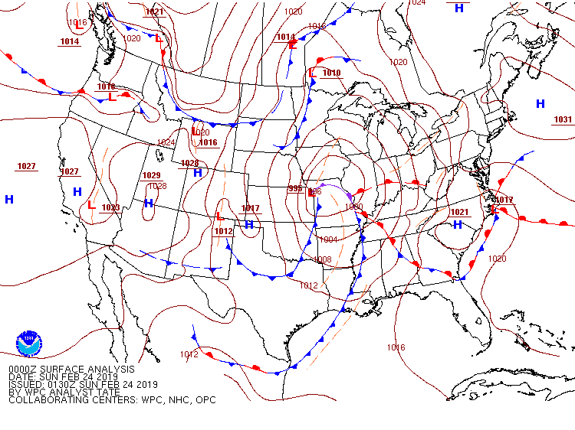
February 24-25, 2019 Wind Storm
7PM EDT February 23, 2019

Slide 23
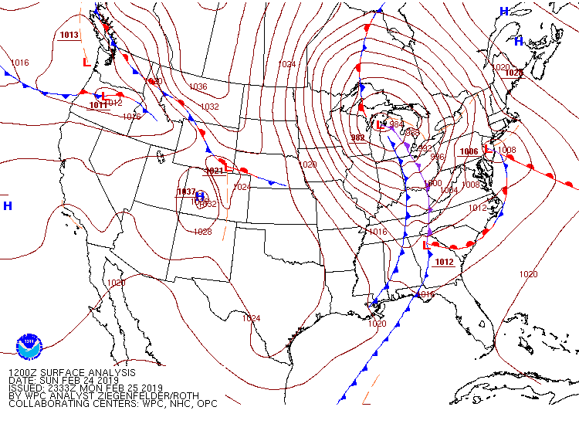
February 24-25, 2019 Wind Storm
7AM EDT February 24, 2019

Slide 24
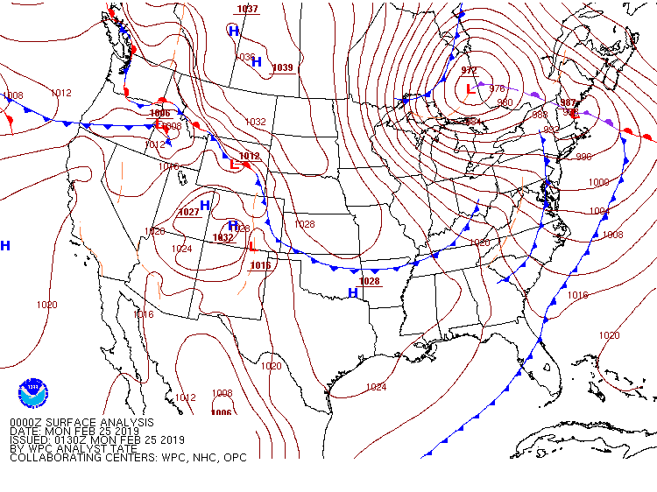
February 24-25, 2019 Wind Storm
7PM EDT February 24, 2019

Slide 25
February 24-25, 2019 Wind Storm
Peak Wind Gusts:
Oswego…………………….80 mph
Batavia……………………..74 mph
Niagara Falls Airport…..74 mph
Hamburg…………………..72 mph
Buffalo Airport……………69 mph
Rochester Airport……….66 mph

Slide 26
Wind Storms –
Role of the Human Forecaster
Model guidance accurately forecasts wind speeds aloft (several thousand feet off the surface), but struggle with diagnosing how much of the wind will reach the surface
During periods of warm advection (warm air advancing into a region), model guidance over-forecasts surface wind gusts
During periods of cold advection (cold air advancing into a region), model guidance under-forecasts surface wind gusts
Winds are channeled down Lake Erie, leading to higher gusts along the corridor from Buffalo to Rochester during southwest wind events
Human forecasters with local expertise recognize these scenarios, and many others, and adjust the wind gust forecast to improve the forecast

Slide 27
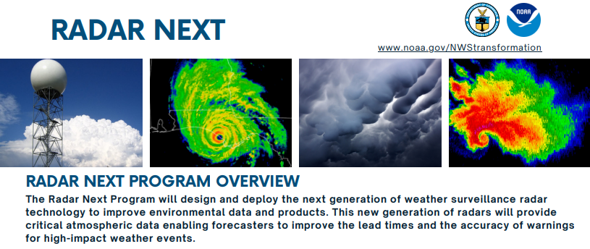
Advancing Technology in Meteorology

Slide 28
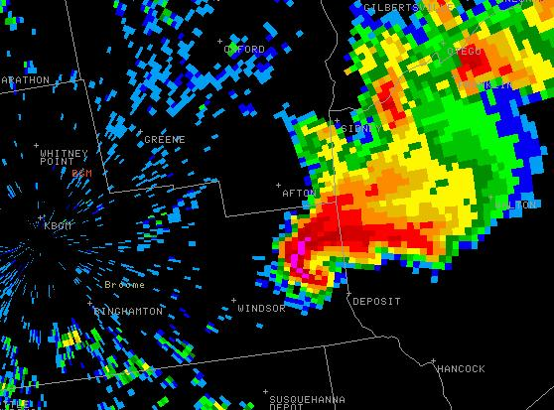
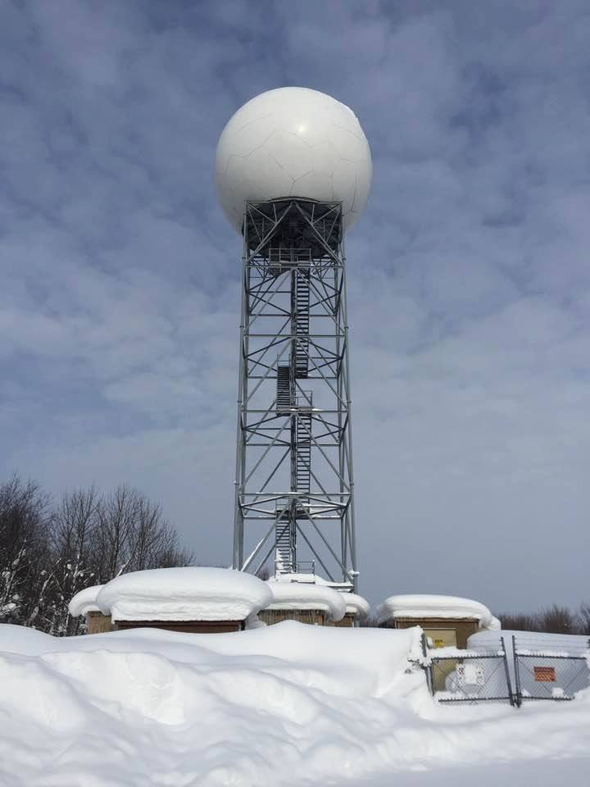

Weather Surveillance Radar WSR-88D
Montague, NY Radar

Slide 29
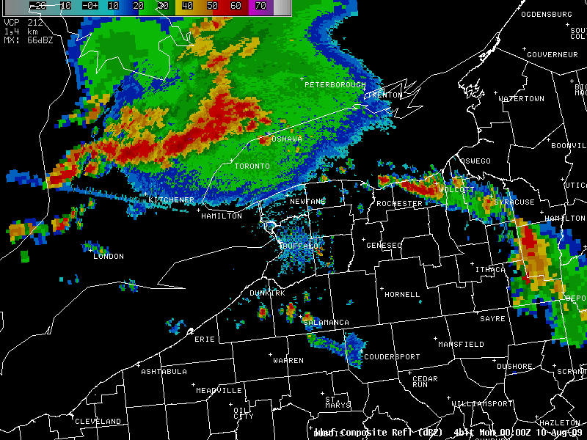
Radar Reflectivity
Displays energy reflected back to the radar
Shows location and movement of rain, snow, hail, etc.
Radar energy can also reflect back off birds, insects, and ground targets

Slide 30
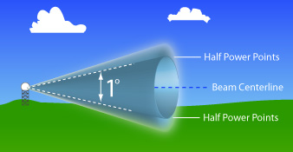

Radar Limitations – Beam Spreading
Affects resolution capability of the radar

Slide 31
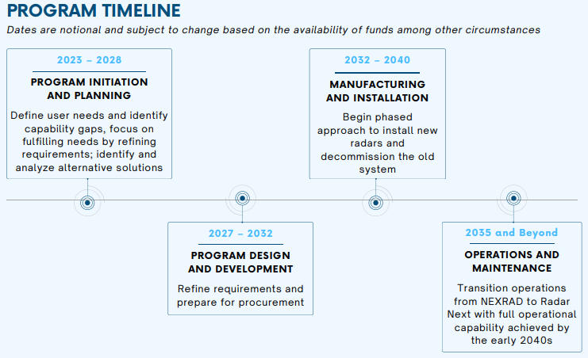
Radar Next Program

Slide 32

Numerical Weather Prediction
Some of the most powerful supercomputers in the world are used for numerical weather prediction
NWS Supercomputer processing capacity
2018 – 8.4 petaflops
2024 – 49 petaflops
over 45 quadrillion calculations per second!
Number crunching of numerical weather prediction still done with Fortran
NWS Supercomputer system

Slide 33
The Future? Artificial Intelligence (AI)?
AI isn’t new in meteorology, rudimentary AI in the form of machine learning and neural networks have been used for 30+ years
Modern AI – Two types
  Generative AI – A computer assists you in writing a forecast discussion
  Predictive AI – A computer assists you in forecasting the future
Can predictive AI be coupled with traditional numerical weather prediction to improve the forecast?

Slide 34
The Role of the Human Forecaster in the Future
The job of a meteorologist will likely be quite different in 10 years due to accelerating technological advances
There will always be a need for trained, professional meteorologists to explain and describe the impacts of the forecast weather to emergency management, DOT, highway departments, and the public
Forecasters in the loop vs over the loop

Slide 35
The Role of the Human Forecaster in the Future
Forecasters in the loop:
  Current National Weather Service operations
  Forecasters make direct decisions and input on the forecast and physically generate the forecast
Forecasters over the loop:
  Some private sector meteorology companies have already gone this direction
  Forecast is largely automated, meteorologists analyze the forecast output and can adjust anything they perceive as a significant error

Slide 36
Questions and Open Discussion
Contact Information:
Jon Hitchcock
Senior Forecaster, NWS Buffalo, NY
Email: Jon.Hitchcock@noaa.gov

