Slide 1

Best Practices in Organizational Excellence
at ESL Federal Credit Union
May 24, 2023

Slide 2
Today we will cover:
GRQC Organizational Excellence Award
Strengths identified and best practices
Questions

Slide 3
GRQC Organizational Excellence Award
Modeled after Malcolm Baldrige Award – but simpler
Focuses on how an applicant leads, manages and achieves results
  “Organization” defined by authority and autonomy
  Can be an entity, division, subsidiary, dept., ward, floor, plant, region, etc.
Seven Categories:
  Leadership
  Strategy
  Customers
  Measurement, Analysis & Knowledge Management
  Workforce
  Operations
  Results

Slide 4
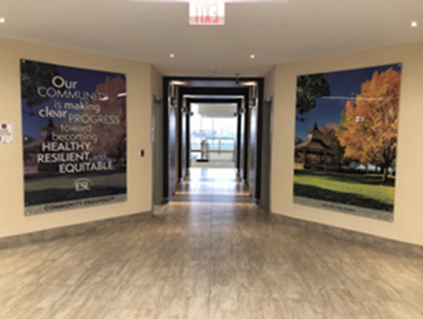
Strength 1 – Mature and Robust Strategic Planning Process
Strategic plan guides the organization:
  Foundation is our Mission, Vision and Purpose
  Goal alignment at every level
  Utilize the Kaplan and Norton Balanced Scorecard Methodology
Strategy is communicated in numerous ways:
  Strategy Map
  “ESLtoday” Intranet
  Signage around ESL’s workplace

Slide 5
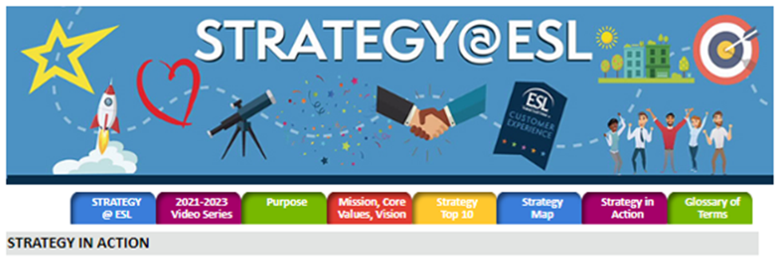
Strength 2 – Communication via the Intranet
ESLtoday Intranet used by all employees:
  Central location for employee communications
  Employees are expected to access daily as part of their job responsibilities
  Robust source of information
Helps employees see the link between daily work and organization’s long-term goals

Slide 6
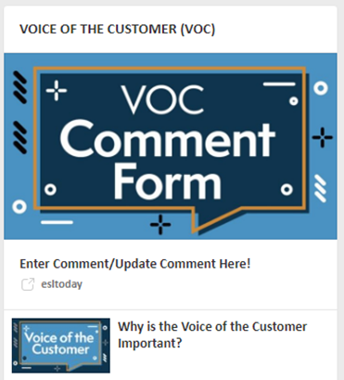
Strengths 3 and 4 – Obtain and Use “Voice of the Customer”
Feedback collected in multiple ways:
  Focus groups
  Surveys / third party market research
  Net Promoter Score
  Internal “Voice of the customer” system and database
Insights used in numerous ways:
  Informs strategic plan
  Drives improvements
  Aids in design and launch of products/services
  Enhances employees’ work

Slide 7
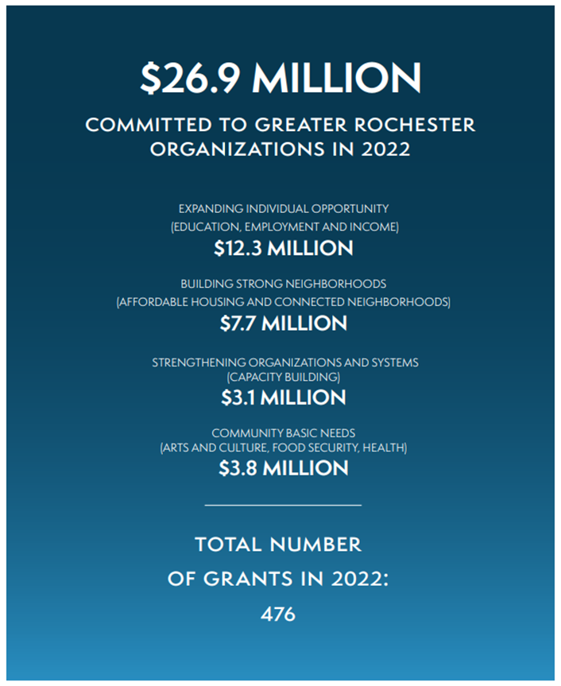

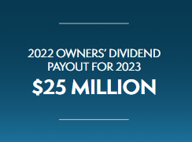
Strength 5 – Committed to the Greater Rochester Community
We live our purpose… Help our community thrive and prosper:
  Philanthropic grants
  New Branches in the City of Rochester
  Financial Wellness
  College Scholarships
  Organization Sponsorships
  Owners Dividend
  Voluncare program

Slide 8
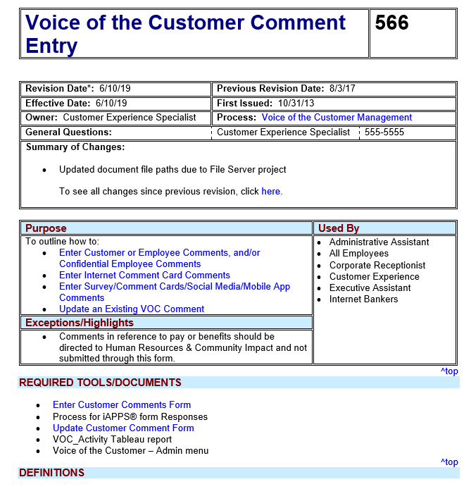
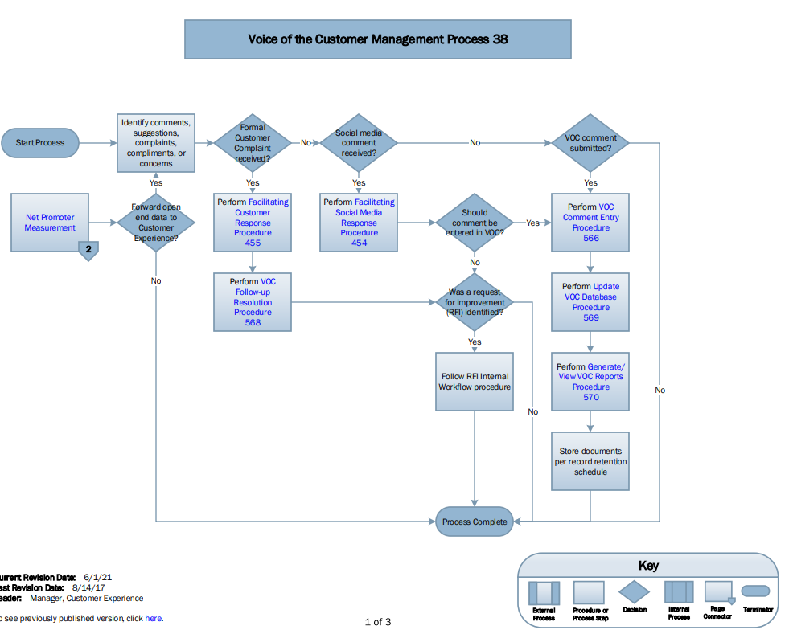
Strength 6 – Comprehensive Policies and Procedures
Policies, Programs, Processes and Procedures:
  Well-defined and documented
  Published on ESLtoday intranet
  Incorporated into new hire training

Slide 9

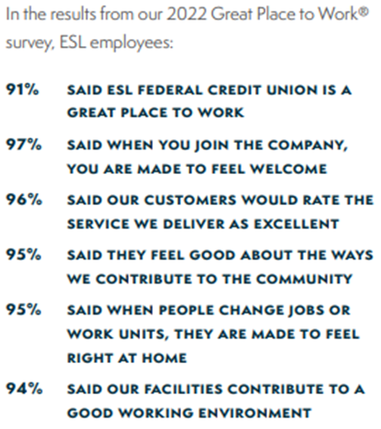
Strength 7 – High Employee Satisfaction
Employee satisfaction is part of the strategic plan:
  Measured for continuous improvement
  Results of well-defined recruiting, hiring, training and employment practices
A superior employee experience is essential to a superior customer experience:
  Ensuring employees are thoroughly trained and prepared for customer engagement
  Senior leaders clearly understand what employees are thinking

Slide 10
Strength 8 – Developing Current and Future Leaders
Clear strategy to develop current and future leaders:
  Goal to promote primarily from within the organization
  On-going employee training
  Focus on taking action to increase diversity:
  Building a workforce that mirrors the greater Rochester community
  Employee resource groups

Slide 11
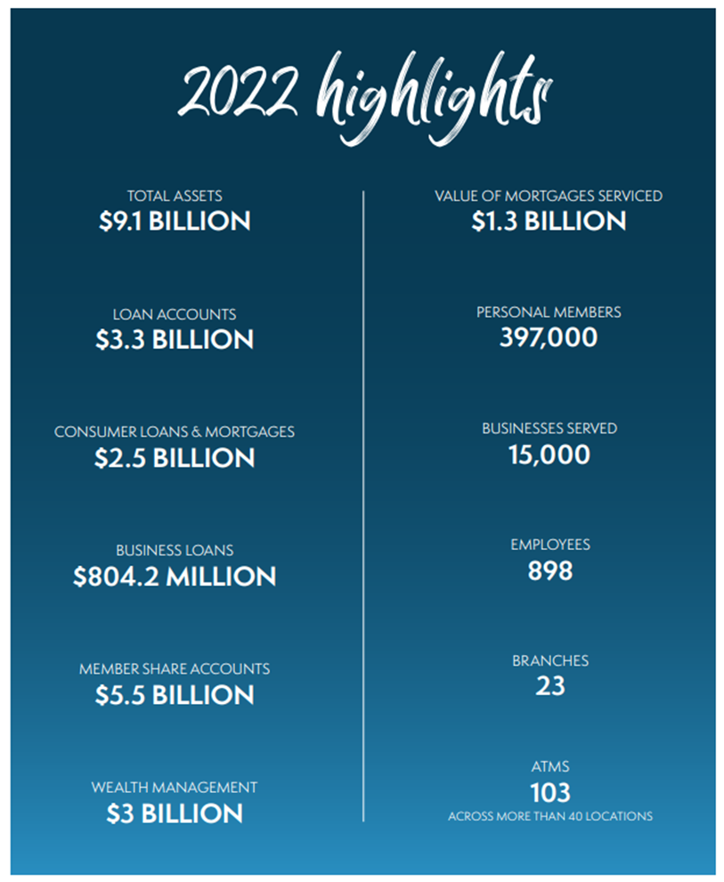
Strength 9 – Strong Financial Performance
Strong year over year results:
  Based on assets, ESL is in the top 1% of credit unions nationwide
  Ranks 1st in personal banking deposits in the Greater Rochester Area
  Totals assets increased approximately 50% since 2019, from $6.1 billion to $9.1 billion
A disciplined approach to planning, leadership, focus on customers and workforce drives strong business results

Slide 12
Questions?

