Slide 1

Operational Excellence for Nonprofits
3 Things Every Nonprofit Should Know
Terry Callanan
Chief Culture Officer, Carestream
Board of Directors, Greater Rochester Quality Council
Lead Trainer, Quality for Leaders
March 12, 2020

Slide 2

Your Jobs are Hard Enough….
Government regulations
Shrinking budgets
Retaining top talent
Ineffective software
Maintaining client/constituent satisfaction

Slide 3

…Without the Following
    We move a lot of information from one desk or computer to another without any value being added to it
    Material or information tends to pile up (e.g., calls on hold, appts in queue, paperwork, marketing materials in storage)
    We spend a lot of time looking for material or information (hardcopy or electronic)
How many feel this way?
    Our people are moving from here to there (e.g., walking to printer, driving to other locations) without adding value for the client
    We have too many internal approvals, or reports, or handoffs between departments; we are often waiting
    We tend to create more than we need just in case (e.g., manuals, handouts, posters, client folders)
    We are often dealing with material or information that is late, incomplete or wrong
    Our processes are unpredictable in their quality, timeliness, or cost
Notes:
Yellow Belt

Slide 4

The Result

Slide 5

There is a Better Way
    Through your leadership, you have the opportunity to create a culture of employee engagement and empowerment, focused on creating client value at the lowest cost.
      Relentless focus on waste elimination
      Understanding of how to solve problems
      Change management (gaining acceptance)
      Continuous improvement mindset
      Understanding, meeting and exceeding client needs
      Balancing strategy, execution and process improvement (need all 3)

Slide 6

Today: 3 Things Every Nonprofit Should Know
    Waste
    Variation
    Flow
    Summary and What’s Next
Notes:
Yellow Belt

Slide 7
Waste

Slide 8
Value Added
Value Added | Non-Value Added
Any process or operation that shapes or transforms a product or service into a final form that the client will pay for | Those process steps that take time, resources, or space, but do not transform or shape the product or service towards that which is sold to the client
  Any activity that does not add value is waste and only adds cost to the process

Slide 9
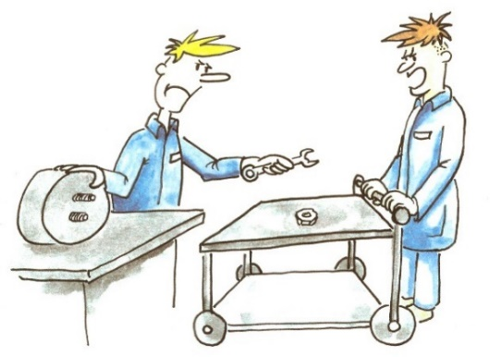
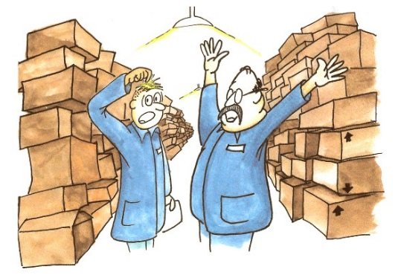
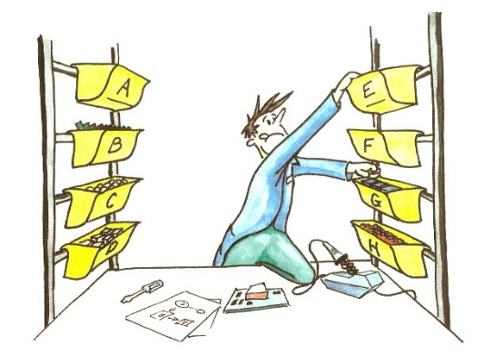
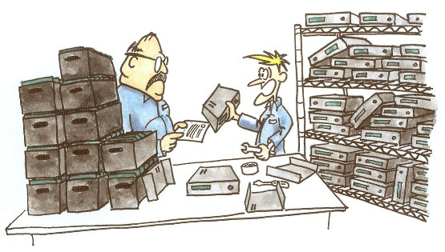
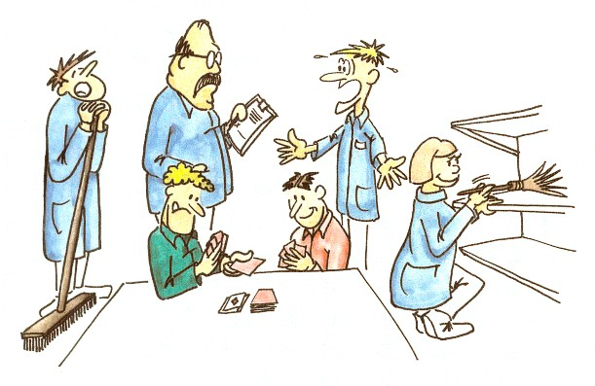
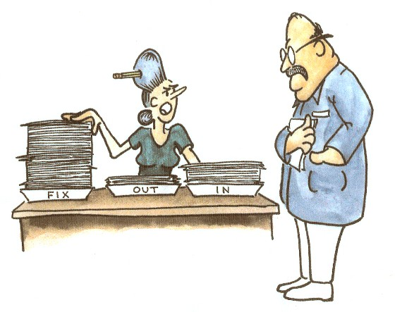
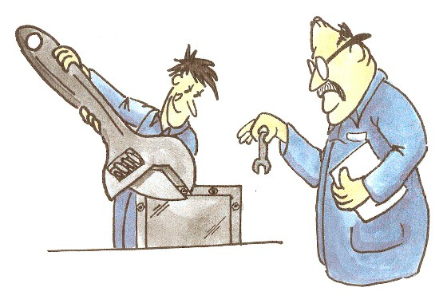
Seven Forms of Waste – “TIM WOOD”
Transportation
Inventory
Motion
Over-Production
Defects/Rejects/
Re-work
Waiting
Over-Processing

Slide 10
TIM WOOD
Typical Non-Value Added Activities
Transportation (moving material or information from one place to another)
Inventory (items/paperwork/information waiting to be processed)
Motion (excess movement and/or poor ergonomics)
Waiting (delays caused by shortages, approvals, downtime)
Over-production (producing more than is needed)
Over-processing (adding more than the client is willing to pay for)
Defects (doing the same job more than once in order to correct it)

Slide 11
Typical Operation
95% Non-Value Adding
5% Value Adding

Slide 12
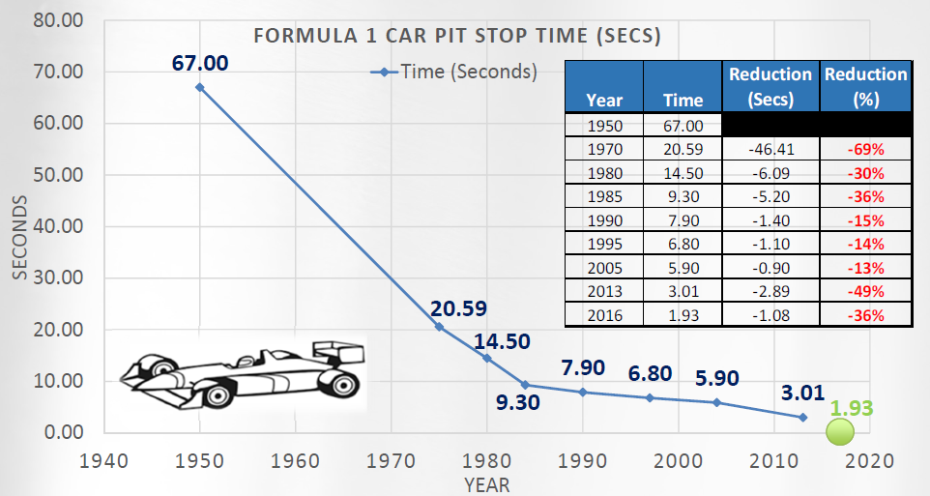
Relentless Focus on Waste Elimination
Formula 1 Pit Stop Video

Slide 13
Variation
Notes:
Yellow Belt

Slide 14
What do you Think?
“It Doesn't Snow Around Here Like It Used To.”
Agree ________
Disagree ________
14
Notes:
14
You may wish to substitute a local example here.
Probe why they answered the question the way they did - many responses will be based on a single observation or event.
Question: How should we settle this? DATA!!
This lack of agreement is why we need S.T. - to reach agreement and make decisions on facts.
1

Slide 15
Let’s Look at Some Data
Year
Inches of
Year
Inches of
Year
Inches of
Year
Inches of
snowfall
snowfall
snowfall
snowfall
1958-59
140.6
1976-77
92.1
1994-95
56.2
2012-13
78.0
1959-60
161.7
1977-78
160.9
1995-96
130.3
2013-14
112.7
1960-61
89.4
1978-79
138.5
1996-97
104.7
101.9
2014-15
2015-16 62.8
2016-17 107.1
2017-18 120.5
2018-19 97.1
1961-62
65.6
1979-80
72.2
1997-98
99.7
1962-63
76.4
1980-81
94.4
1998-99
111.6
1963-64
92
1981-82
128.4
1999-00
110.7
1964-65
71.1
1982-83
59.9
2000-01
132.5
1965-66
103.2
1983-84
118
2001-02
57.5
1966-67
74
1984-85
87.1
2002-03
135.2
1967-68
76.7
1985-86
70.7
2003-04
125.6
1968-69
79.8
1986-87
67.1
2004-05
113.6
1969-70
119.6
1987-88
69.8
2005-06
73.9
1970-71
142.7
1988-89
86.6
2006-07
107.2
1971-72
105.1
1989-90
105.8
2007-08
106
1972-73
73
1990-91
68.3
2008-09
103.7
1973-74
99.1
1991-92
110.6
2009-10
90.2
1974-75
91.2
1992-93
131.5
2010-11
127
1975-76
86.2
1993-94
126.2
2011-12
59.9
Notes:
15
What do you see? Variation.
What do you think? Is there a trend downward over time that would suggest that it doesn't’t snow around here like it used to? Hard to tell.
What would be a better way of looking at these data? PLOT the data!!

Slide 16
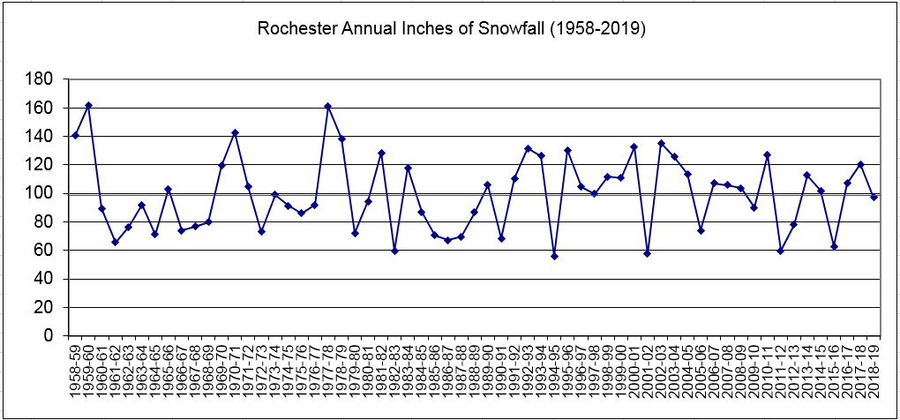
Plot The Data!
16
Notes:
16
What do you see now? Variation, no trends, random behavior.
How do recent snowfalls compare to the past? Nothing unusual – seems to just be part of normal variation.
If you had to predict what next years snowfall would be what would you say? Likely to be 100”, but could fall within 20-180” and be normal behavior. Don’t let perception (“it doesn't’t snow around here like it used to”) guide you – look at the data for trends and patterns before you react.
Someone says our results are down from last year, or our error rate has increased this quarter, or our client base has dropped YTD….what should you do?
We have our first two Data Learnings from this simple example (have the volunteer write these on the easel):
Ask to see the data
Plot the data

Slide 17
Another Example
Your friend comes back from vacation and says, “I gained five pounds last week.”
The same friend comes back a few days later and says, “I'm on a new diet and lost 5 pounds already.”
What is your best response to these comments?
  Keep your mouth shut ______
  Sympathize and then rejoice ______
  Ask to see the data ______
17
Notes:
17
Poll the students in a FUN survey: ASK people to vote by raising their hands.
Ans: Ask to see the data (if you dare)

Slide 18
Plot the Data (but is it enough?)
RS DAILY WEIGHTS
228
After
P
O
U
N
D
S
224
Vacation
220
Before
After
216
Vacation
Diet
212
18
Notes:
18
LECTURE / DISCUSS
These are the three data points. The weight really was different before the vacation, after the vacation and after the diets. The real question is “Did the process / system change?” What’s missing to answer the question?
Ans: The three points in context of additional data.

Slide 19
The Data In Context
RS DAILY WEIGHTS
228
P
O
U
N
D
S
224
220
216
212
Jan 1998
19
Notes:
19
ASK
• Here are the three point in the context of the process. What do you see?
Ans: At that time they represent just random variability in the process.
LECTURE
There are really changes, trends and cycles. But there is also random noise. The three points appear at a time when the basic process is not changing.
The data based decision is at that point: It’s just random variability. Don’t worry about the initial “gain,” don’t celebrate the later “loss.”

Slide 20
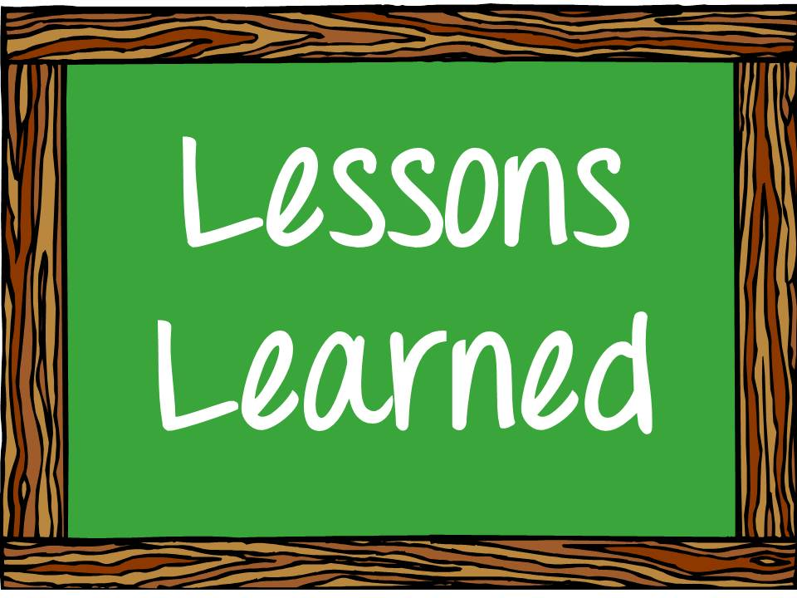
Learnings
Everything we do has inherent variation
Ask to see the data (don’t rely on perception)
Plot the data to best understand process variation and performance
Plot the data in context (don’t make point-to-point comparisons)
Notes:
20
ASK
• Here are the three point in the context of the process. What do you see?
Ans: At that time they represent just random variability in the process.
LECTURE
There are really changes, trends and cycles. But there is also random noise. The three points appear at a time when the basic process is not changing.
The data based decision is at that point: It’s just random variability. Don’t worry about the initial “gain,” don’t celebrate the later “loss.”

Slide 21
Flow

Slide 22
Post-It Note Exercise
A B C D E F G H
This is a completed “Report”

Slide 23
Post-It Note Exercise
Form teams of size 8 (count off 1-2-3…# teams)
Assign a letter per person A, B, …. H
Each person learns their process step (write your letter “A”, “B”, …)
Give stack of post-its to person A
Assign a time keeper per team
Goal: Produce 5 completed “reports” in the most efficient manner
Run #1: Each person complete your process step on 5 reports. Only when 5 reports are completed through your operation, move those 5 reports to the next operation.
Run #2: Participants re-seat themselves in process order (“A” next to “B”, “B” next to “C”, etc) Repeat the process as done in Run #1.
Run #3: Each person complete your process step on 5 reports. But move each report to the next operation as soon as you’ve completed your step.

Slide 24
Summary
and
What’s Next

Slide 25
You’ve Just Seen Key Principles of “Lean Six Sigma”
Lean
Identifies problems in the flow
X
Lean
Helps identify steps that don’t add value (waste) and provides tools to eliminate them

Slide 26
You’ve Just Seen Key Principles of “Lean Six Sigma”
Six Sigma
Improves the capability of steps that do add value (reduce variation)
X
Six Sigma
Improving capability can eliminate additional steps and time

Slide 27
You’ve Just Seen Key Principles of “Lean Six Sigma”
Lean
Identifies problems in the flow
Six Sigma
Improves the capability of steps that do add value (reduce variation)
X
X
Lean
Helps identify steps that don’t add value (waste) and provides tools to eliminate them
Six Sigma
Improving capability can eliminate additional steps and time
Together, Lean and Six Sigma provide a holistic approach to process improvement.

Slide 28
Want to Know More?
Quality for Leaders
Brought to you by GRQC, MCC and RIT
2-day classroom instructor-led training with interactive lectures, videos, participative exercises and success stories
Topics include:
  The value of quality improvement and performance excellence
  The importance of top management leadership
  Lean Enterprise
  Six Sigma
  Voice of the Customer
  Change Management
  Creating your own organization’s improvement plan
Go to www.grqc.org to sign up for Quality for Leaders on May 14-15 (at RIT)

Slide 29
Want to Try It?
Day of Quality
Brought to you by GRQC
Modeled after the United Way Day of Caring
A volunteer effort across Greater Rochester to improve organizational performance in 1 day!
You sign up to host a 2-person team of quality experts to partner with your team to solve a challenge you are facing
Look to sign up during 2Q for Day of Quality on Thursday, Oct 15 (hold the date)
Quality for Leaders + Day of Quality = Your First Steps Toward Cultural Change

Slide 30

Contact Info:
terry.callanan@carestream.com
terrancepcallanan@gmail.com
(585) 500-7236

