Slide 1
Gaining Buy-in to Quality Improvement Initiatives March 29, 2023

Slide 2
AGENDA
Welcome (10 min)
About GRQC
Why today’s topic?
Speaker introductions
Speaker presentations (2 x 20 min each = 40 min)
Discussion – your experiences and questions (10 min)
2
Notes:
2

Slide 3
About GRQC
Overview
Greater Rochester Quality Council is a collaborative network of organizations and individuals whose expertise is quality and performance excellence. Our purpose is to stimulate and foster excellence in the products, services, & processes of all organizations & businesses in the community so that the Greater Rochester area continues to grow economically and attracts new business. We promote sharing of resources, learning, & expertise in Quality principles and practices.
We serve the five economic sectors of:
- Business
- Education
- Government
- Healthcare
- Not for Profit
GRQC has accomplished more for the local community than any other quality organization in New York State.
- GRQC is an organization of organizations and individuals dedicated to continuous quality improvements
- GRQC is and affiliate of the Greater Rochester Chamber of Commerce
- GRQC, through its volunteers, supports several community improvement initiatives such as GRQC Day of Quality, Lean Six Sigma Consortium and the Performance Excellence Awards
3
Notes:
3

Slide 4
Performance Excellence Awards
4
Notes:
4

Slide 5
April Performance Excellence Forum
5
Notes:
5

Slide 6
Why Today’s Topic?
Q x B = E
EFFECTIVENESS of Quality Improvement Initiative
Modeled after QxA=E: General Electric, Change Acceleration Process

Slide 7
Why Today’s Topic?
Q x B = E
QUALITY
of Initiative
EFFECTIVENESS of Quality Improvement Initiative
Modeled after QxA=E: General Electric, Change Acceleration Process

Slide 8
Why Today’s Topic?
Q x B = E
QUALITY
of Initiative
BUY-IN
of Initiative
EFFECTIVENESS of Quality Improvement Initiative
Modeled after QxA=E: General Electric, Change Acceleration Process

Slide 9
Speaker Introductions
Terry Callanan is the owner of WalkOn Consulting, LLC.
Trish Mooney is the President of Lifetime Benefit Solutions.
Modeled after QxA=E: General Electric, Change Acceleration Process

Slide 10
GAINING BUY-IN TO QUALITY IMPROVEMENT INITIATIVES Terry Callanan

Slide 11
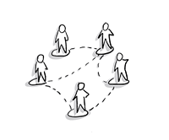
Gaining Buy-in to Quality Improvement Initiatives
Stories...4 Parts
Roles
Individual Quality Improvement contributor
Senior leader of Quality Improvement
Situation
Approach
Outcome
Moral
People Image: Unknown Author (CC BY-SA-NC)

Slide 12
Story of an
Individual Quality Improvement Contributor
#1
Situation
Presented an important Business problem
Story Image: Unknown Author (CC BY-SA-NC)
Radiology Image: National Cancer Institute, an agency part of the National Institutes of Health, ID 2498

Slide 13
Story of an
Individual Quality Improvement Contributor
Approach
Translated Business Problem to a Quality problem – how to design an experiment and model its data in a way that (1) confirms our competitive position and (2) reveals the technical drivers behind the perceptions of radiologists
Statistics Image: Open.Ed@PSU (CC BY-NC 4.0)

Slide 14
Story of an
Individual Quality Improvement Contributor
Solved Quality problem
Translated back to Business problem
Approach
(cont’d)
Blind stimuli
Forced rank
Paired comparisons
Partial Least Squares
Principal components
Mask the images
Simultaneously present on view box
Present some select comparisons
Follow an interview script
Physicist observe/listen
Statistics Image: Open.Ed@PSU (CC BY-NC 4.0)

Slide 15
Story of an
Individual Quality Improvement Contributor
Executed design across multiple orthopedic units in US and CA
Analyzed data for drivers of radiologist preference
Formulated a new film that became award winning and #1 in the market
Outcome
Award Image: Creative Commons (4.0 BY-NC)

Slide 16
Story of an
Individual Quality Improvement Contributor
Importance of translation
Speak the language of the organization
Keep the neat technical stuff in the background (unless there is interest)
Favor working on problems that will have the most impact; this will prove your value and generate pull and buy-in for your services
Moral

Slide 17
Today’s Purpose
Q x B = E
QUALITY
of Initiative
BUY-IN
of Initiative
EFFECTIVENESS of Quality Improvement Initiative
Speak the language of the organization; keep the neat technical stuff in the background

Slide 18
#2
Story of a
Senior Leader of Quality Improvement
Situation
Asked to assess how we were measuring and improving customer satisfaction as a company
Dashboard Image: Unknown Author (CC BY-SA-NC)

Slide 19
Story of a
Senior Leader of Quality Improvement
Approach
Collected “VOC” from senior business leaders
Established vision:
Own the survey process so we are closer to the customer
Shorten survey to be more meaningful and actionable
Present the data in real-time, filterable by business, location and other demographics

Slide 20
Story of a
Senior Leader of Quality Improvement
Approach
(cont’d)
Focused on one business where we had pull, in one geography, covering specific product lines. Collected data for a month; shared what we learn
Did not:
Publicize what we were doing with the full organization
Purchase software
Add staff

Slide 21
Story of a
Senior Leader of Quality Improvement
Outcome
Business gleaned timely and actionable insights (themes and by customer)
And…
Other businesses wanted to participate
Branded program internally as “eXceed” and developed companion training
Purchased commercial software to help us scale
People Image: Mentalmind/Shutterstock.com

Slide 22
Story of a
Senior Leader of Quality Improvement
Before making a big splash about a culture change initiative (banners, announcements, promotions), pilot the change first. Demonstrate the business value. Create pull to scale up.
Use data to demonstrate what’s possible (not just the hypothetical) in order to gain buy-in
Moral
Arrow Image: Unknown Author (CC BY-SA-NC)

Slide 23
Today’s Purpose
Q x B = E
QUALITY
of Initiative
BUY-IN
of Initiative
EFFECTIVENESS of Quality Improvement Initiative
Speak the language of the organization; keep the neat technical stuff in the background
Before making a big splash about a culture change, pilot the change first

Slide 24
#3
Story of a
Quality Improvement Manager
Six Sigma training rolled out, seeing early applications; workforce “shook” from recent time recording abuses
Situation

Slide 25
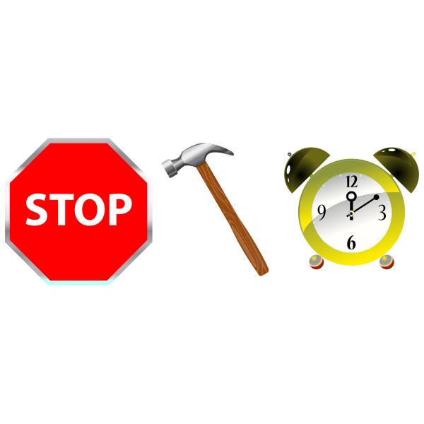
#3
Story of a
Quality Improvement Manager
Six Sigma training rolled out, seeing early applications; workforce “shook” from recent time recording abuses
Wanted to incent and recognize the application of quality tools and processes via an awards ceremony, where we would shut down for a day and all employees would be required to attend
Situation

Slide 26
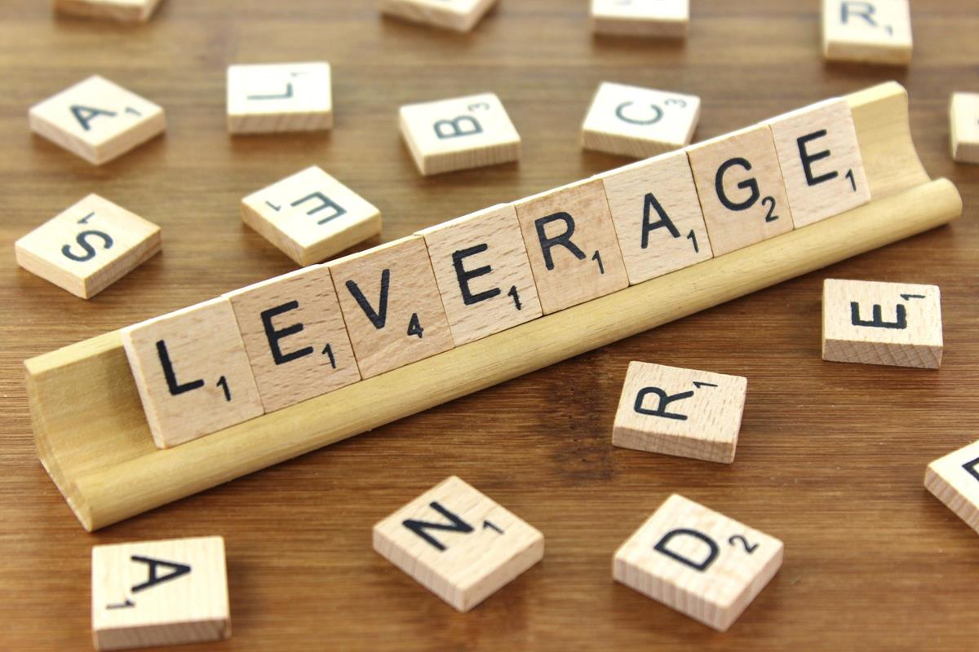
Story of a
Quality Improvement Manager
Approach
Designed a proposal, leveraging two things:
Manager: Believed in empowering people with skills and capability, building their confidence and pride, and breeding commitment through results
Precedent: We had shut down for a day previously (safety), and by doing so communicated a message of the importance of safety
Leverage Image: Creative Commons (CC BY-SA 3.0)

Slide 27
Story of a
Quality Improvement Manager
Outcome
LT agreed to shut down for a day for our “Six Sigma Expo”
Presented “Siggy” Awards (modeled after Tony, Grammys, Emmys)
Held in a theater to music; manager wearing a tuxedo
“I would like to thank my mom…”
Teams hosted poster sessions; showcased their awards; shared learning
Employees and management loved it
Six Sigma
Expo

Slide 28
Story of a
Quality Improvement Manager
Tie your quality ideas to the culture you are working in
Sustained quality improvement often requires a shift in culture, but when you are taking those first steps, seek to leverage parts of the existing culture to gain buy-in
Moral

Slide 29
Today’s Purpose
Q x B = E
QUALITY
of Initiative
BUY-IN
of Initiative
EFFECTIVENESS of Quality Improvement Initiative
Speak the language of the organization; keep the neat technical stuff in the background
Before making a big splash about a culture change, pilot the change first
Tie your quality ideas to the culture you are working in

Slide 30
Gaining Buy In on Continuous Improvement projects
Trish Mooney
March 29, 2023

Slide 31
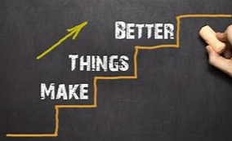
Purpose of this Overview
Continuous Improvement benefits
Gaining Leader Buy In
How do CI Project differ from a Technical Projects?
Gaining Team Level Buy In
Things to Consider

Slide 32
Benefits of Continuous Improvement
Process Efficiency
Cost Efficiency
High Quality
Reduced time and rework
Process visibility
Can we accomplish improvements without Buy In??

Slide 33
Gaining buy in - Leadership level
Identify key leadership stakeholder
Identify their mission, goals and customers
Understand their business problem(s)
Understand their vision and expectation post project
Share the difference between a Technical vs a CI project
Set expectations
Deliver benefit early and often
COMMUNICATE….. COMMUNICATE

Slide 34
How CI Projects differ from Technical projects?
CI projects focus on things like decreasing cycle time, reducing cost, and/or improving accuracy Goals may be known, but the solution is not Gaps and root causes need to be identified Deliverables may include actions for business process changes and/or requirements for technical changes Improvement tools are used Process Improvement Methodology is used | Technical Enterprise projects focus on developing and/or implementing a solution for a desired future state It is known at the outset what needs to be done, e.g., implement this mandate, deploy that vendor’s application in our environment, etc. Requirements are created Project management skills are required Project is led by a Project Manager Project Lifecycle Methodology process is followed

Slide 35
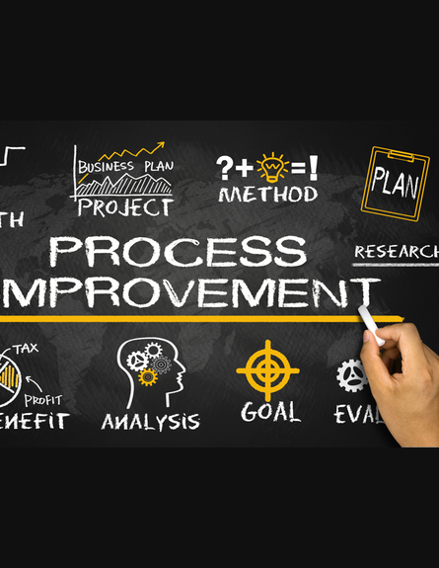
Gaining Buy In – team level
Identify Stakeholders
Identify and unify on Stakeholder needs and goals
Level set on terminology and collaboration guideline – create a data dictionary
Remove “you, your “ from your vocabulary
Facilitate the team identifying opportunities and improvements
Don’t highlight everything that is wrong. Provide data that illuminates opportunities.
Execute on Improvement Plan
Create a measurement plan that includes metrics from the improvement effort
COMMUNICATE
CELEBRATE Success

Slide 36
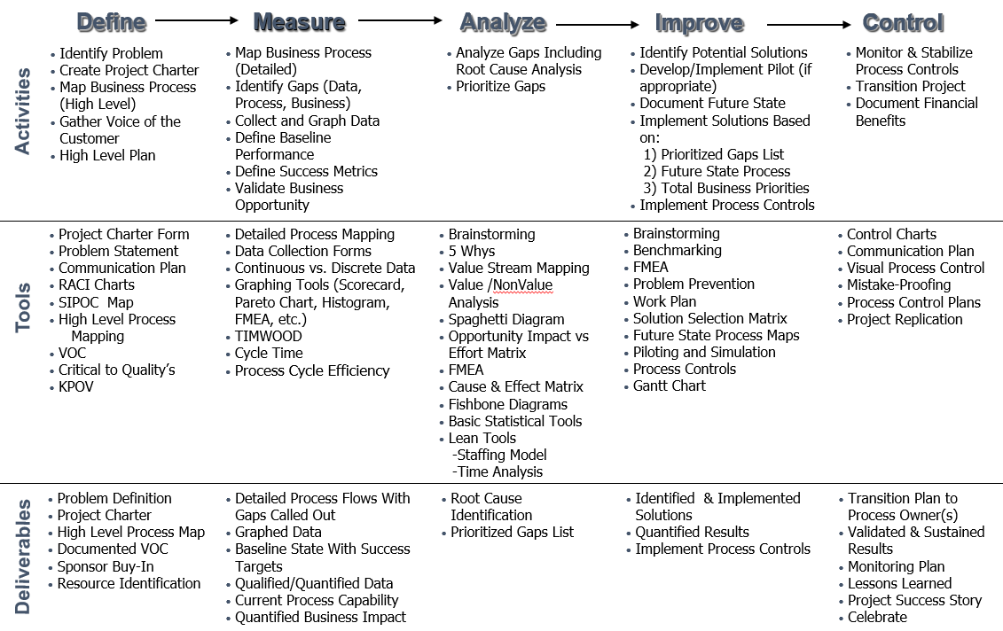
Things to consider
Think with your Head, Heart and Hand
Business team members are Subject Matter Experts on their business process not CI tool, terminology and technique – Don’t Overwhelm Them
Get the business team involved:
Let the team tell their improvement journey
Create a scorecard that can be shared a KPI meetings
Add improved KPIs to the Performance Appraisal

Slide 37
Questions?

