Slide 1


Prevention Measures to Reduce the Spread of COVID-19 in a Child Care Setting and the Effectiveness of Measures.

Slide 2
Agenda
Introductions
Brief history of Care-a-lot
Changes to procedures due to the COVID-19 pandemic
Face covering policy
Unique Challenges with Infants
Adjusting Procedures in Response to Increase in Infection Rates
Tracking Data
Impact on Staff, Culture and Business
Questions

Slide 3

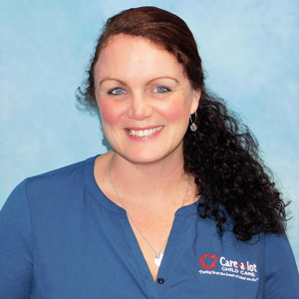
Introductions
David Kolczynski
President and Owner
Shannon Rynkiewicz
Director of Programs/
COVID-19 Liasion

Slide 4
A Brief History
Care-a-lot was established in 1991
David Kolczynski acquired three Care-a-lot centers in 2017
Acquired three Storybook centers in 2018 and rebranded in 2019
Acquired Fairport After-School program in 2019
Acquired Bates-Rich Beginnings in Fairport in 2020
7 locations: Greece (2), Farmington, Henrietta, Pittsford, Fairport (2)

Slide 5
Changes to Procedures
Modified procedures in late March
Almost weekly changes until early June due to a lack of formal guidance from NYS
Received written guidance from Office of Child and Family Services (OCFS) in early June

Slide 6
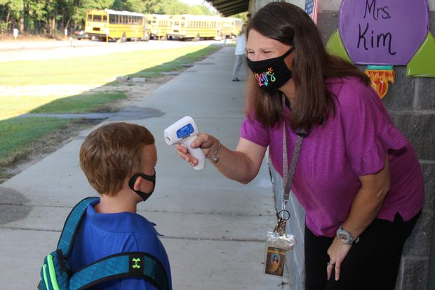
Changes to Procedures
Two Factor Screening Process
All individuals who enter the facility are screened at the Screening Station.
Temperatures are taken using a no contact thermometer.
Individuals who enter the facility are encouraged to use hand sanitizer.
COVID-19 screening questions are asked.
Screening staff wear appropriate PPE
Any individuals exhibiting symptoms of COVID-19 are not permitted to enter the facility.
Children are then “health checked” in the classroom and monitored for symptoms.

Slide 7
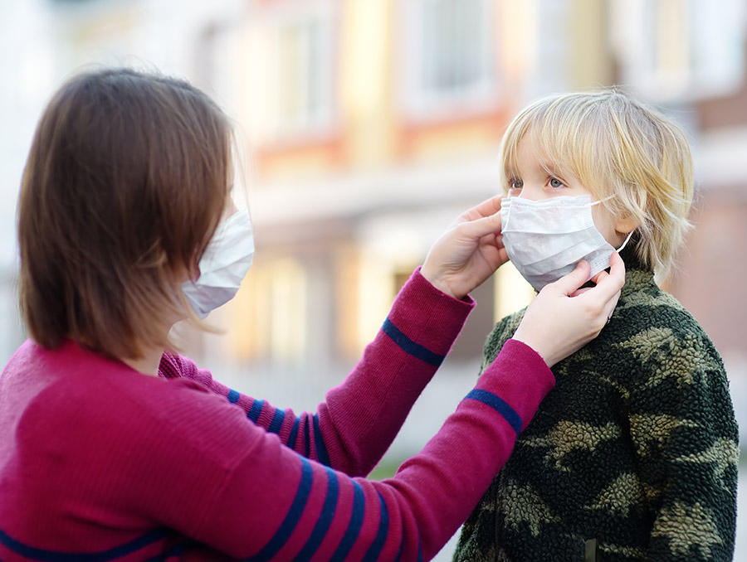
Changes to Procedures
Safe Drop off and Pick up Procedures
Families are instructed to drop children off at the entry door or at the classroom door. This decreases the contact between staff and families.
Children are welcomed at the door and escorted into their classrooms.
All staff wear face masks at all times.

Slide 8
Changes to Procedures
Visitor Policy
Restricted visitors based on OCFS guidance
Restricted therapist visits
No ‘non-essential’ visitors allowed in buildings
Virtual tours, interviews, meetings and trainings

Slide 9
Changes to Procedures
Cleaning and Sanitization Procedures
Classrooms, offices and common area floors are vacuumed and mopped frequently.
Cleaning and sanitizing checklist of classroom equipment, materials and touch points utilized to ensure all areas are always clean and sanitary.
Soft and washable materials and equipment are washed in hot soapy water on a weekly basis.
Extra staff required for cleaning
Chose to not pursue ‘fogging’ of facilities due to cost and lack of evidence of impact

Slide 10
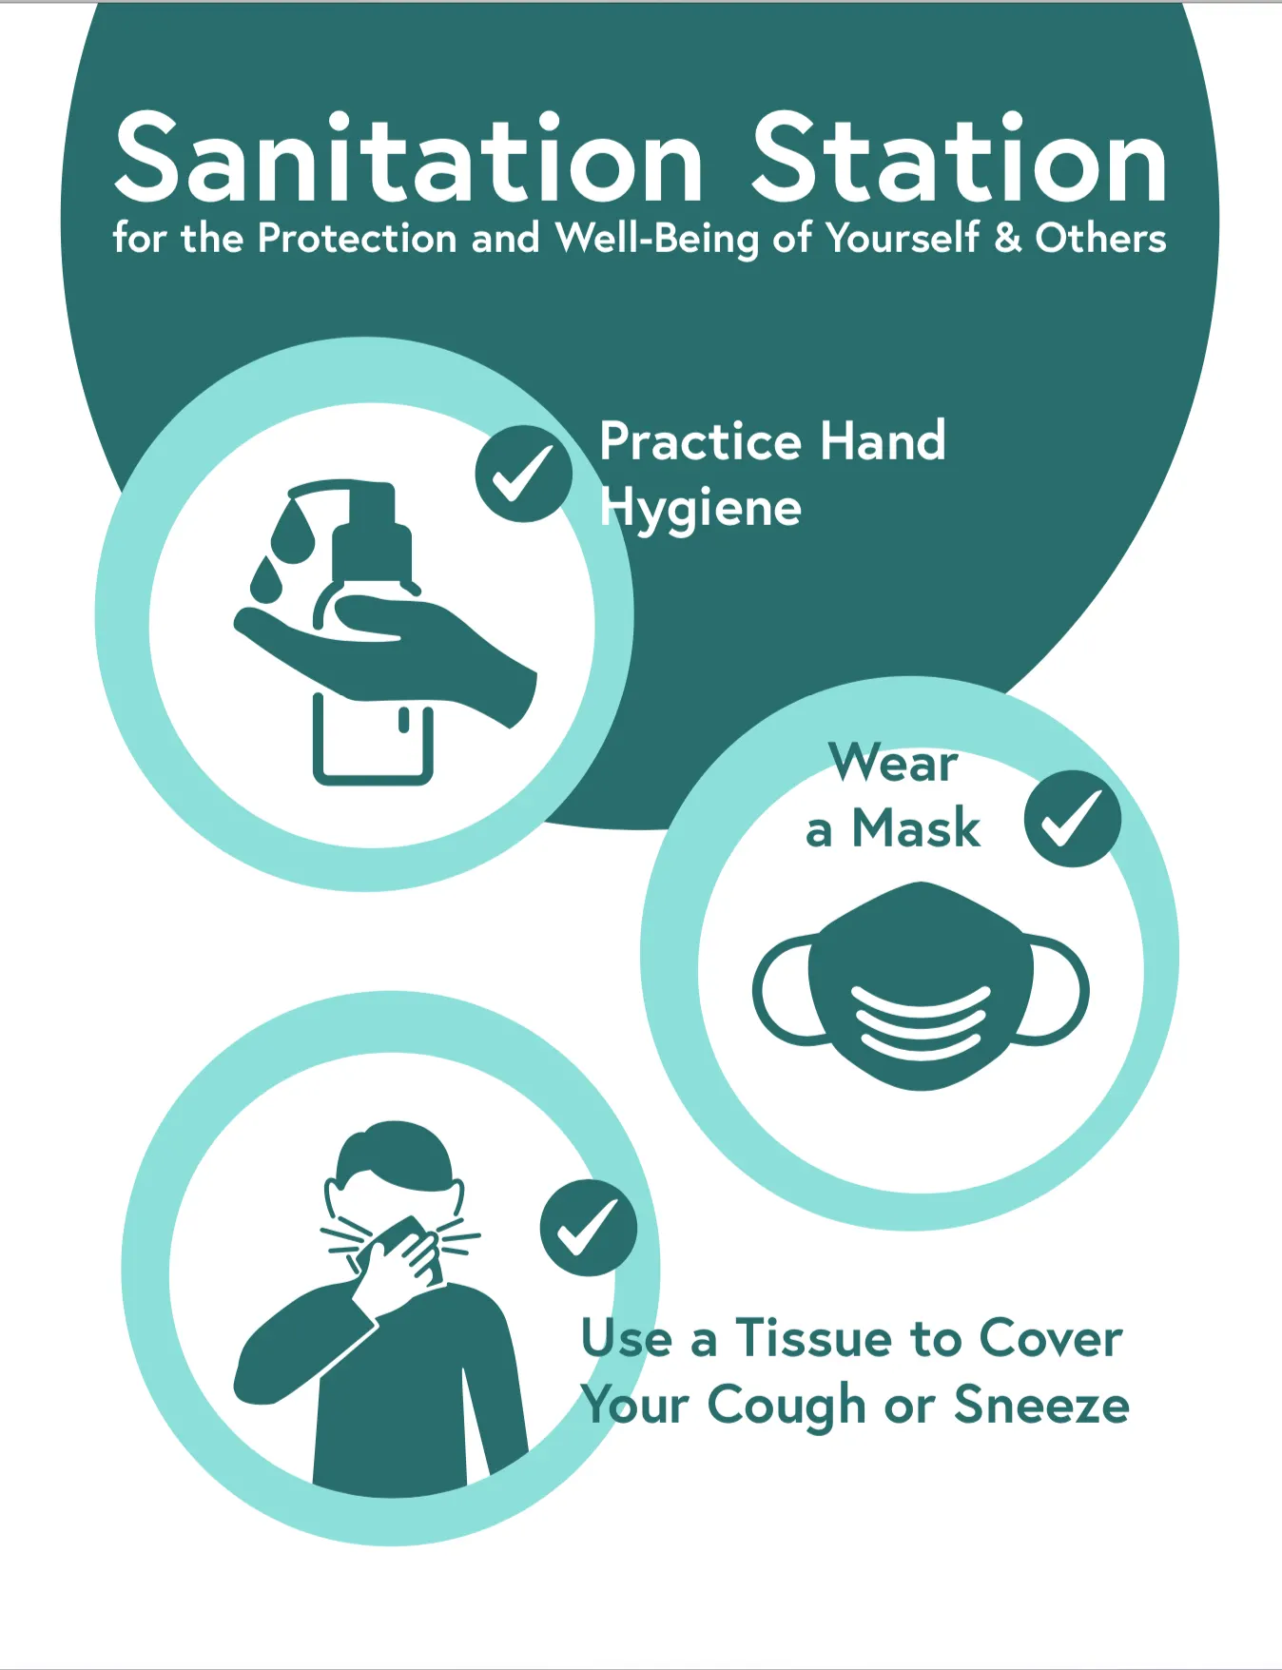
Changes to Procedures
Scheduled Cleaning and Sanitization of
High Traffic Touch Points
Fresh bleach water is kept at “cleaning stations” around the facilities.
High traffic touch points are wiped down with bleach water every hour and more frequent during drop off and pick up time.
Cleaning documented using log sheet

Slide 11


Slide 12
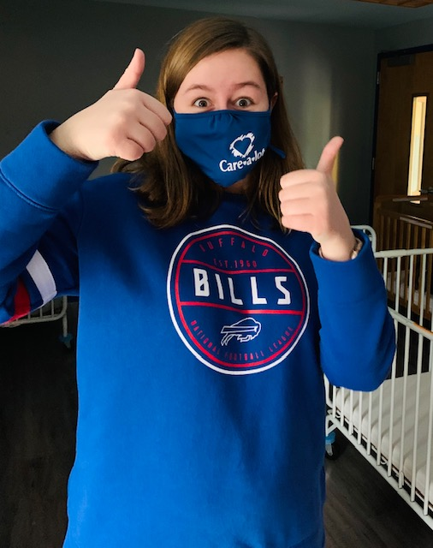
Face Covering Policy
All individuals (parents and children >2) who enter the facility must wear a face covering.
Staff members are required to wear a face covering that always covers their mouth and nose.
Initially had to buy masks for employees from a family friend as we could not buy them.
All staff received a complimentary Care-a-lot face mask.
Initially children were not required to wear masks inside the center.

Slide 13
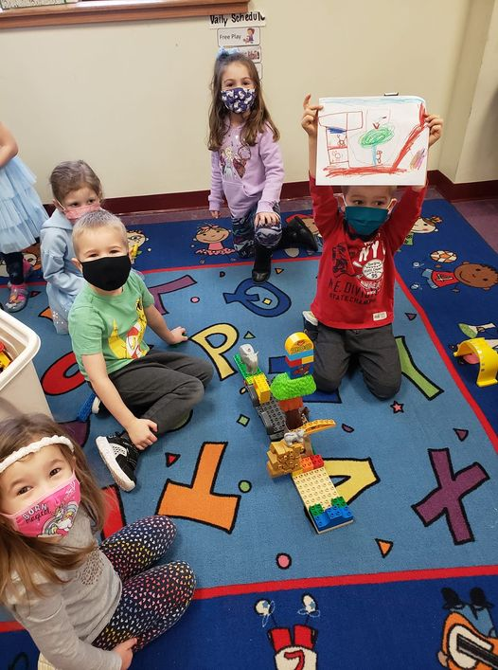
Face Covering Policy
Modified Face Covering Policy 1
Children 2 – 5 years old are required to wear a face covering whenever they are moving around the building and not in their home classrooms.
Intent was to minimize number of children who would be considered to have had ‘contact’ if there was a positive case at the center

Slide 14
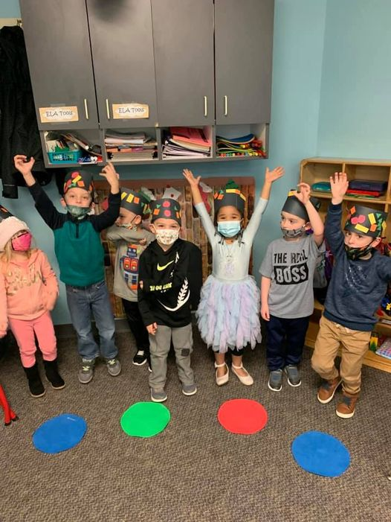
Face Covering Policy
Modified Face Covering Policy 2
School Age children required to wear masks all day.
Considered requiring all children >2 to wear masks all day but chose not to because:
  Masks are off during lunch and nap time
  Parents did not want children wearing masks all day

Slide 15
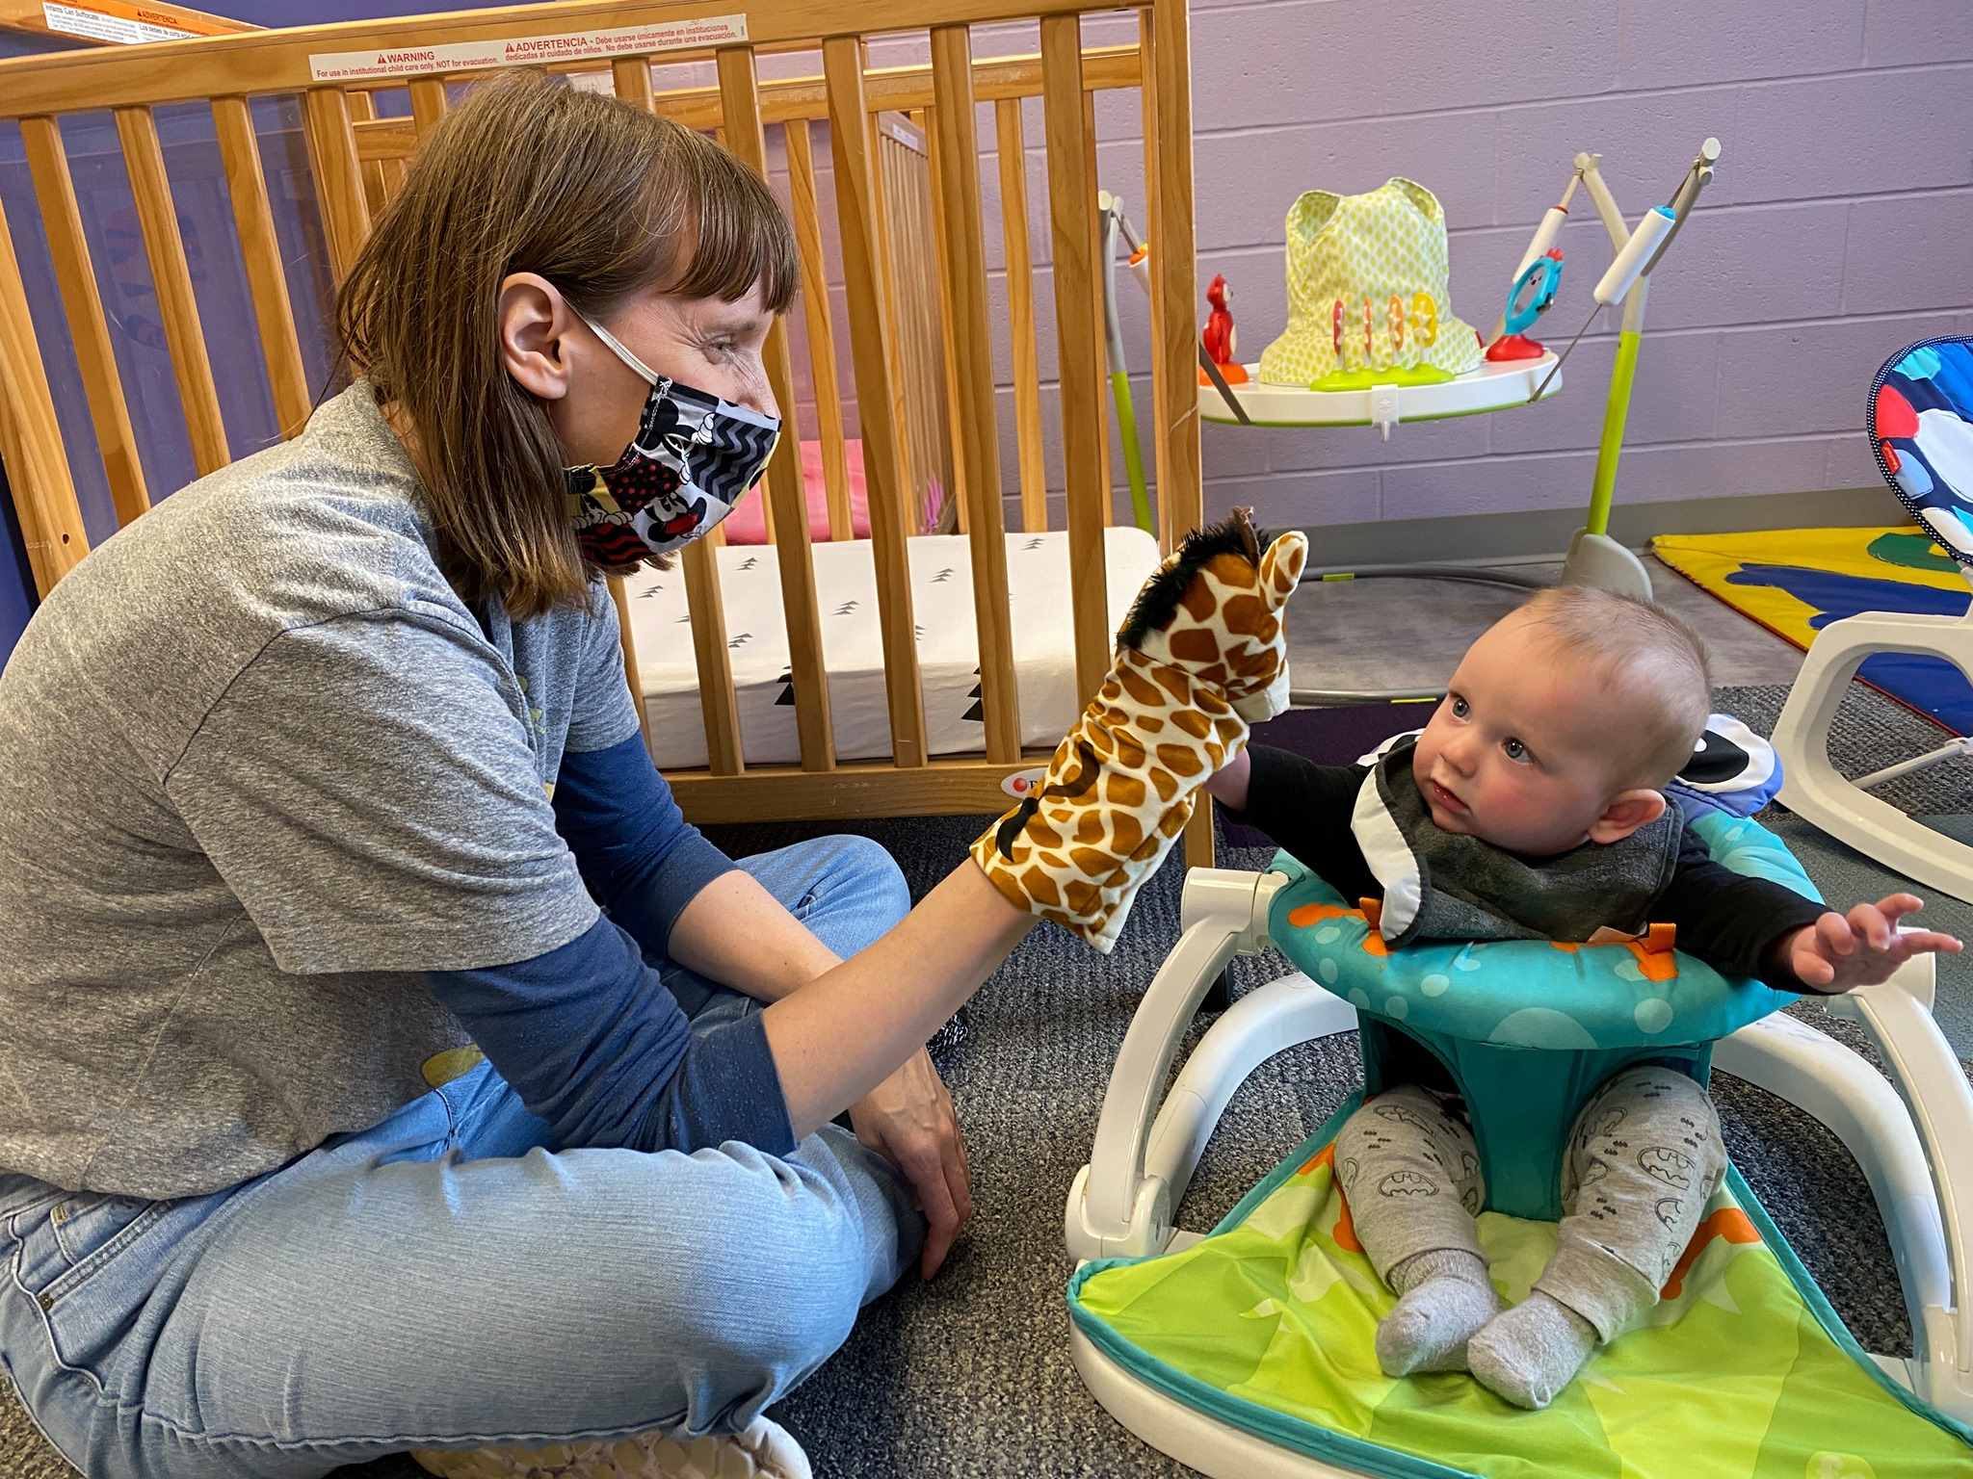
Unique Challenges with Infants
Children under the age of 2 do not wear masks
Increased likelihood of “direct exposure” with infants
Higher risk of transmission between infants and with staff
Difficult to assess symptoms in infants
  Runny noses common

Slide 16
Adjusting Procedures Due To Increased Infection Rates
Staff living with someone who is positive are not allowed in center until they have a negative test result.
Any staff or child awaiting test results ​is not permitted in the facility until proof of negative test result.
Any positive cases are reported to the Department of Health (DOH)
  Care-a-lot reports all possible direct contacts and follows DOH guidance.​
  Challenges with inconsistent guidance from DOH from different counties

Slide 17
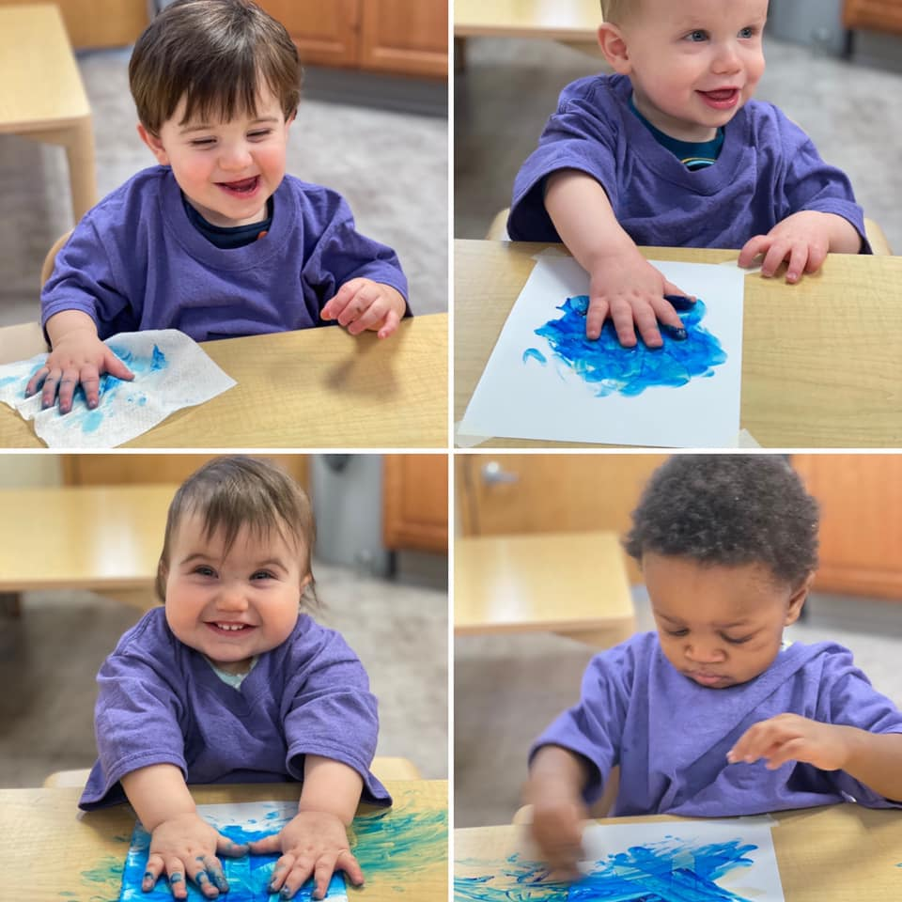
Tracking Data
Caring for 300 – 500 children per day across all centers
Positivity rate across all 7 Centers
  Total of 17 cases over 12 months
  Less than 0.02% infection rate
Rate of infection without infants
  Total of 9 cases over 12 months
  Infection rate drops to 0.01%
Singular cases – no spread except for infants

Slide 18
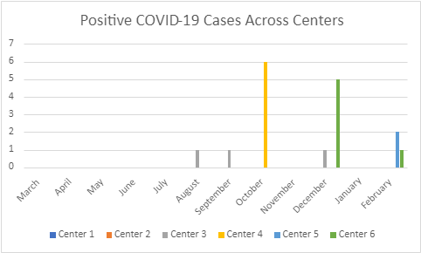
Tracking Data

Slide 19
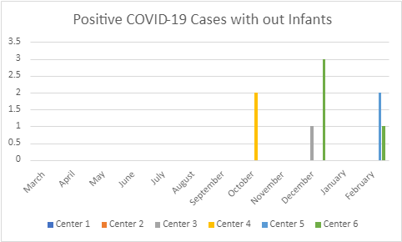
Tracking Data

Slide 20
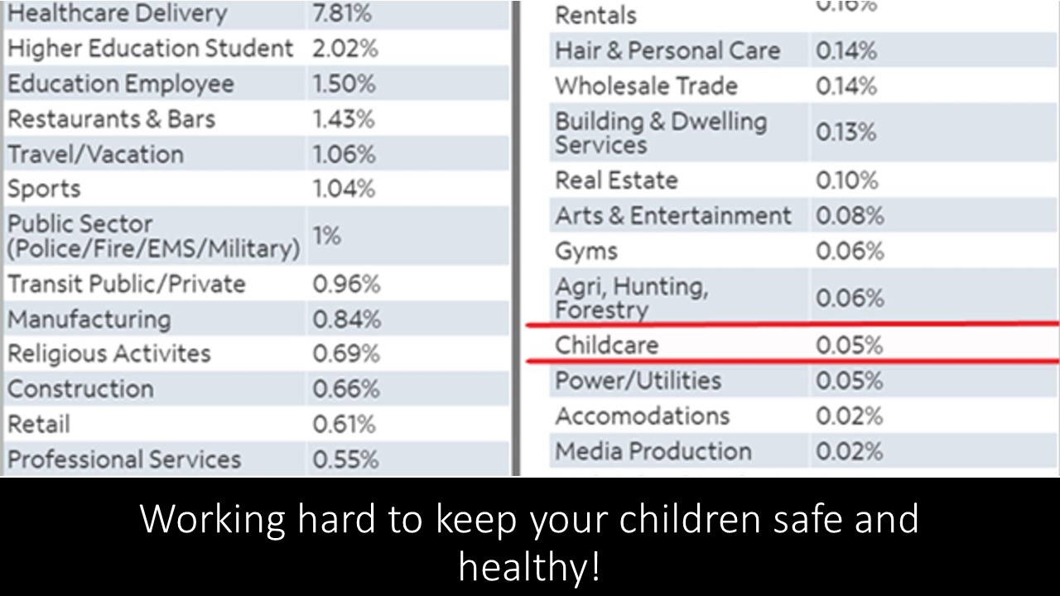
NYS Data

Slide 21
Tracking Data
Care-a-lot data shows that childcare centers are very safe
NYS data show that childcare centers are safe
  Unfortunately, data not released until November
Enrollment levels remain low due to public fear regardless of data
Frustrating that public officials would talk about schools being safe but would not comment on childcare despite the data

Slide 22

Impact on Staff, Culture & Business
Challenges faced by Staff
  Fear of getting sick
  Fear of bringing it home
  Fear of being quarantined
  Travel restrictions
Confusion around definition of “Essential” Workers

Slide 23
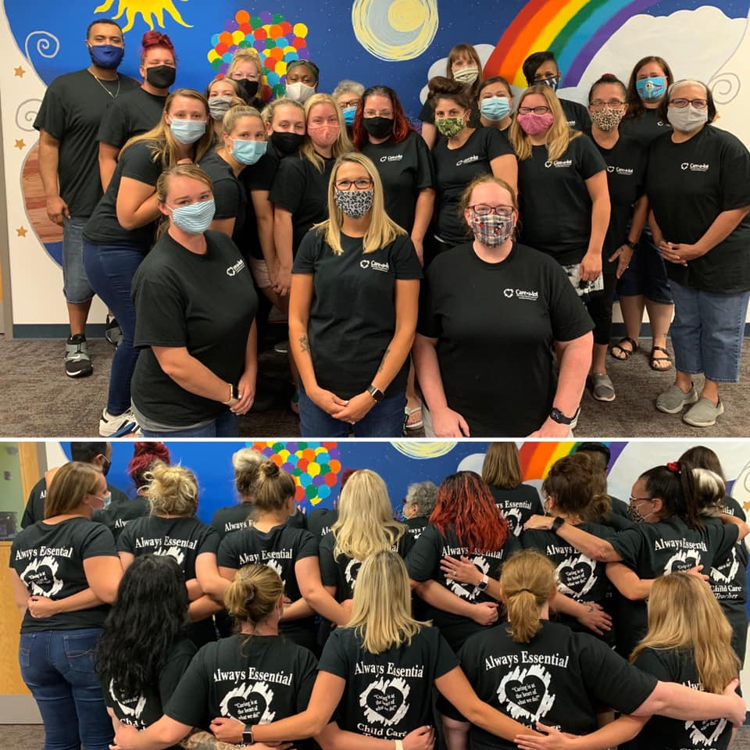
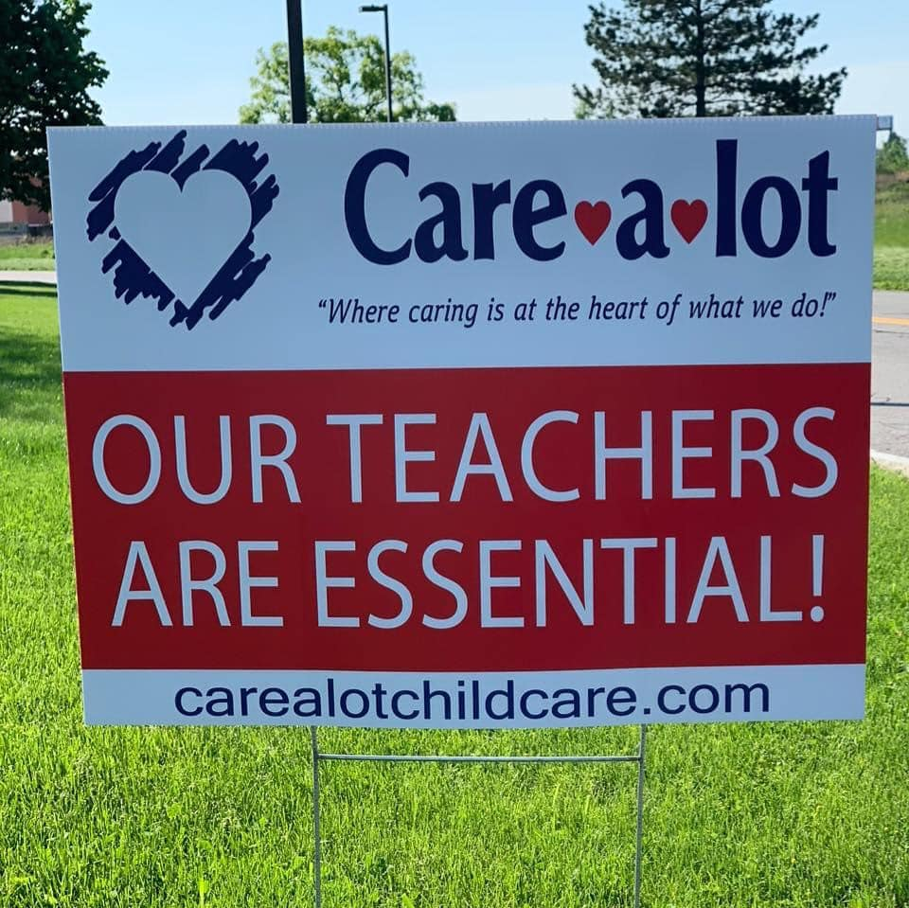
Impact on Staff, Culture & Business
Keeping spirits up and maintaining a positive culture
Constant Communication on changing policies
Recognizing great performance - Gift Cards, T-shirts
Teachers are “Essential” signs
Staff Luncheons
COVID-19 stipends

Slide 24
Impact on Staff, Culture & Business
Impact on Business
Increased Staff Absences
Furloughed Employees in April
  Non-furloughed staff angry due to Federal Unemployment
  Staff not wanting to return to work when needed due to Unemployment
State regulations and COVID procedures require additional staff
NYS poorly managed federal CARES funding for childcare centers

Slide 25
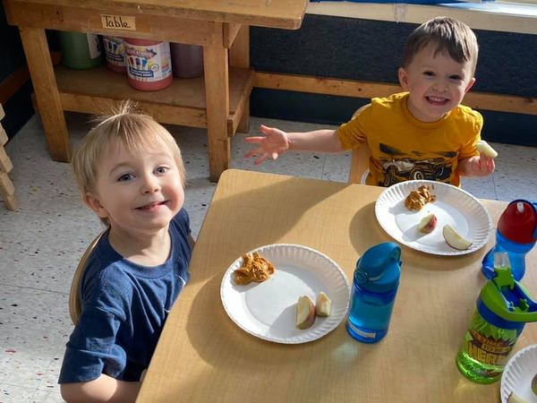
Summary
Continued challenges with COVID-19
Difficult to budget/plan for 2021
Summer Camp – field trips allowed?
Vaccine
  Getting staff vaccinated
  Percentage of staff choosing to not get vaccinated

Slide 26
