Slide 1
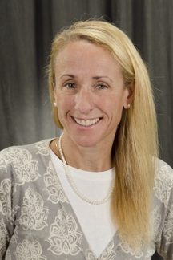

Give your Strategic Plan Legs…How to Improve Implementation and Tracking of Your Strategic Plan
Jan Schriefer RN MBA MSN DrPH
Associate Professor, Pediatrics
Division of Pediatric Hospital Medicine
University of Rochester School of Medicine
Director of Quality and Patient Safety
Golisano Children’s Hospital at URMC
Board Member Greater Rochester Quality Council
Marketing Committee Member
Twitter: @schrieferj
Notes:
)

Slide 2
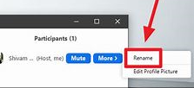
Logistics for this presentation…
Please chat in your name, role and your organization
Please use chat for questions and discussion
Raise your hand if you want to share a thought or comment
Click on your name in participant listing and rename yourself with your organization

Slide 3
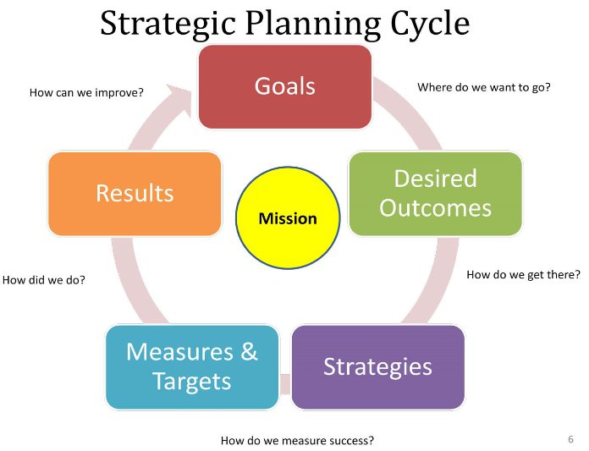
Disclosures and Learning Objectives
Dr. Schriefer has no disclosures
  Learning Objectives:
  Apply quality improvement science to strategic plans
  Formulate how to set vision, mission and direction
  Create ways to develop others – as a mentor, coach, sponsor, connector
  Build your strategic QI support network

Slide 4


Include the customer perspective
Allow adequate time for questions
Interactive – ask for people to chat in comments, questions
Relevant topic: Strategic planning is essential
Detailed evaluations and suggestions for future topics
Opportunity for future collaboration with the presenter
  Please call on me anytime to assist your planning and QI work
  Happy to serve as a mentor, coach, sponsor or connector

Slide 5
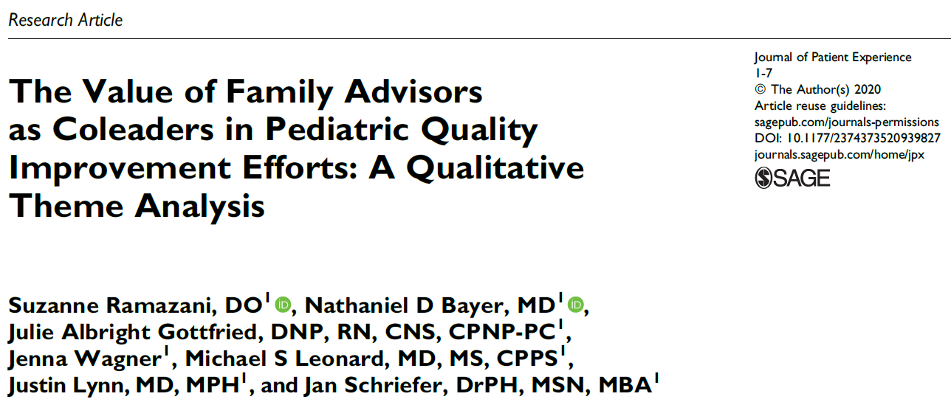
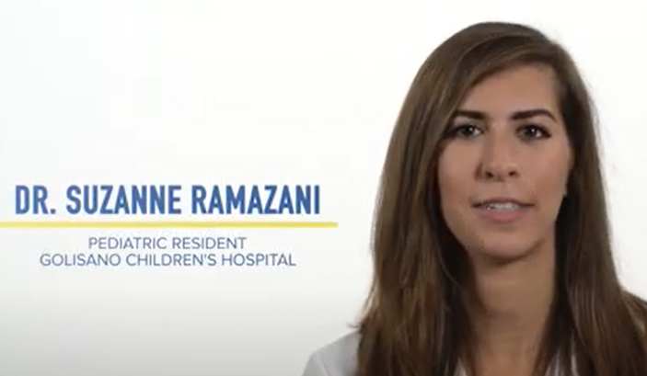
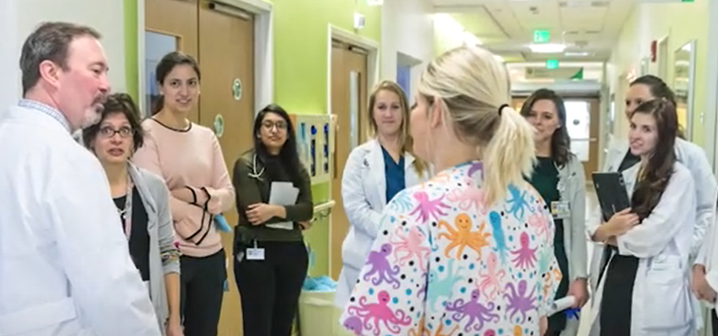

Voice of the Customer is Key for Strategic Planning: In URMC’s Case it Means Having Families Lead QI Teams
https://www.youtube.com/watch?v=UTCyqbsHd-w&feature=youtu.be
https://journals.sagepub.com/doi/pdf/10.1177/2374373520939827

Slide 6
Chat in Question
How engaged do you feel about your organizations strategic plan:
A LOT
A LITTLE
NOT MUCH
NOT AT ALL

Slide 7


Read Innovation Books to Drive your Strategic Plan

Slide 8
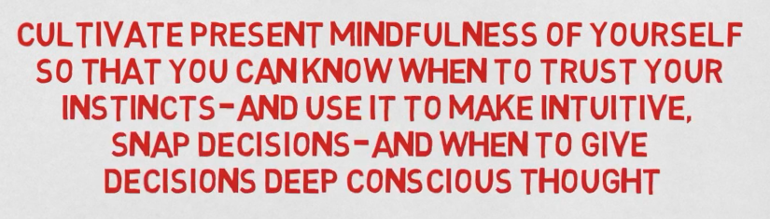

Slide 9

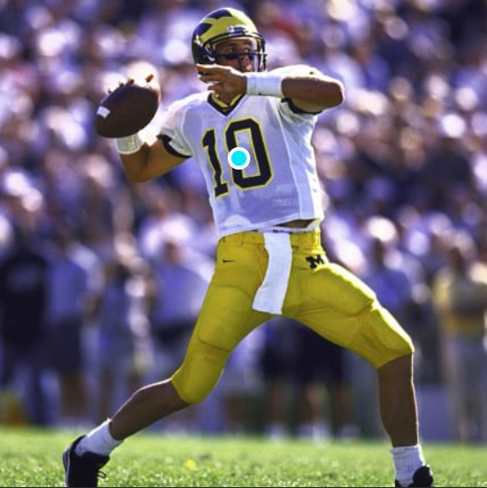
Leadership Lesson – Sports Illustrated Vault - 199th draft pick
Tom Brady – Study the Game, Set Direction, and Develop Others
https://vault.si.com/vault/2012/01/09/tom-brady-as-you-forgot-him
How many NFL Touch Downs has Brady had in 20 years?

Slide 10

561 NFL Touchdowns
28 TDs per season

Slide 11
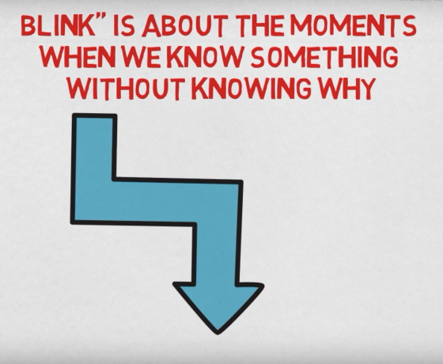
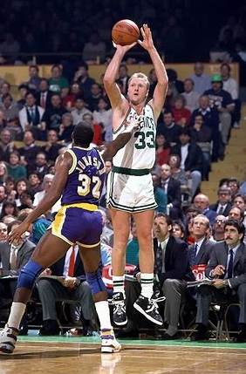
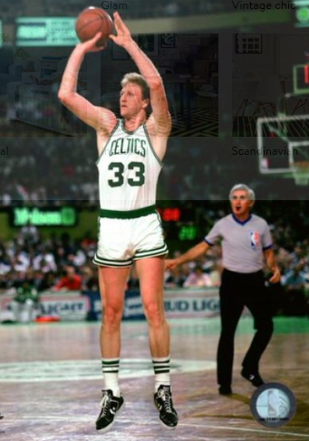
Leadership Lesson – Blink by Malcolm Gladwell
Larry Bird – in the blink of an eye/split second could stop, focus, settle and shoot
How many NBA 3 point shots did Larry Bird have in his 13 seasons?

Slide 12
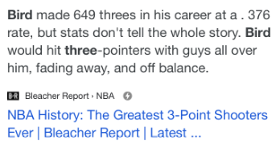

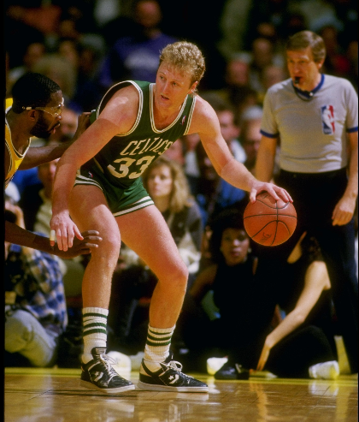
649 3 Pointers in the NBA
50 three pointers per season

Slide 13

What do Tom Brady and Larry Bird have in common:
Strategic Planning – Forward thinking, transformational leaders
Quality Improvement – Strategize rapid cycle test of change
Set Direction – Communicate plan widely and produce results
Develop Others – Build diverse, talented implementation teams

Slide 14

GCH 5-Year Strategic Plan FY 2020-2024
  Mission: Do everything in our power to help every child reach their fullest potential.
  Vision: Improving children’s lives.
  Goal Areas:
    Patient Care
    Population Health
    Digital Health
    Community
    Education
    Research
    Culture
Notes:
.

Slide 15

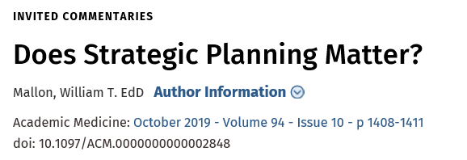

William Mallon - Sr. Director of Strategy and Innovation AAMC
“The power of strategic planning is the way you talk about it to shape the culture of your institution”
”Strategic planning matters for the values it conveys, the rituals it embodies, and the way it nudges your organization in new directions”

Slide 16
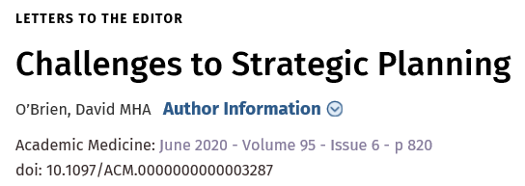

David O’Brien MHA Director of Institutional Planning, Emeritus at Stanford
“The delegation of responsibility for specific initiatives frequently lacks necessary accountability”
“Strategic initiatives are frequently launched without necessary resources and require a commitment to communication and change management”

Slide 17
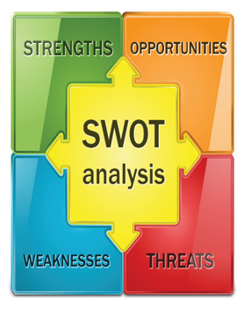
What strategic QI opportunities do you see for 2021-2022?

Slide 18
How Familiar are you with SWOT Analysis
PLEASE CHAT IN:
A LOT
A LITTLE
NOT MUCH
NOT AT ALL

Slide 19
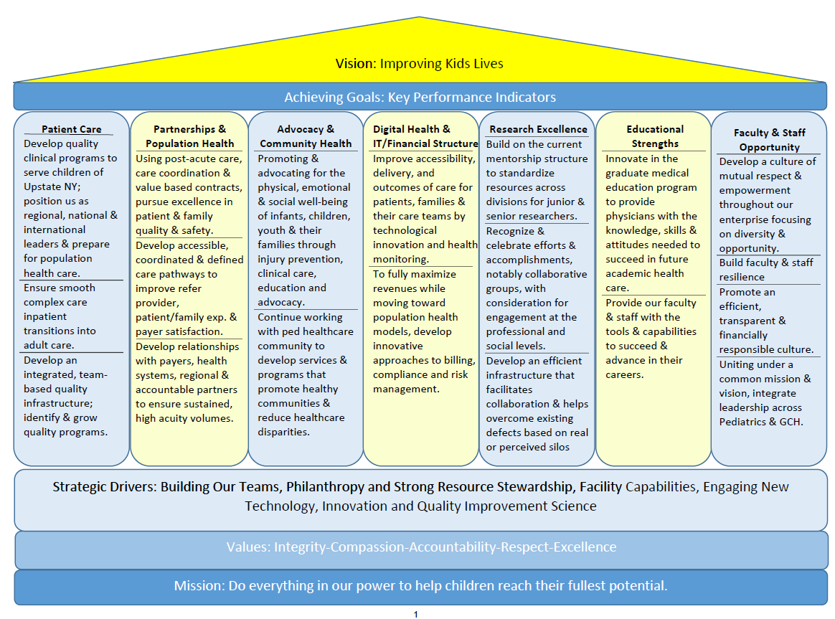
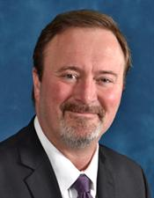


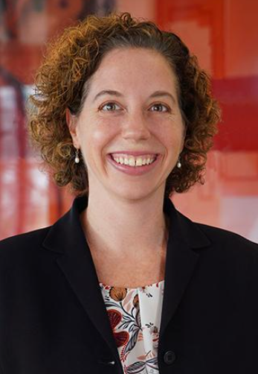
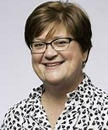
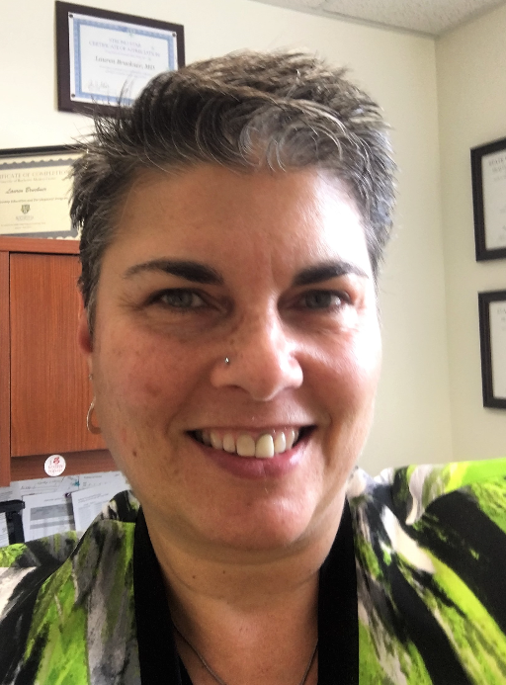

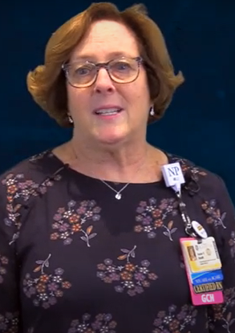



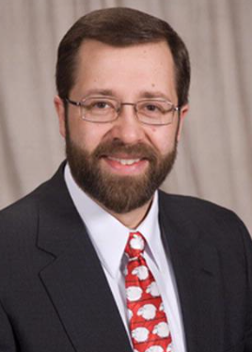
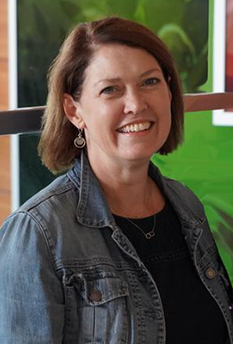

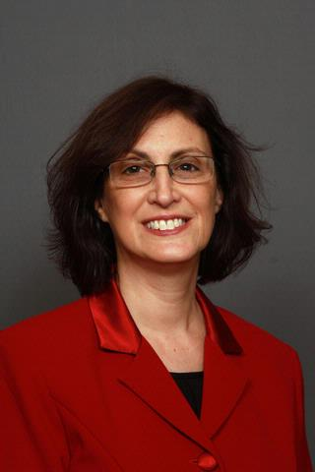





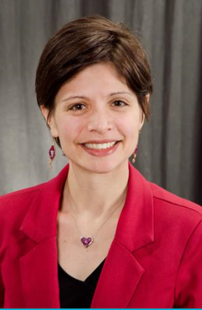


GCH Strategic Goal Pillars and Goal Area Leaders

Slide 20


How Stella Saved the Farm – A Tale Making Innovation Happen
Encourage and support teams to be innovative and forward thinking
Value an innovation culture in the workplace
Empower teams to tackle issues with the trust of leadership
Support teams by removing barriers to their success
Understand everything we try might not work but learn from our mistakes
Work together to find innovative solutions to address the most serious child health issues

Slide 21


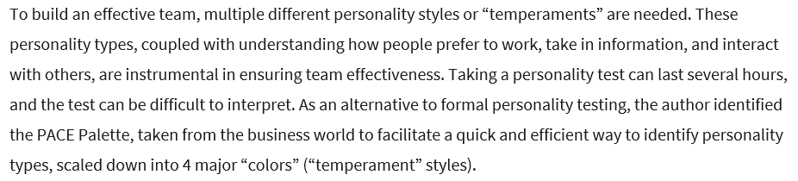
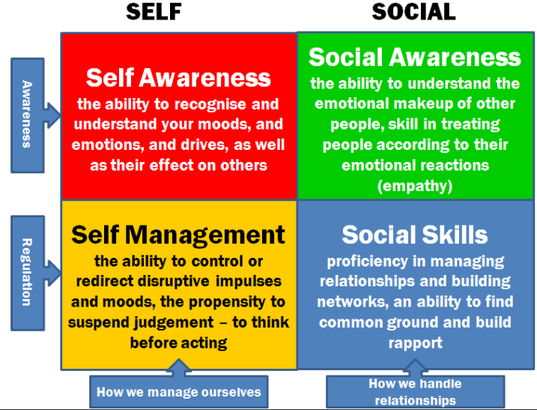

Slide 22

Vegas Anyone by PACE Color Palette/Temperaments
A trip to Las Vegas, how would each color approach the trip?
Green: When is the best time to go? Should we consider some place closer?
Red: Let’s go!
Yellow: We need to plan dates, travel and hotel arrangements, meals, etc., etc.
Blue: Let’s make sure everyone wants to go. Can we all ride together?
What color would you be?

Slide 23


Strategic QI: Setting Direction – Developing Others
ACGME Pursuing Excellence Initiative (PEI) Mission:
“Training Quality Conversant Physicians to Lead to Healthcare Teams of the Future”
PRSM 606 Quality and Safety Elective
Drs. Rashid, Meyers and Schriefer

Slide 24
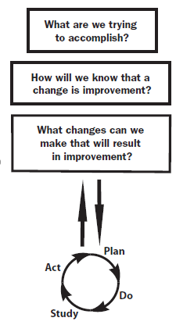


IHI Model for Improvement Applied to GCH Strategic Plan
Helping Every Child Reach their fullest Potential
Metrics – Public, Internal, Aspirational
Deliverables reviewed quarterly
PDSA-Plan Do Study Act rapid tests of change

Slide 25
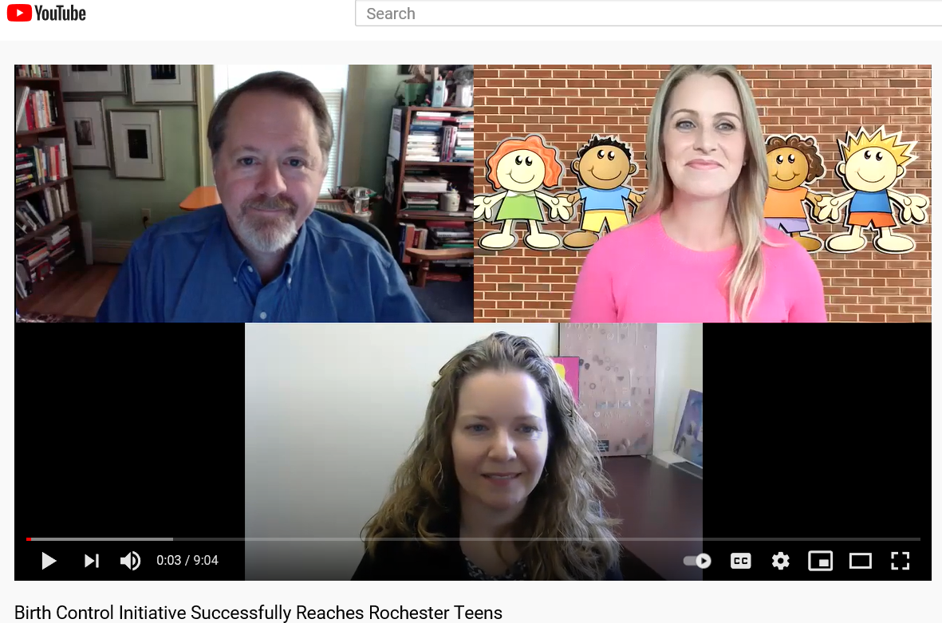
GCH Strategic Plan Quarterly Monitoring Spreadsheets
Quality Improvement “PROCESS” Measure
Quality Improvement “OUTCOME” Measure
Tier | Metric | Metric Progress
 |  | 5 Year Target | FY2019 Baseline | FY2020 Target | FY2020 Actual | FY2020 Variance
1 | Rates of teen pregnancies in 1) Monroe County and 2) Rochester | 25% decrease in Monroe | 1) 12 per 1000 2) 29 per 1000 in 2017 | decrease
Impact of the Rochester LARC Initiative
on Adolescents' Utilization of Long-Acting
Reversible Contraception
https://pubmed.ncbi.nlm.nih.gov/31978438/
https://www.youtube.com/watch?v=CGtDyXjdbDE

Slide 26

https://www.jpeds.com/article/S0022-3476(20)30133-5/fulltext
https://www.sciencedirect.com/journal/the-journal-of-pediatrics/vol/224/suppl/C

Slide 27
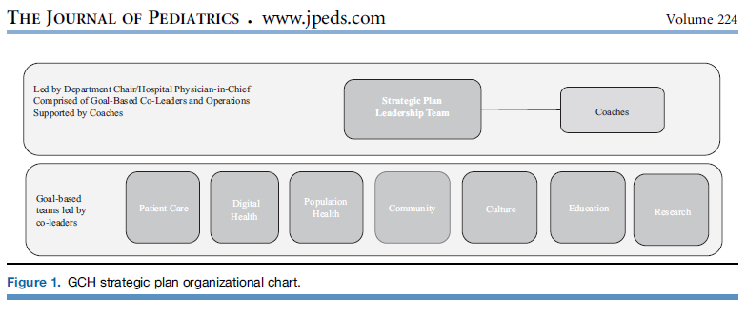
Brophy, Stevenson, Kaczorowski, Schriefer 2020 JPeds

Slide 28
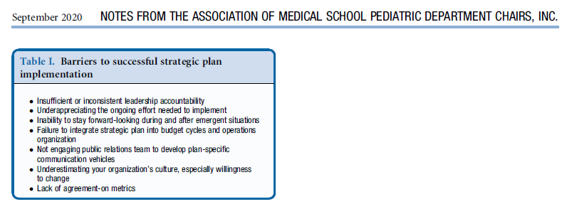


Brophy, Stevenson, Kaczorowski, Schriefer 2020 JPeds
https://jamanetwork.com/journals/jamapediatrics/fullarticle/2771108

Slide 29
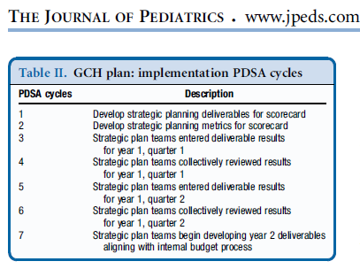
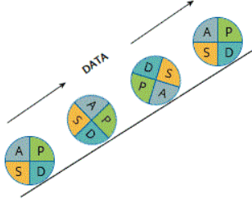
Plan Do Study Act Cycles Across all 7 Strategic Plan Goal Areas

Slide 30
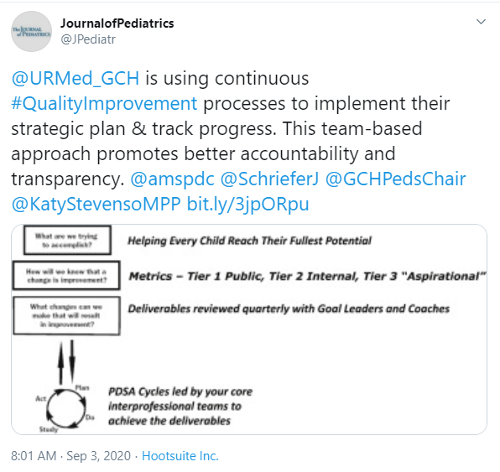
Use of Social Media to Communicate and Share Innovation
~7,000 Followers

Slide 31



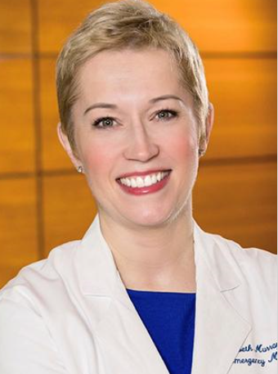
Partnerships, Community Outreach and PR Drive Strategic Plans
@JJ_Rochester
16,500 Followers
@DocEMurray
5,068 Followers

Slide 32
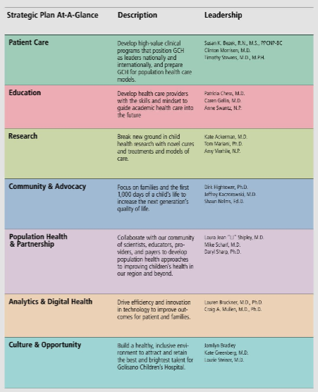

GCH Strong Kids
https://issuu.com/urmc/docs/strongkids_2020_vol1-01-30-20fin-rev2

Slide 33

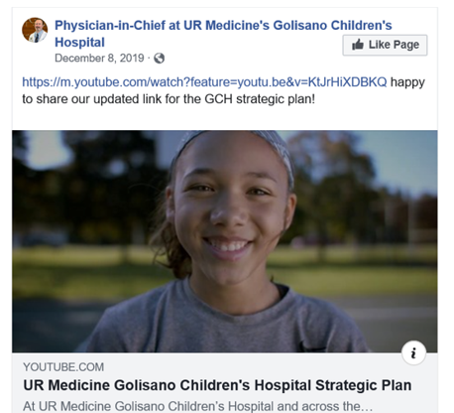
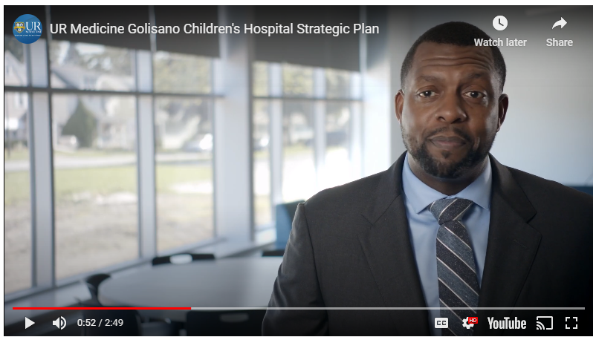
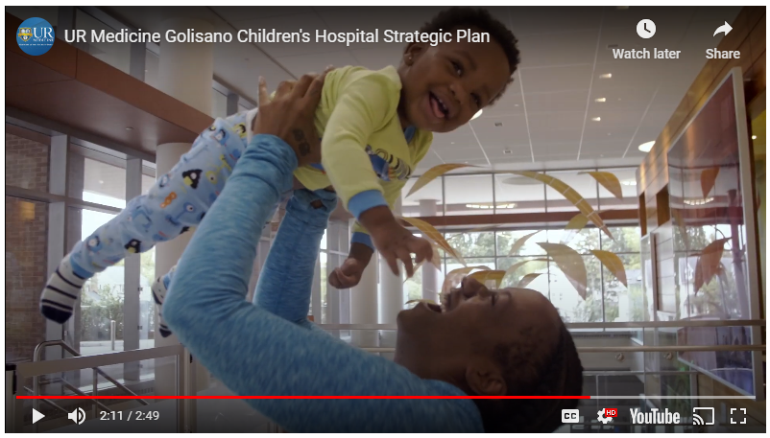
GCH Strategic Plan Public Website and Video
https://www.urmc.rochester.edu/childrens-hospital/our-strategic-plan.aspx
@DrNelms
3,500 Followers

Slide 34

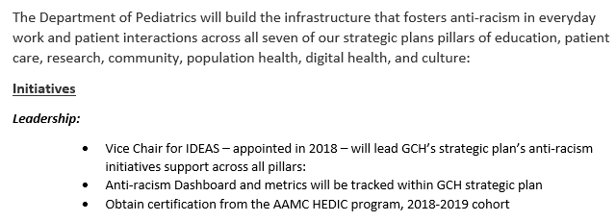
IDEAS = Inclusion, Diversity, Equity, Anti-Racism, and Social Justice

Slide 35
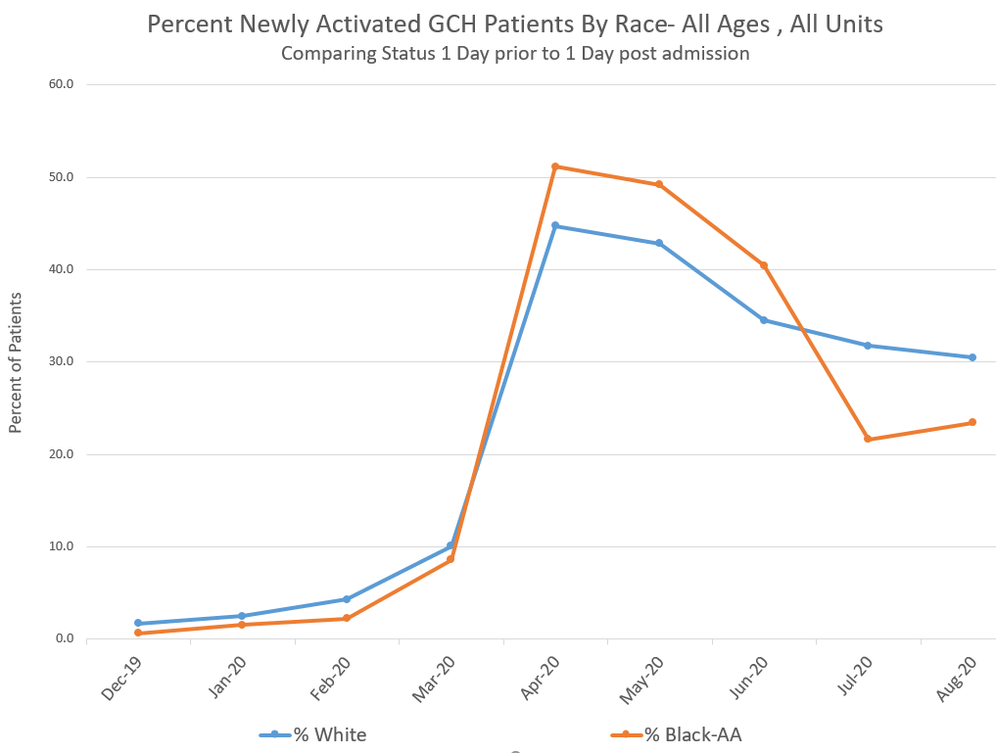

“My Chart” Patient Portal Inpatient Activation QI Increasing Telehealth Access
Does your hospital have QI projects to reduce racial, ethnic or language disparities?
Is your hospital addressing disparities in access to virtual care by patients and families

Slide 36
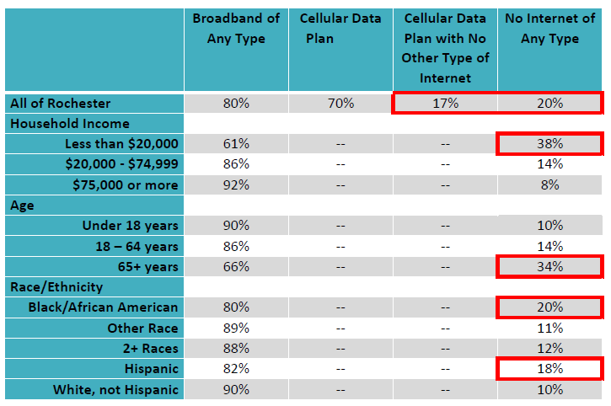
Roc the Future Digital Divide and the Children’s Institute SROT https://rocthefuture.org/wp-content/uploads/2020/12/Digital-Divide-Briefing-Slides-12-15-2020.pdf

Slide 37
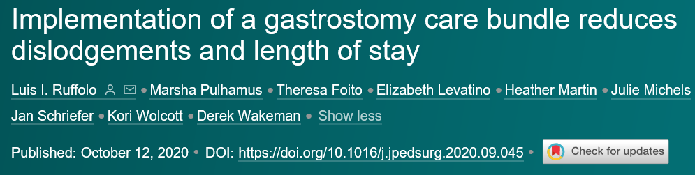

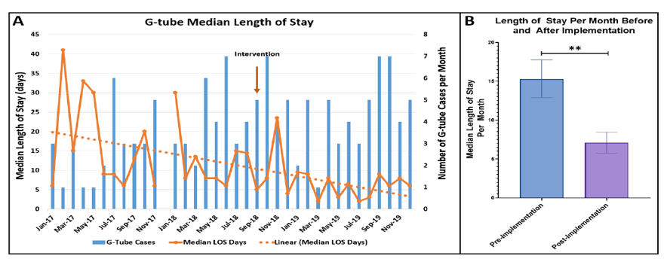
Ruffolo 1st Author Wakeman Sr Author JPedsSurg (2020) PEI UPP Team Cohort I
Strategic Smart QI Aim: Reduce Feeding Tube Dislodgements, LOS and ED Revisits
https://www.jpedsurg.org/article/S0022-3468(20)30694-1/pdf

Slide 38
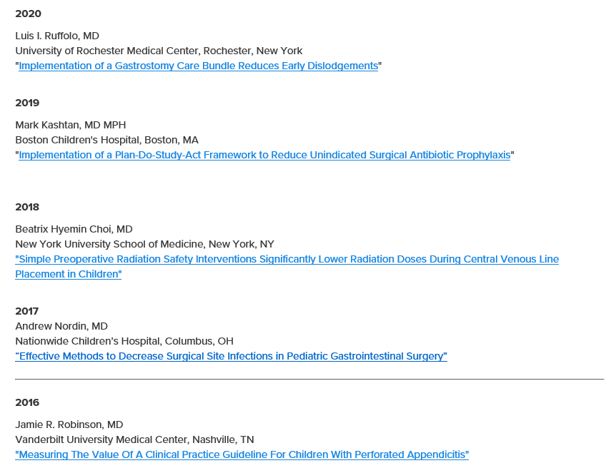

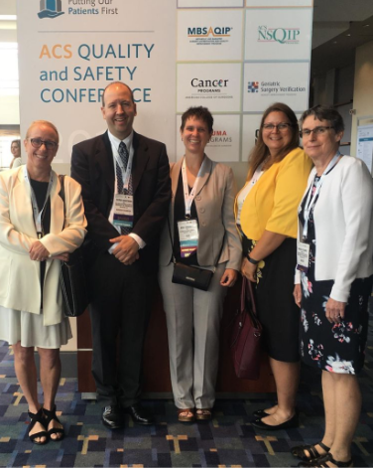
APSA Quality, Safety and Value in Surgery Award

Slide 39
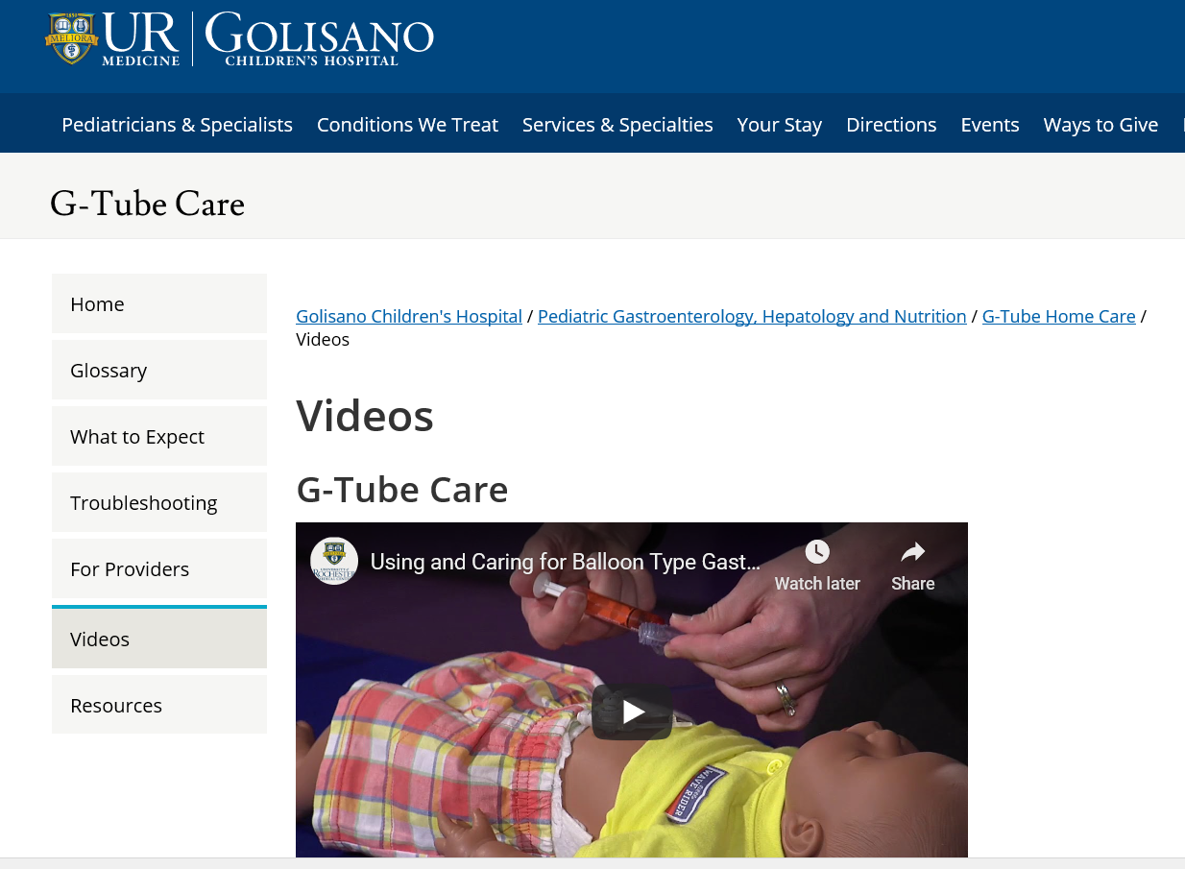
Public Facing Website – Vanity URL
Golisano.rochester.edu/feedingtube
https://www.urmc.rochester.edu/childrens-hospital/gastroenterology/g-tube-home-care.aspx

Slide 40
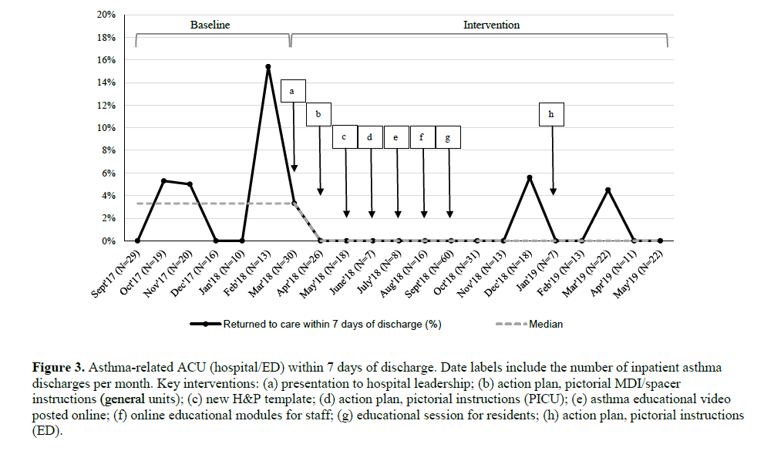



Bracken 1st Author Frey Sr Author – Hospital Pediatrics Accepted Manuscript
Strategic Smart QI Aim: Decrease Acute Care Reutilization for Children with Asthma
http://www.squire-statement.org/index.cfm?fuseaction=page.viewpage&pageid=471

Slide 41

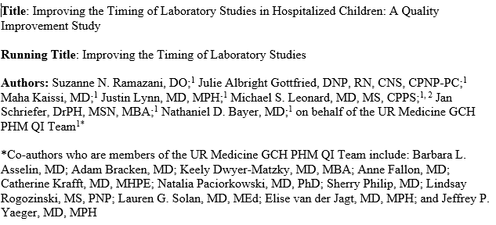


Ramazani 1st Author Bayer Sr Author – Submitted Manuscript
Strategic Smart QI Aim: Improving the Timing of Laboratory Studies in Hospitalized Children: A Quality Improvement Study

Slide 42













GCH Strategic Plan Quality Improvement Science Scholarship 2020

Slide 43

Chopra and Saint (2017) Harvard Business Review
https://hbr.org/2017/11/what-mentors-wish-their-mentees-knew

Slide 44

Chopra and Saint (2017) Harvard Business Review
Mentees should:
  Clarify what you need from your mentor
  Choose mentors wisely for altruism and patience
  Under promise and over deliver
  Be a closer with mentor requests
  Mind your mentor’s time
  Be engaged and energizing
  Be fun to work with

Slide 45


Chopra, Arora, Saint (2018) JAMA Internal Medicine
Traditional Mentor - Reciprocal relationship focused on career growth, one hour meetings (SOC)
Coach - Improve specific skill, no set meetings
Sponsor - Showcase talent with no direct benefit
Connector - Pairs mentors, coaches and sponsors.
Gladwell in Tipping Point “Connectors multiply strategic networks”
https://pathology.wustl.edu/wp-content/uploads/2020/05/jamainternal_Chopra_2017_vp_170034.pdf

Slide 46



https://www.gallup.com/workplace/236213/why-need-best-friends-work.aspx

Slide 47

















































My Strategic QI Network: mentors, coaches, sponsors, connectors and friends that text or email me back in a BLINK to Help me Set Direction and Develop Others

Slide 48

GRQC Knowledge Center

Slide 49
For more information:
Jan_Schriefer@urmc.Rochester.edu
585-315-4588

